Slide 1
SamePlaceAs Server
Simple atomic Linked Data service that takes a URI as input and outputs owl:sameAs URIs
In the likeness of sameAs.org but also allows spatial BBOX queries
“samePlaceAs” may have more appropriate name “sameFeatureAs”
Service acts as a “Graph Hopper” (kind of like a grasshopper!) that offers equivalent URIs which allows “hopping” from graph to graph to find more info
An owl:sameAs KB supporting reflexive, symmetric, transitive semantics
Cloud-based service built on Google App Engine (no triple store)
Service can return CSV, text, JSON, N3, NT, TTL formats (= flexible)
Supports Named Graphs for source, lineage, provenance information
Will support multiple KBs to support multiple contexts of equivalence

Slide 2
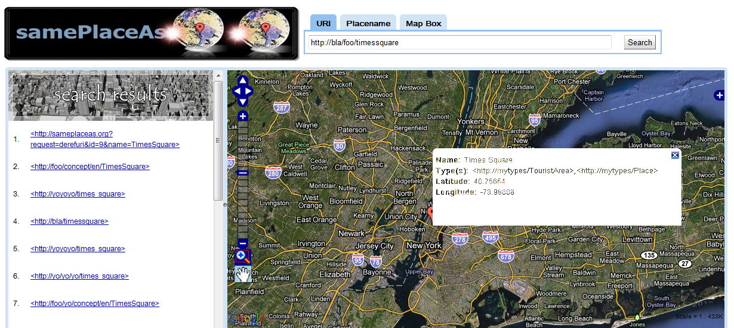
SamePlaceAs GUI – Search by URI

Slide 3
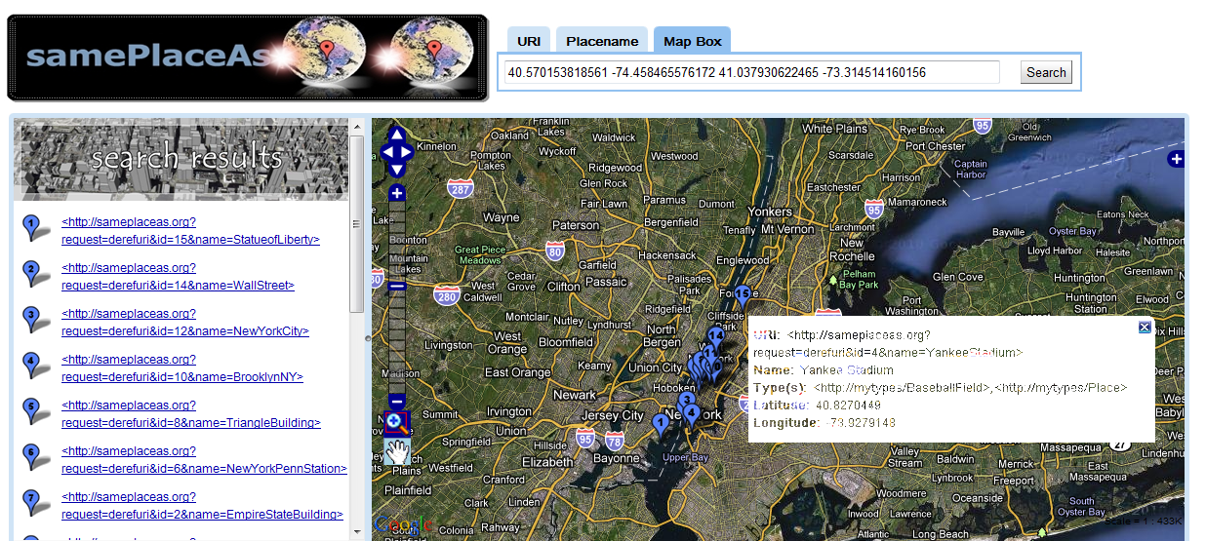
SamePlaceAs GUI – Search by BBOX

