Slide 1
Volunteered Geographic Services: Developing a Linked Data Driven Location-based Service
Alexander Savelyev¹, Krzysztof Janowicz², Jim Thatcher³, Sen Xu⁴, Christoph Mulligann⁵, Wei Luo⁶
^{1, 4, 6} The Pennsylvania State University, ² UC Santa Barbara,
³ Clark University, ⁵ University of Munster

Slide 2
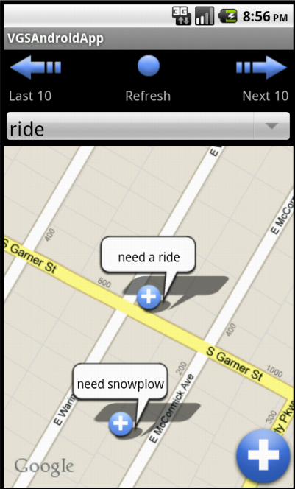
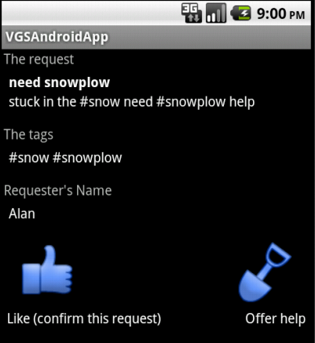
VGS at Work

Slide 3
Related Work
Crowdsourcing in the wild
Everyday applications (Airbnb, Avego, Yelp)
Emergency management (CrisisCommons, Ushahidi)
Volunteered Geographic Information
One of the many applications of crowdsourcing
Focus on collaborative data creation and management
Shift towards analysis of social interaction
Volunteer effort in Haiti
Role in the events of Arab Spring

Slide 4
Motivation for VGS
Focus on collaboration instead of data collection
In traditional VGI, volunteers collect and share data, whereas only sanctioned, authoritative parties formulate and address specific tasks.
Linked Data adopted as the main paradigm
Flexibility is the recipe for success. Generic request-offer messaging bus aims to address diverse user communities.
Explicit support for mobile applications
The Mobile Semantic Web is in its early stage of development. Established APIs, ontologies, and best practice guidelines for mobile applications are lacking.

Slide 5
Prototype Implementation
A prototype VGS system implemented in four steps:
Design of a Linked Data model
Generic model for handling of the key VGS concepts.
Implementation of a VGS Service Bus
Server-side mechanisms for storage and query of data.
Implementation of Triploid API
Client-side application for transparent processing of RDF statements.
Implementation of a VGS Client
Android-based VGS application.

Slide 6
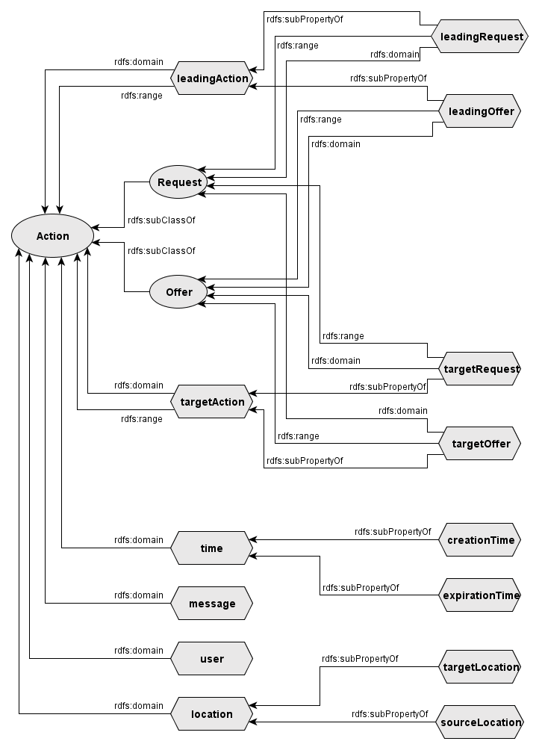
Linked Data Model
 | Request | Offer
Request | – Need help! – Me too! | – Need help! – Will do.
Offer | – Can help. – Please do! | – Can help. – Me too.

Slide 7
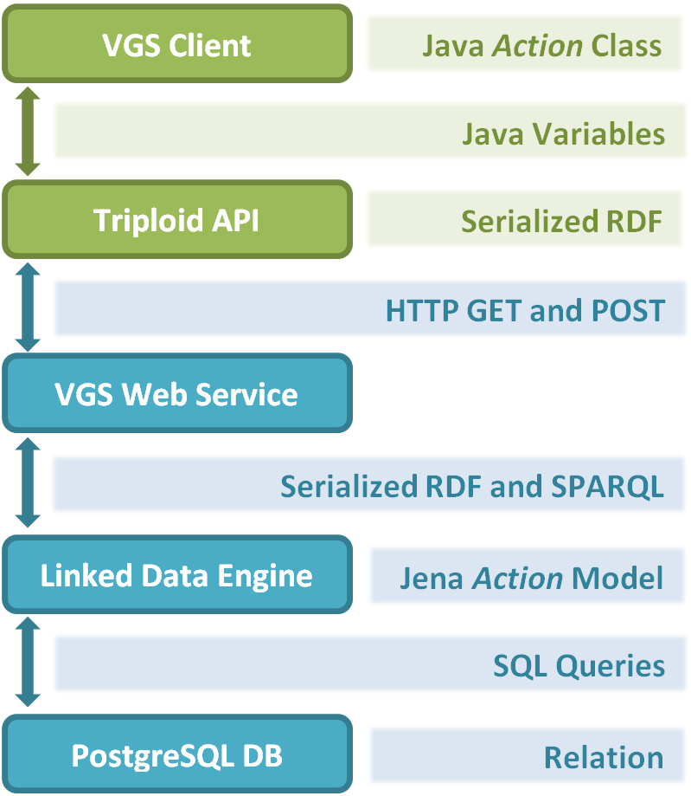
Implementation: Service Bus
Service Bus* goals:
Collect, store, and organize Actions.
Support spatial, temporal and thematic queries.
Provide auxiliary services.
* “service” as in “helpful act”

Slide 8
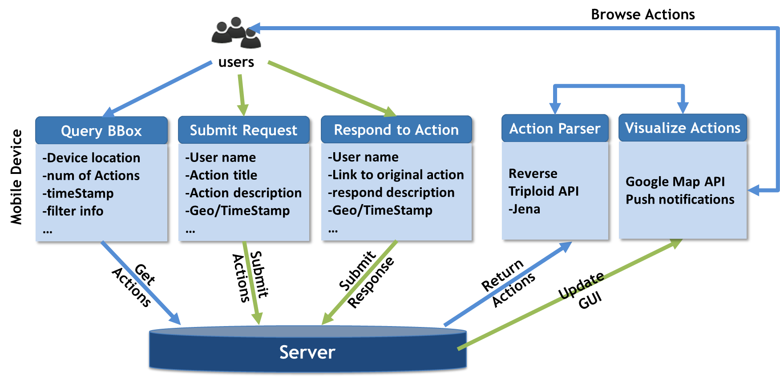
Implementation: Client

Slide 9
Implementation: Client

Slide 10
Limitations and Future Work
Technical problems to be solved:
Support for ontologies “on the go” is still in the works
GeoSPARQL standard is yet to be released
Research problems to be investigated:
Vulnerability to spam and fraud
Location-aware trust and reputation model
Code is available at:
http://vgs.svn.sourceforge.net/viewvc/vgs/

