Slide 1
GeoVoCamp Humor Nov. 2013

Slide 2
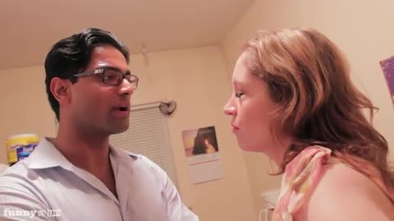
Top Candidates
Why don’t Ontologists get married?

Slide 3
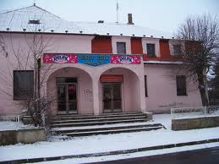
Because they are afraid of making commitments.
What does the sign above the Linked Open Data Club say?

Slide 4
N3
A domain expert, an ontologist and a LOD technologist are lost in the forest. They spy a stream. What does each of them say?

Slide 5
Domain Expert – Look a stream, lets follow it… Ontologsist – Look, a stream exists. LOD – Did you know that every stream has an end point?
If a tree falls in a forest and there is no ontologies to hear it, does the forest exist?
(Many variants noted… are you still wrong..)

Slide 6
LOD was confused reading a web site. What help did he ask URI for?

Slide 7
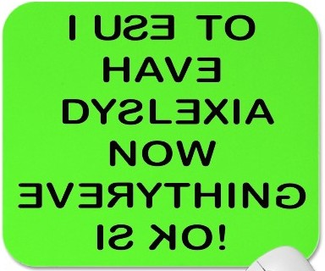
De-reference
Why do people think that Semantic web technologists are dyslexic?

Slide 8
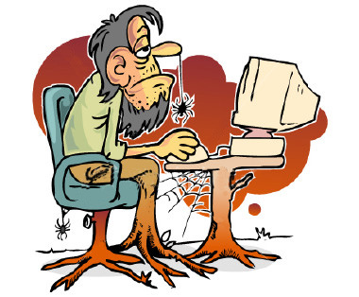
Because the abbreviate Web Ontology Language as OWL.
How do we know that OWL is a plot to slow down the Internet?

Slide 9
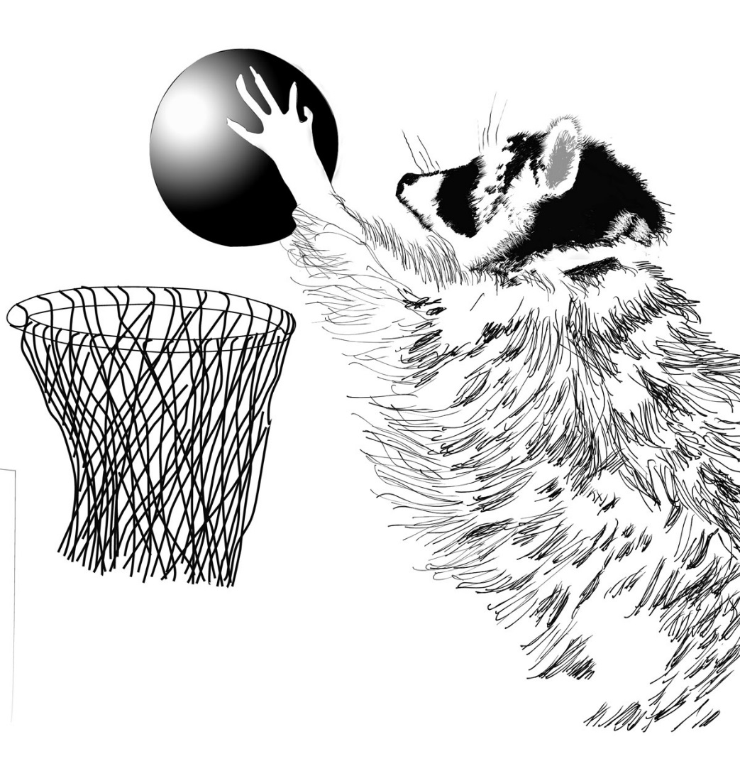
Because they use Turtle
Did you hear that China is using trained dogs, monkeys and turtles to make down sleeping bags? NSA says they know what the monkeys are doing but when asked about the others they said….

Slide 10
I don’t know, but it’s turtles are all weighing down.
Why don’t GIS professionals like OWL.

Slide 11
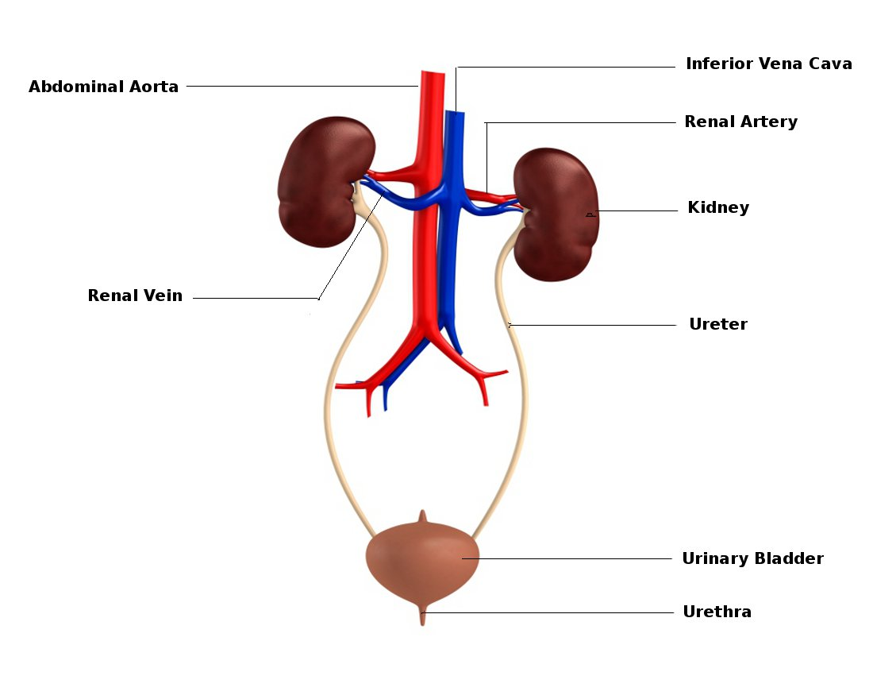
Because they don’t give a Hoot.
Ontologiests O and D created a small urinary ontology. What with they call it?

Slide 12
The OD-Pee
An ontologist started translated his favorite jokes into Owl. But when he tested them out on his friends no one laughed. Why?

Slide 13
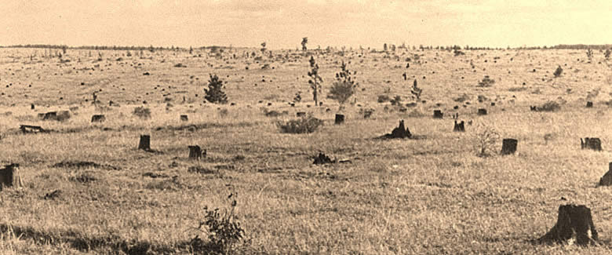
He only formalized the classes but no punchline was entailed.
There existed a first-class grove of trees, known as the canonical forest. An underemployed and underfunded ontoligist cut them all down. When asked why? He said.
“My reason was Simple. It’s axiomatic.”

Slide 14
What’s a Endurant then a Perdurant, then an Endurant then a Perdurant
A stream (????)
Why is RDF limited to triples?
Because RD-MF got bleeped
Or ….because NSF ran out of $$ after three (tree?)

Slide 15
The Info Family has 3 children. The youngest is called Datum, the middle called Data. What is the oldest called?
Big Data

Slide 16
How did Big Data Get so Big?
Bit by Bit….

