Slide 1
Semantic Trajectory
Mike Dean mdean@bbn.com GeoVoCampSOCoP2012 USGS Reston 29 November 2012

Slide 2
Semantic Trajectory
Composes 2 patterns developed at GeoVoCampSB2012
Point Of Interest (POI)
Motion/Path
Emerging term in the literature
Capture the semantics of motion as well as those of the geographic points
Zhixian Yan. Towards Semantic Trajectory Data Analysis: A Conceptual and Computational Approach. VLDB 2009.

Slide 3
DUL Motion Specialization
partOf
hasPart
owl:Class
dul:Event
owl:Class
dul:Event
hasStartEvent
hasEndEvent
dul:Event Motion
xsd:string
rdfs:label
xsd:string
hasName
participatesIn
participatesIn
hasReference
dul:Object
TransportedObject
dul:Object
MovingObject
hasLocation
dul:Object
Path
dul:Abstract
ReferenceFrame
Cardinality of all relations [0..m]
Notes:
Just one of many specializations, but DUL provided ideas for most of the classes and the Property/Relations (hasLocation) were also taken from DUL.
See http://www.w3.org/2005/Incubator/ssn/wiki/DUL_ssn#Object
http://www.w3.org/2005/Incubator/ssn/wiki/DUL_ssn#Event
http://www.w3.org/2005/Incubator/ssn/wiki/DUL_ssn#InformationEntity
Note parts of events may be further specified by the relation “isEventIncludedIn’

Slide 4
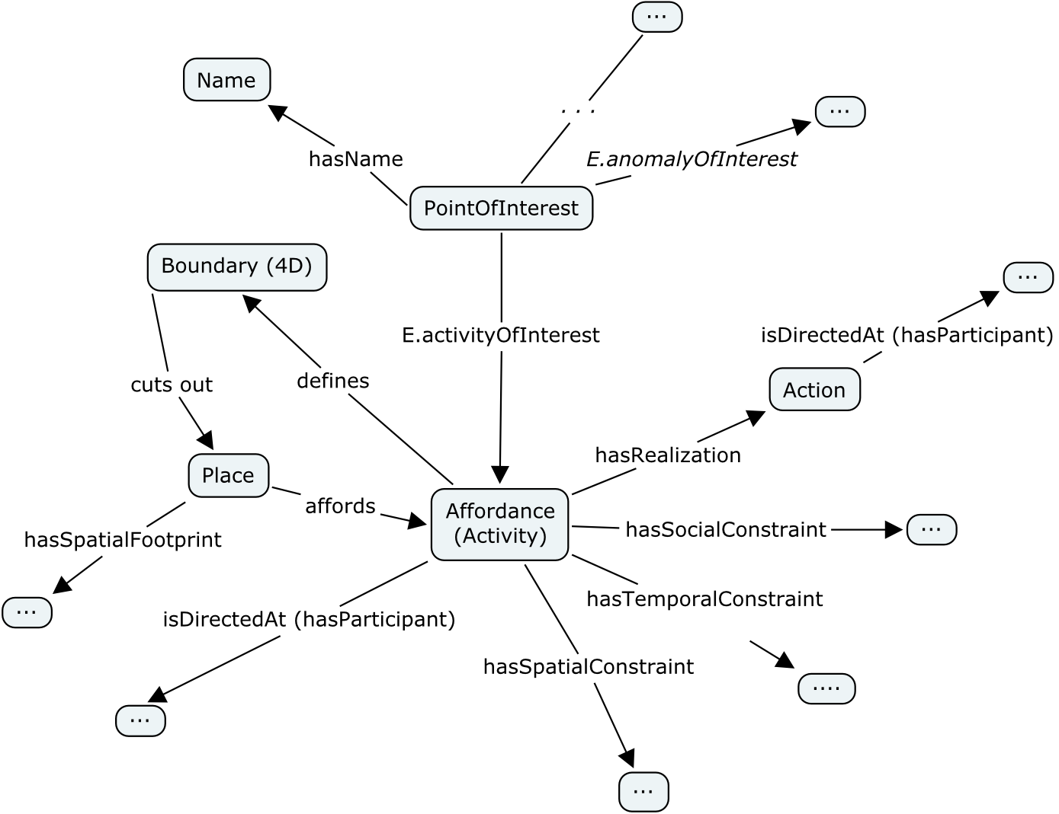
Point of Interest (POI) Pattern: Geographic information constructs, not direct representations of real entities

Slide 5
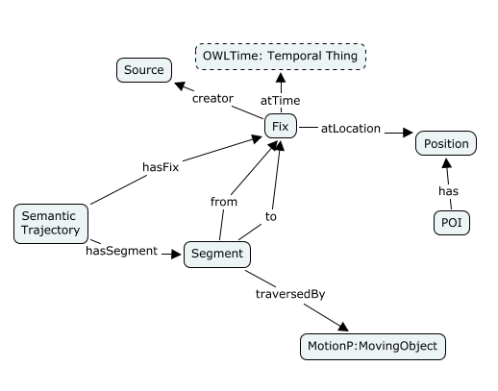
Dayton Output

Slide 6
Data Driven Validation
Apply pattern to real data as validation
Dayton: Manually annotated GPS tracks from my drive from Ann Arbor to Dayton
Reston: ?

