Slide 1
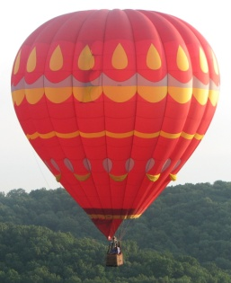
Balloon: Representing and Querying the Near Future Movement of Predictive Moving Objects
Hechen Liu & Markus Schneider
Department of Computer and Information Science and Engineering
University of Florida
1st ACM SIGSPATIAL International Workshop on Spatial Semantics and Ontologies (SSO) 2011

Slide 2
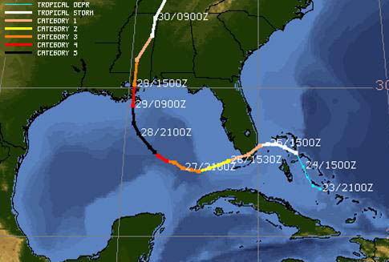
Motivation
Moving objects (cars, animals, and hurricanes) are ubiquitous.
Their movements are observed and represented, for example, by means of trajectories:
Such movements can be stored in moving objects databases (MOD)
Trajectory of Hurricane Katrina, indicating the strength of the hurricane as it moved first west, then north

Slide 3
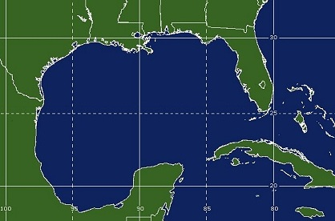
Problem
How can we represent and query the movement of spatial objects in the future?
The locations of a moving object in the future are uncertain.
All possible locations are within a region.
Position now
Possible positions later

Slide 4
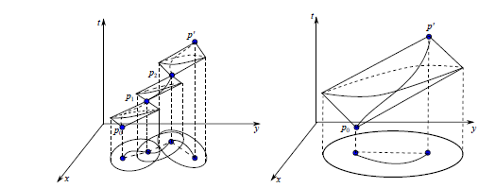
Goals and Solutions
Our goal is to represent and query the spatio-temporal uncertainty in the near future
Related work
Examples: 3D cylinder model, space-time prism model
Models assume a maximum speed constraint

Slide 5
Goals and Solutions
The speeds in the future may vary largely from the previous ones, and are difficult to predict
On the other hand, it is not the task of the database designer or GIS expert to make predictions. It is the task of a domain scientist to design prediction models and to determine the relevant input parameters of these models.

Slide 6
Balloon Model: Representing Near Future Movement Afflicted with Uncertainty
Represent the movement in the 2D+time space
Historical movement: at a time instant, the function returns a location in the 2D space
Future movement: at a specific time instant, the possible location is a single point that can be anywhere in a region
t
t
now
t₃
t₂
t₁
now
y
y
x
x

Slide 7
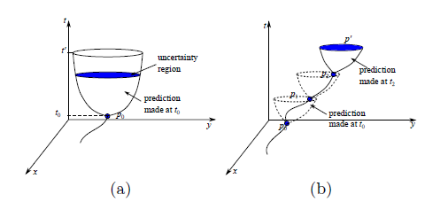
Balloon Model: Representing Near Future Movement Afflicted with Uncertainty
Combine the historical and future movements together
The historical movement corresponds to the string of the balloon
The future movement corresponds to the body of the balloon

Slide 8
Balloon Model: Representing Near Future Movement Afflicted with Uncertainty
How to represent the uncertainty?
Confidence distribution function:
Shows how the confidence is distributed over the 2D space
Shows the degree of certainty that a spatial object (point or region) will be the future location of the moving point
Each point is associated with a confidence distribution value
The confidence of a region S to represent the possible locations of a moving region can be calculated as
Example: How certain is it that hurricane Katrina will enter Florida?

Slide 9
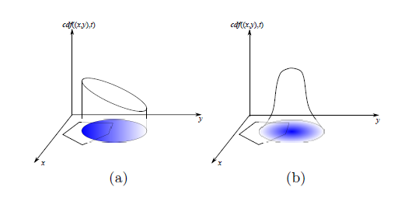
Balloon Model: Representing Near Future Movement Afflicted with Uncertainty
Different confidence distribution functions within a region

Slide 10
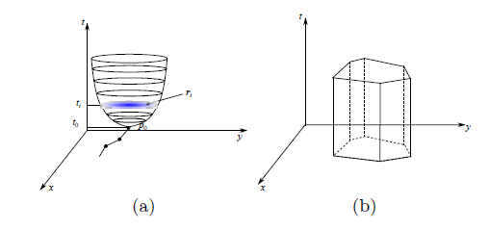
Representation of Balloon Objects
A balloon object bo in the database is represented by a finite set of tuples, or slices
bo = < cdf, (t₀, t₁, p₁, r₁), …, (t_{n-1}, t_{n}, p_{n}, r_{n}) >

Slide 11
Representing the Uncertainty
Confidence_at
A value between [0,1] which shows the degree of certainty that a region will be traversed by a balloon object at a time instance.
Let at_future_instance operation return the uncertain region of the moving point at a specific time in the future.
Input: A balloon object bo, a region r, a time instance t
Output: A decimal number d between [0,1]
Method: confidence_at (bo, r, t)
1 c := 0
2 if t > now
3 r₁ := at_future_instant(bo, t);
4 r₀ := intersection(r, r₁);
5 c := Integrate over all (x, y) in r₀ with bo.cdf
6 return c
7 end

Slide 12
Predicates on Balloon Objects
Had_crossed
Indicates whether a moving point had entered and then left a specific region in the given time interval
Assume temporal_selection selects part of the moving object within a specific time interval
Input: A balloon object bo, a region r, an interval I,
Output: A boolean value
Method: had_crossed(bo, r, I)
1 if I.t2 >= now then return false;
2 bo’ := temporal_selection(bo, I)
3 sa := the first slice in bo’;
4 sb := the last slice in bo’;
5 if inside(sa.p, r) or inside(sb.p, r) then return false;
6 while disjoint(sa.p, r) do sa := get_next_slice(sa);
7 while disjoint(sb.p, r) do sb := get_prev_slice(sb);
8 if sa.t <= sb.t and inside(sa.p, r) then return true else return false;
9 end

Slide 13
Predicates on Balloon Objects
Possibly_enter
The confidence that the moving object will enter the region in the future is not less than 0.25
Similar terms: likely (confidence ≥0.5), probably (confidence ≥ 0.75)
Input A balloon object bo, a region r, an interval I,
Output A boolean value
Method possibly_enter (bo,r,I)
1 max_conf := 0
2 if I.t1 < now or confidence_at(bo, r, I.t1) > 0 or confidence_at(bo, r, I.t2) = 0 then
3 return false;
4 bo’ := temporal_selection(bo, I)
5 foreach slice s in bo’ do
7 conf := confidence_at(bo1,r, s.t);
8 if conf > max_conf then max_conf := conf
9 endfor;
10 return max_conf >= 0.25
11 end

Slide 14
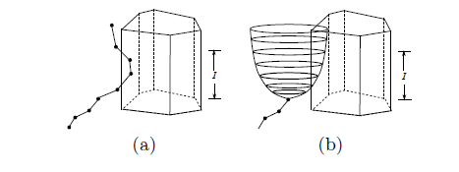
Predicates on Balloon Objects
The had_crossed (a) and possibly_enter (b) predicates

Slide 15
Query Example on Balloon Objects
Goal: Enable users to query predicted and uncertain future movements using an SQL-like query language
Confidence distribution functions have to be provided by domain scientists
Assume we have the following schema
hurricanes(name: string, eye: balloon, life: range)
Cities(name: string, extent: region)
The query “Find all cities that will possibly be traversed by Katrina between 25 Aug 2007 and 27 Aug 2007”
SELECT c.name
FROM hurricanes h, cities c
WHERE possibly_enter(h.eye,c.extent,
interval(‘25-08-2005’,’27-08-2005’))
and h.name=‘Katrina’;

Slide 16
Conclusions and Future Work
We address the problem of modeling and querying the uncertainty of a moving object in the near future
We introduce the balloon model to represent the historical and future movements
We define some important operations and predicates which can enable users to query the future movements of moving objects in a database context
Plan: Implementation of an entire type system for this balloon model in the future

Slide 17
Thank you!

