Slide 1
Mapping Repository in BioPortal
Natasha Noy
Stanford University

Slide 2
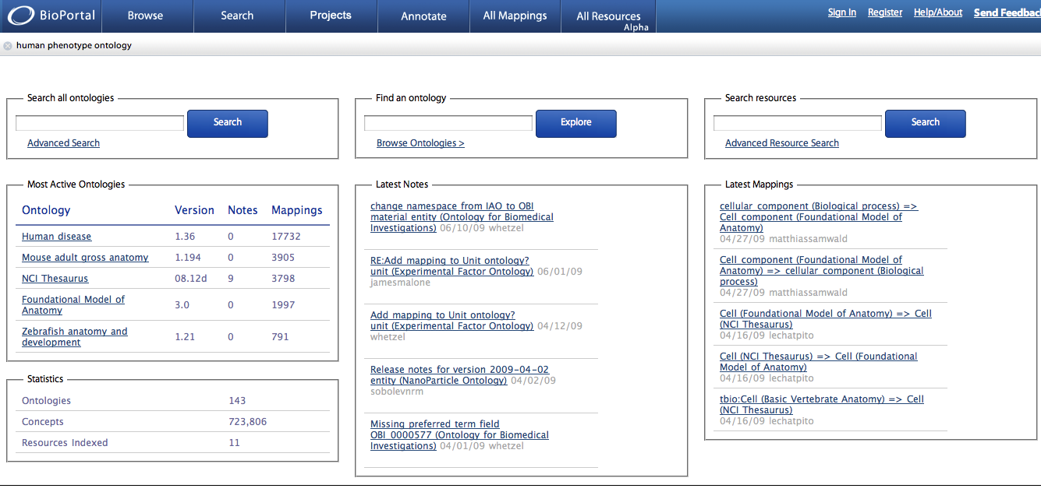
BioPortal: A Community-Based Ontology Repository
http://bioportal.bioontology.org

Slide 3
BioPortal
Web accessible repository of ontologies for the biomedical community:
http://bioportal.bioontology.org
Online support for ontology
Peer review
Notes (comments and discussion)
Versioning
Mapping
Search
Resources

Slide 4
The BioPortal Technology
BioPortal is a library of more than 300 biomedical ontologies
All BioPortal data is accessible through REST services
BioPortal user interface accesses the repository through REST services as well
The BioPortal technology is domain-independent
There are installations of BioPortal for libraries in other domains
BioPortal code is open-source

Slide 5
Why Would a Mapping Repository Help?
Source of data for automatic algorithms
machine learning
algorithms that need a priori alignment
Use for annotating and browsing resources through ontology elements
Use for finding “important” ontologies:
If everyone maps to NCI Thesaurus, it must be important
Accessible through web services
can be used in other applications

Slide 6
Mappings in BioPortal
Mappings in BioPortal are concept-to-concept mappings
Mappings are created by users or uploaded in bulk
Bulk uploads are usually the results of automatic or semi-automatic mapping
There is detailed metadata for provenance of mappings
~2M mappings in BioPortal now

Slide 7
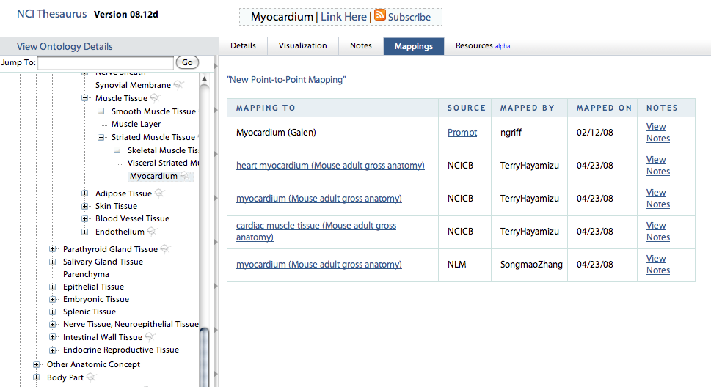

Slide 8
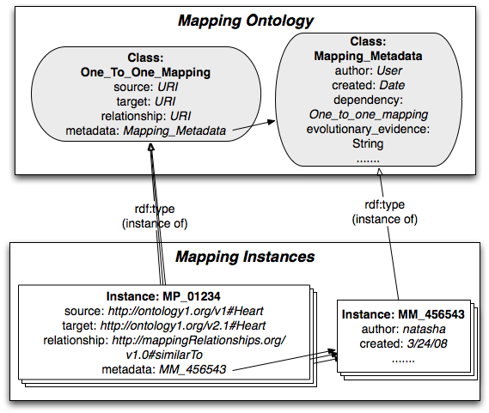
Representing mappings

Slide 9
Mapping Metadata
mapping relationship
provenance (who created the mapping and when)
comments, which may include transformation scripts, etc.
discussion and comments
application context
mapping dependency
algorithm used to create the mapping (configuration, parameters, etc.)
external references

Slide 10
Types of mappings in BioPortal
Lexical match on preferred names or preferred names and synonyms (skos:closeMatch)
For ontologies from UMLS, a CUI-based mapping
created if two terms have the same CUI
skos:closeMatch
Terms in different ontologies with the same URI (skos:exactMatch)

Slide 11
Issues
Mappings and ontology versions
Re-generate all automatically generated mappings as new versions become available
Delete mappings for previous versions, unless they have discussions associated with them
Make mappings accessible through all versions
Scalability
Majority of mappings have the same provenance data
Reuse the object that represents the provenance metadata

Slide 12
Current work
Re-generating all the mappings
Adding mappings to the SPARQL endpoint

