Slide 1
Adding Common Logic Support to the Heterogeneous Toolset
John Bateman / Till Mossakowski

Slide 2
The story so far...
Work in a variety of projects concerned with diverse ontologies: need for heterogeneity
Formal and computational tools adopted:
CASL Common Algebraic Specification Language (for specification, structuring and relating of theories: including ontologies)
HeTS Heterogeneous Tool Set (for connecting to a range of reasoners and for working with structured specifications)
:

Slide 3
Formalization choice: CASL Common Algebraic Specification Language
Standardised first-order specification language
designed by CoFI “Common Framework Initiative for algebraic specification and development” since 1995
de facto standard approved by IFIP WG 1.3 “Foundations of Systems Specifications” (1998)
extensive User Manual and Reference Manual now available from Springer (LNCS 2900, LNCS 2960)
straightforwardly extensible: higher-order logic, modal logic, ...
supports structured specifications including imports, hiding, renaming, union, extensions, etc.

Slide 4
Hets The Heterogeneous Tool Set
Hets is a multi-logic parsing, analysis and proof tool
Logics covered include:
propositional logic (with SAT solvers minisat and zChaff),
OWL (with provers Pellet and FACT++),
first-order logic (with provers SPASS, Vampire, Darwin and MathServe),
higher-order logic (with prover Isabelle).

Slide 5
Hets The Heterogeneous Tool Set
Structuring mechanisms: potentially applicable to any specification language as an additional layer of ‘meta’-organisation for semantic modularity
HetCASL
Institution Theory

Slide 6
Hets The Heterogeneous Tool Set
Hets is freely available from:
www.dfki.de/sks/hets

Slide 7
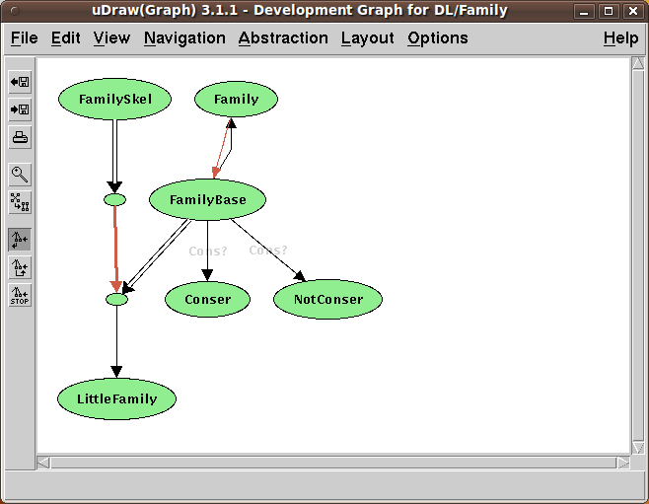
Structuring of theories
Development Graph
showing dependencies between specifications
and proof obligations
Links: theory morphisms
imports of theories
relative interpretations of theories
open
proved

Slide 8
Flashback: Further Steps... (Ontolog, March 2010)
we have already added OWL-DL to the family of logics supported
we are exploring combining the structuring principles of CASL and description logics
Now:
we are planning to add Common Logic as a HETS logic node
thereby providing access to all the tools already linked to HETS

Slide 9
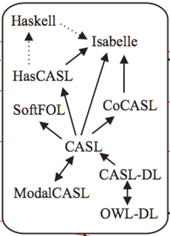
HeTS: Continuing extension of the treated logics
logic OWL
spec Family_OWL =
Class: Female Class: Person ObjectProperty: hasChild Class: Mother
EquivalentTo:
Female and hasChild some Person
Individual: Carol Facts: hasChild Peter end
HetOWL / HOWL

Slide 10
Flashback: Further Steps... (Ontolog, March 2010)
we have already added OWL-DL to the family of logics supported
we are exploring combining the structuring principles of CASL and description logics
Now:
we are planning to add Common Logic as a HETS logic node
thereby providing access to all the tools already linked to HETS

Slide 11
HeTS: Continuing extension of the treated logics
logic CommonLogic
spec Family_CL =
. (forall (a) (if (Mother a) (Female a)))
%(Mother1)% . (forall (a) (if (Mother a)
(exists (b) (and (hasChild a b)
(Person b))))) %(Mother2)% . (forall (a b)
(if (and (Female a)
(hasChild a b)
(Person b)) (Mother a) )) %(Mother3)%
. (Female Carol)
. (hasChild Carol Peter) end
CommonLogic
HetOWL / HOWL

Slide 12
Current Hets capabilities
Capable of reading CLIF files, e.g., the specifications of the COLORE Repository
SPASS, Vampire, Darwin and MathServe available for proofs in Common Logic
Isabelle available for proofs (if induction on lists needed)
Translation from OWL into Common Logic provided
HetCASL provides heterogeneous structuring and refinement (.het files with HetCASL structuring for Common Logic)
A view expresses a refinement (= interpretation of theories = logical entailment between theories) view v : Family_OWL to Family_CL end

Slide 13
Demonstration
simple example: Cat(kitty)
Parsing, proving
duration.clif from Colore
Hets logic graph
View from OWL ontology to CL ontology
Translation OWL ⟶ CL
Consistency

Slide 14
Ongoing work
Using the module structure of Common Logic Specifications
The semantics of the module construct in Common Logic must be agreed upon
A compositional semantics would be much easier to implement (but need to check details)
Support for disproving

Slide 15
Conclusion
Hets continues to provide support for the kinds of diverse heterogeneous ontologies we require, now extended to Common Logic
Link to the OMDoc world is under development ⟶ will provide web interface and repository for Hets specifications with XML database and nice querying
Link to the OOR world building on this would also be highly desirable

