Slide 1
Ontology Summit 2015 Internet of Things
Toward Smart Networked Systems and Societies
Track D: Related standards & synergies for emerging iot ontologies

Slide 2
Track D Invitees
*William Miller, Chair ISO/IEC/IEEE 21451-1-4
*Geoff Brown (Oasis MQTT Chair, Sec’y)
*Shoumen Palit Austin Datta (Industry Internet Consortium, OMG)
Mark Hamilton, RTI Sr. Director of Services
Chuck Evanhoe, Chairman, IoT-SG, US Technical Advisors Group for ISO/IEC JTC 1/WG 10 – IoT Working Group
Dave Ragget, W3C Web of Things (Funding source: EU Compose project)
Roberto Minerva, Telecom Italia (IEEE, iot.ieee.org)
ZigBee (Gary Audin)
*Accepted

Slide 3
“The nice thing about standards is that there are so many to choose from.”
--Andrew tanenbaum

Slide 4
Reasons to Standardize
Avoid technological dead-ends*
Reduce dependence on vendors* or foreign countries
Promote universality*
Develop competitive edge or partnership, or respond to same
Solve a technical, enterprise or social problem
Bridge previously disparate technologies or disciplines
Incorporate elements from a related, entrenched standard
Lower cost by market-broadening
* Adapted from K. Jakobs, “Information Technology Standards, Standards Setting and Standards Research.”

Slide 5
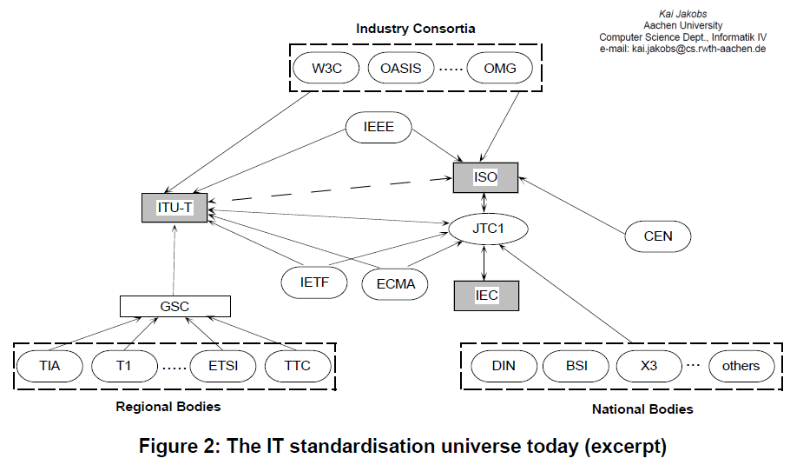
The Standards Semi-verse

Slide 6
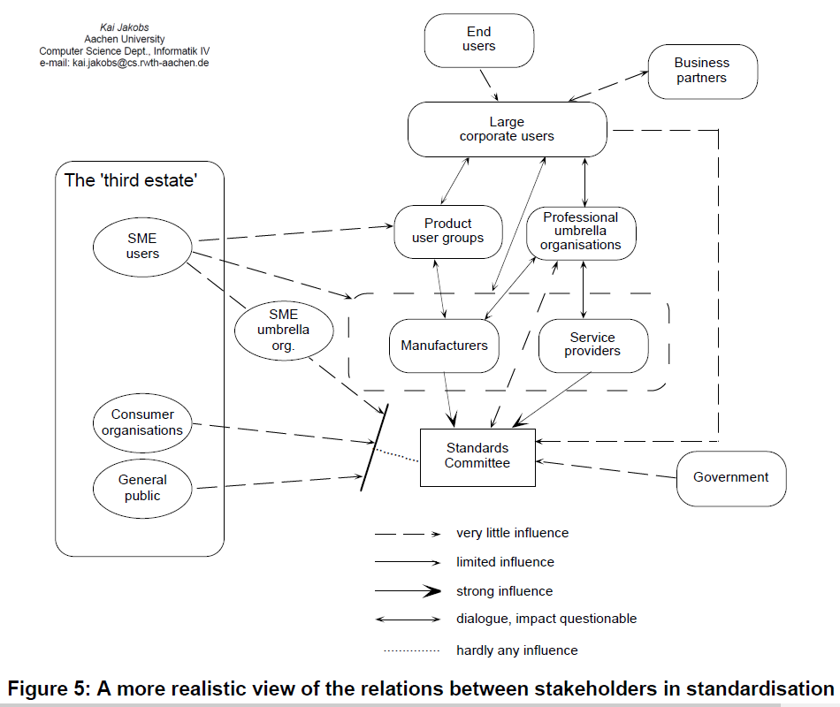
The Standards Influence Maze

Slide 7
Mission Statement*
The existence of standards – both official and de facto – can dramatically influence the software development life cycle for ontology projects. This is especially for greenfield efforts, which can peg existing vocabulary, interoperability settings, test harnesses and verification processes to new projects. Standards may be essential for domain-specific data quality assurance. Standards also have a sociotechnical purpose. Communities of Interest (CoI) behind a standards effort can supersede a standard by concentrating expertise and collecting artifacts related to the standard. Because the world of “things” is by definition vast, standards can facilitate connecting software to devices by offering abstractions that impact domain-specific knowledge of the devices. This is helpful for building ontologies. That said, software development is a deregulated engineering process, and many successful software ventures have succeeded by ignoring or incorporating bits and pieces of unacknowledged standards work – sometimes creating new de facto standards in the process. The purpose of this track is to help potential IoT ontology developers understand the standards landscape – both official and de facto.
*Also appears as Abstract

Slide 8
Approach
►Survey “official” IoT standards
►Identify de facto standards
►Identify related standards, projects, bodies not officially designed as IoT or WoT
►Highlight domains where ontology efforts:
(1) are most needed; (2) have harmonious partnership opportunities; (3) available subcomponents
►Discuss Challenges: Power mgmt., security, signal post-processing, provenance, signal quality, discovery, metadata, network issues, Big Data
►Related work: Modsim (e.g., Yang Song, et al. 2012, Sensor Fusion, Linked Open Data, augmented reality, Software Defined Networks (SDN)
►Lessons from history: middleware, intelligent agents, CEP, embedded systems, DoD fusion
►Retrospective: Related Lessons from Ontology Big Data 2014

Slide 9
Track Agenda
Two Sessions (January 22, February 26)
Session 1
Speaker Background & Introduction
Standards Overview
“Official” | De Facto
Current IoT standards state of affairs
Strengths, weaknesses, trends
IoT standards “Semi-verse”
Influencers
Panel Q & A
Session 2
Low-hanging Ontology Fruit
Speakers’ Favorite Use Cases
Moderator’s Puzzles
Panel Q & A

Slide 10
Reference
Lists, references and related resources

Slide 11
Standards Orgs & Initiatives
W3C – Web of Things Community Group
Industrial Internet Consortium
ECHONET Consortium (home appliances, LITE spec, cert equip)
Share-PSI 2.0 Thematic Network (EU Open Data initiatives)
ZigBee Alliance (IEEE 802.15)
Oasis Message Queuing Telemetry Transport (IBM, Cisco, Red Hat, Tibco, Facebook)
ISO/IEEE 11073 Health Informatics Devices
OGC Sensor Web Enablement
International Telecommunication Union (IoT-GSI)
European Research Cluster on IoT
Project Haystack
Wi-SUN Wireless smart utility networks
AllJoyn
OPENIoT
Eu Lighthouse Integrated Project IoT-A
XMPP IoT
AllSeen Alliance
OneM2M
* more at Postscapes.com

Slide 12
Related Standards & Groups
Spatial Data (GeoSPARQL, NeoGeo, ISA Locn)
IEEE TC’s: Smart Cities, Big Data, Cybersecurity, IoT Communities
Semantic Sensor Web (OGC + SWE specifications)
RFID
W3C Semantic Sensor Networks Incubator Group
BPMN – BPEL: Connect to other enterprise events, workflow
REST (Bosch)
Thread Group
Heterogeneous System Architecture Foundation
Micro Electro Mechanical Systems (MEMS) Industry Group
Marine Metadata Interoperability Project
City Pulse Project | Knoesis
Temporal Abstractions Ontology
Temporal Ontologies (e.g., SWRLTO)

Slide 13
De Facto Standards and Influences
Intel Edison Embedded Processor, HDMI Compute Stick, Stick Computing (Android)
Activity Streams (Slides by C. Messina @Google)
Alliance for Wireless Power (Rezence)
ZigBee Ontology (Chien et al., 2013)
W3C Semantic Sensor Network XG Final Report (June 2011)

Slide 14
Misc Resources for Communique
Web of Things Meeting Report (June 2014)
SeeControl (Cloud IoT)
Automated Buildings columnists
Libelium 50 Sensor Applications for IoT
IoT: Converging Technologies for Smart Environments (Ontology discussions, bibliography)

Slide 15
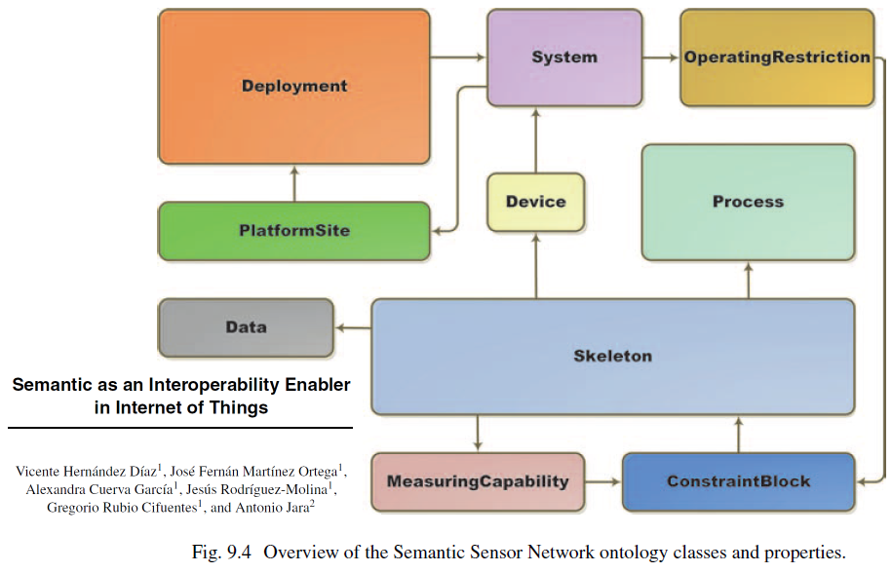
Semantic Sensor Network Ontology

Slide 16
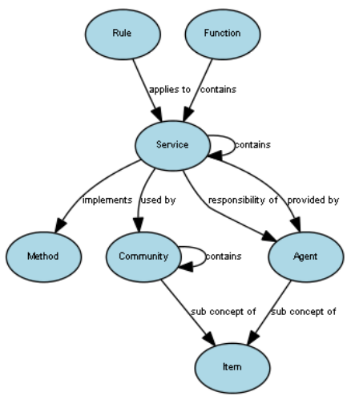
Phil Archer phila@w3.org

Slide 17
Keynoter Candidates
Roberto Minerva (IEEE IoT)
Joseph Bradley (Cisco IoE Evangelist and VP)
William Sennett, Alex Wahl (?) (IBM Watson)
Rex St. John (Intel IoT Evangelist)
Carla Diana (Ted Talk)
Richard McElhinney Project Haystack

