Slide 1
Ontology Summit 2015 Internet of Things
Toward Smart Networked Systems and Societies
Track D: Related standards & synergies for emerging iot ontologies

Slide 2
Track D Invitees
William Miller, Chair ISO/IEC/IEEE 21451-1-4 (accepted)
Mark Hamilton, RTI Sr. Director of Services
Chuck Evanhoe, Chairman, IoT-SG, US Technical Advisors Group for ISO/IEC JTC 1/WG 10 – IoT Working Group
Dave Ragget, W3C Web of Things (Funding source: EU Compose project)
Roberto Minerva, Telecom Italia (IEEE, iot.ieee.org)
Raphael Cohn (Oasis MQTT Chair)
ZigBee (Gary Audin)

Slide 3
Questions & Topics
What are cross-cutting abstractions?
Status of connectivity
Discovery
Calibration, measurement, resolution (from 2015 Summit)
What’s new vs. legacy from embedded & pervasive computing?

Slide 4
Misc Resources
Web of Things Meeting Report (June 2014)
SeeControl (Cloud IoT)
Automated Buildings columnists

Slide 5
Keynoter Candidates
Roberto Minerva (IEEE IoT)
Joseph Bradley (Cisco IoE Evangelist and VP)
William Sennett, Alex Wahl (?) (IBM Watson)
Rex St. John (Intel IoT Evangelist)
Carla Diana (Ted Talk)
Richard McElhinney Project Haystack

Slide 6
Standards Orgs & Initiatives
W3C – Web of Things Community Group
IEEE
ECHONET Consortium (home appliances, LITE spec, cert equip)
Wi-SUN Wireless smart utility networks
Share-PSI 2.0 Thematic Network (EU Open Data initiatives)
ZigBee Alliance (IEEE 802.15)
Oasis Message Queuing Telemetry Transport (IBM, Cisco, Red Hat, Tibco, Facebook)
AllJoyn
ISO/IEEE 11073 Health Informatics Devices
Project Haystack

Slide 7
De Facto Standards and Influences
Intel Edison Embedded Processor, HDMI Stick Computer
Activity Streams (Slides by C. Messina @Google)
Alliance for Wireless Power (Rezence)
ZigBee Ontology (Chien et al., 2013)

Slide 8
Related Standards & Groups
Spatial Data (GeoSPARQL, NeoGeo, ISA Locn)
Time Ontology (reference?)
IEEE TC’s: Smart Cities, Big Data, Cybersecurity, IoT Communities

Slide 9
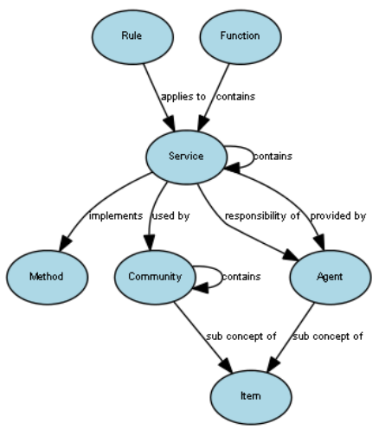
Phil Archer phila@w3.org

