Slide 1
Ontology in
Engineering Big Systems
Matthew West
Henson Graves
April 12, 2012
1
Notes:
Abstract
Background1
I assembled these charts yesterday, based on charts 6 years old.
Background2
based on 7 years of personal experience as the architect of an information system for a very large multinational program
Before that I had 5 years building workbenches and federating systems
Technology has come a long way, yet the problems remain – at great cost
Yet the critical problem remains as its root cause is not generally understood
During the Summit
Matthew West’s example of the distillation unit system and some of the discussion helped me figure out a conceptualization problem that has been on my mind since the experience

Slide 2
Status of Modeling in Engineering
Models are getting larger and more complex
  Model integration and management brings new problems
The role of models in engineering is changing
  from auxiliary information to authoritative source
Results in reexamination of old questions
  Are the models precise and correct
  How do we establish the semantics of models
  Where does ontology fit
Conclusions?

Slide 3
Models Are Getting Increasingly Large
Example: Air Vehicle Design Model
Subsystems
Top Level Design
Detailed Design
Product Configuration
400 Class Tree
(subsystem
relation)
2000 Classes
4000 Associations
10000 Classes
40000 Associations
22,000 unique part numbers and over 300,000 part counts
PowerPoint
Excel
PowerPoint
Excel
UML/SysML
UML/SysML
MatLab
CATIA
Database
…the design models are only the tip of the iceberg
Notes:
While current product development makes extensive use of modeling there is seldom a unified detailed design model. The result is that design analysis is currently largely manual and error prone. Gaps and disconnects within design process make resulting models often unreliable and inconsistent. Design authoring and analysis tools often produce representations that are not easily integrated. Not only is it difficult to integrate design representations but to tie design representations to requirements which use yet other languages and tools.
The diagram illustrates the complexity of the detailed design fro an air vehicle. An allocated functional requirements specification might specifications for about 400 subsystems. A preliminary design might have 2000 subsystem and assembly classes with 4000 associations that interconnect instances of the classes. A detailed design might have 10000 classes and 40000 associations. A resulting implementation might have a 300,000 part count.
.

Slide 4
Product Data Has Broad Scope, Is Stored In Multiple Places And Has Overlap & Dependences
Product Data to be Managed
Concurrent work on all lifecycle activities
500+ tools with with few common formats
30+ persistent data storage systems
A terabyte of data growing to 100s of terabytes
Little support for maintaining design traceability
Little support for maintaining and publishing in progress designs
PDM Tool
data dependences
Notes:
Problems:
Different tools with different syntax and semantics
Different levels of data abstraction
Granularity at insufficient level to monitor change impact

Slide 5
Data Integrity is a Critical Problem
Each design step
  Processes previously derived data
Data dependency chains are long
Difficult to maintain pedigree information
  Owner (guarantor of integrity)
  Applicability
  Limitations of use
  Source
  Technical data attributes and relationships
Process
Data
Item
…even with the difficulty of model management models are becoming the authoritative source of information

Slide 6
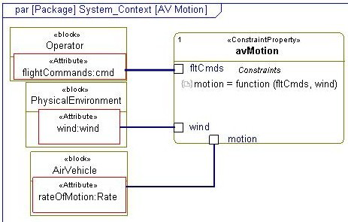

Models Are Becoming The Authoritative Source Of Data
Model of interaction between pilot and aircraft contains
  Physics based air vehicle motion model
  Instantiated for specific type of aircraft
  Empirically derived models of pilot capability
  Weather models
Model is the authoritative source
Flight test is only used to validate the model
Impossible to exhaustively test all conditions

Slide 7
Engineering Viewpoint
How do we establish that the models are precise and correct
  Good practice on model validation
How can we justify analysis and reasoning based on models
  How do we integrate formal semantics and reasoning with modeling
How can we build reusable models
  Can we develop patterns/templates that can be reused

Slide 8
Ontology Viewpoint
What ontologies provide the most leverage and how do we establish their correctness
  The reusable patterns are ontologies
How can we give our modeling languages a formal semantics that is in accord with informal semantics
  Requires careful analysis of logic needed to capture engineering conceptualizations

Slide 9
Ontological Analysis of Distillation System
Matthew West Presented an analysis of replacing a pump within a distillation unit
The analysis has been used to motivate development of the engineering modeling language standard ISO 15926
This is the kind of analysis needed and the results need to be incorporated in other modeling languages
Ontological Analysis
Distinction between parts and components is useful
Spatial-temporal aspects are important
Distinctions of kinds of relations are useful
Notion of identity is extremely important

Slide 10
Conclusions?
… three personal observations
How ontology fits in
Choice of logical foundations for modeling languages
Use of foundation ontologies

Slide 11
How Ontology Fits
Conceptualization
Conceptualization
Ontology for system
Formalized In
?
Ontology
In Modeling Language
Used to build
Used to build
Distillation Unit
?
Formalized In
Model in Modeling Language
Subject
Notes:
This slide (3) represents my current conceptualization of conceptualizations, models, formal models, metamodels, …..
It is my attempt to fit my personal experience, 8 hard years in a position of responsibility without always having the authority on the topic of the presentation. In addition to my own case I investigated a lot of other cases.
The best names to call something is not always totally clear as different names are used in different disciplines – will comment later.
The chart borrows/reuses material from Guzzardi and OMG, but does not exactly correspond to either of them.
Cloud column – informal human usage
Conceptualization (various ontologists) – concepts used to describe, e.g., System with components, parts, etc.
Model – resulting abstraction of reality or specification, e.g., distillation unit
Second column – artifacts in computer parsable languages,
Metamodel (Formal Ontology) – formalization within a compouter language of the conception, e.g., System. formal artifact that describes system, corresponds to OMG metaclass, but metaclasses are too weak, the artifact is a “template” descirption. In reading the ontologists, it seemed to me to correspond to what Husserl meant by formal ontology. But this is simply my observation.
Formal Model – model expressed in a modeling language, it instantiatates a metamodel, e.g., UML model of distillation unit, instantiates not just a well-formed UML model, but the formalization of the conceptuation of a system.

Slide 12
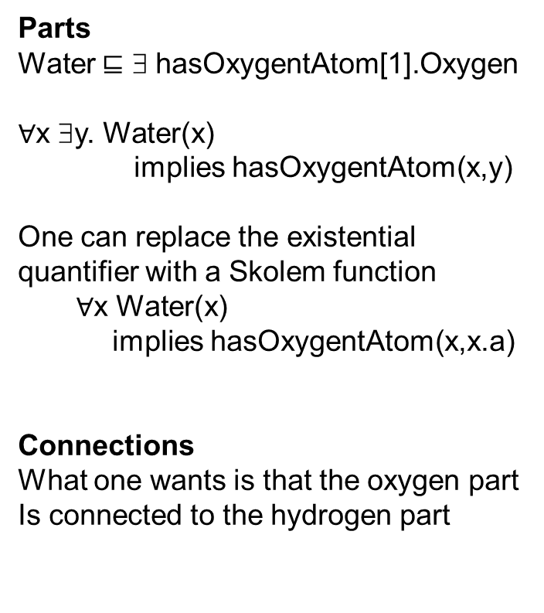
What Logic To Use For Embedding Models?
SysML model of water molecule
Parts
Water ⊑ ∃ hasOxygentAtom[1].Oxygen
$∀$x ∃y. Water(x)
implies hasOxygentAtom(x,y)
One can replace the existential quantifier with a Skolem function
  $∀$x Water(x)
  implies hasOxygentAtom(x,x.a)
Connections
What one wants is that the oxygen part
Is connected to the hydrogen part
… the answer is not best determined by ideology
Notes:
The Berardi results do not cover structure diagrams or more generally composite structure. Structure diagrams are common in engineering and science.
Structures such as the human heart are characterized by parts and connections. Finding the right kind of logic in which to embed an IBD and for which logical services are decidable has presented a challenge. Description Logic (DL) is a natural candidate for structural modeling. However, the ability to represent graph structures such as can be constructed with SysML IBDs is beyond the capability of OWL2. SysML models of structures can be translated into the language of SROIQ. However, the resulting axiom sets contain role equalities that do not satisfy the constraints of SROIQ axiom sets. OWL2 with a Description Graph (DG) extension has been proposed as a candidate for structural modeling. Analysis of application use cases suggest that often the DL axioms, as well as the DG extension axioms do not correctly capture the properties of the structures being modeled. A DL, called structural DL (SDL), is described for representing structures found in science and engineering. An approach to characterizing SysML IBDs as axiom sets within a description logic has been described in [graves, bijain, DL2011]. A proof of the decidability of satisfaction is in draft form.

Slide 13
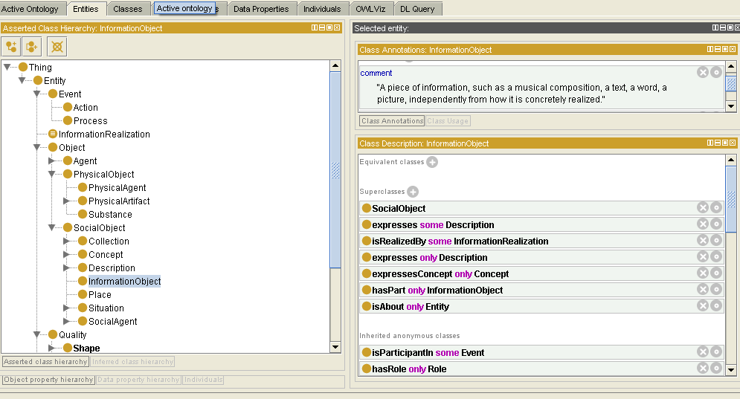
You Could Reinvent the Wheel, but ….
… but most of the concepts and relations needed to produce a metadata specification have already been defined in, for example, the Foundation Ontology, DUL

