Slide 1
Some thoughts on requirements for languages in engineering
Requirements for Languages for modelling big systems
World Ontology Summit, 2012-03-22
David Leal

Slide 2
Topics
Need for classes, classes of class, etc.
Not a problem for practical queries
Inferencing has to accommodate this
Need to treat class level information and instance level information in analogous ways
Existing engineering practice does this for good reasons
A design is created without knowing whether one will be built or lots
What about variables?
Parameterised designs and optimization within design spaces are important

Slide 3
1. Need for classes and classes of class

Slide 4
Things are multiply classified
A query “what type of thing is this” will return lots of stuff.
Therefore it is important to classify the classes, so that you can select what you want.
part type XYZ_1/v2
a
Part type
a
plate
a
Geometry type
a
my aluminium plate
a
AMS 4028
a
Material specification
a
subClassOf
2014 Aluminium
a
Alloy type

Slide 5
Things are multiply classified
A query “what type of thing is this” will return lots of stuff.
Therefore it is important to classify the classes, so that you can select what you want.
part type XYZ_1/v2
a
Part type
a
plate
a
Geometry type
SPARQL to get the alloy type of myAluminiumPlate
a
my aluminium plate
SELECT ?alloyType
WHERE { :myAluminumPlate a ?alloyType .
?alloyType a :AlloyType }
a
AMS 4028
a
Material specification
a
subClassOf
2014 Aluminium
a
Alloy type

Slide 6
Things are multiply classified
Sometimes the relationship with a quantity is just classification too.
my aluminium plate
a
10.3 Kg
a
Mass

Slide 7
Things are multiply classified
Sometimes the relationship with a quantity is just classification too.
my aluminium plate
a
10.3 Kg
a
Mass
SPARQL to get the mass of myAluminiumPlate
SELECT ?mass
WHERE { :myAluminumPlate a ?mass .
?mass a :Mass }

Slide 8
Things are multiply classified
There are so many classes as different meta-levels, that it is difficult to keep track.
AMS 4028
a
Material specification
a
subClassOf
2014 Aluminium
a
Aluminium alloy type
a
my aluminium plate
subClassOf
a
Aluminium alloy object
a
subClassOf
Metal object

Slide 9
Things are multiply classified
There are so many classes as different meta-levels, that it is difficult to keep track.
The use of power classes helps to organise the data.
2014 Aluminium
a
Aluminium alloy type
a
subClassOf
intersectionOf
my aluminium plate
Alloy type
a
Aluminium alloy object
a
Class of Aluminium
alloy object
powerClassOf

Slide 10
2. Need to treat class level and individual level information in analogous ways

Slide 11
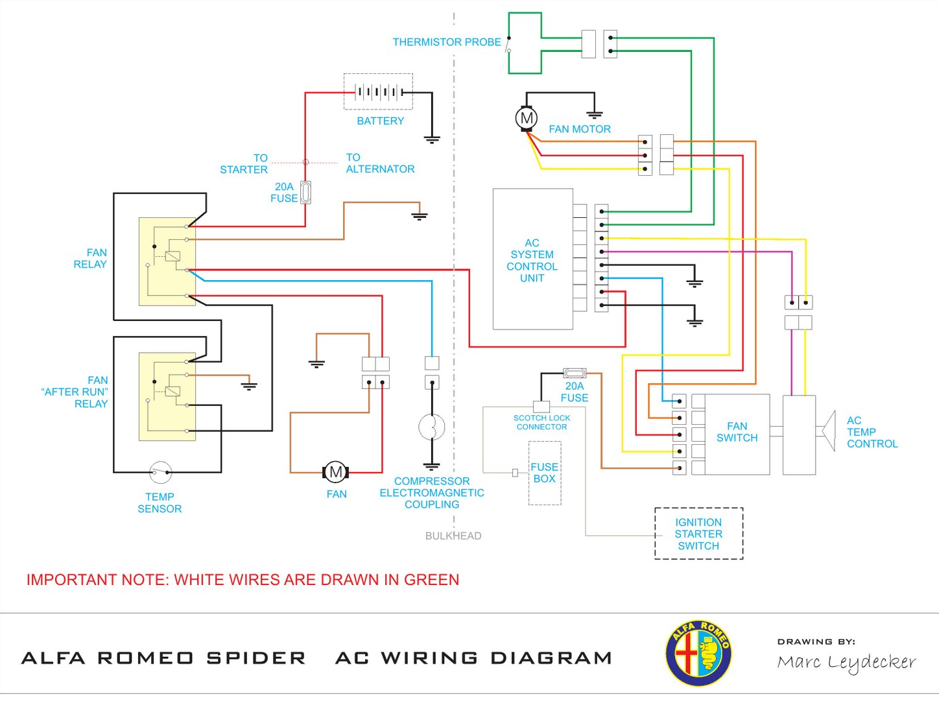
A car wiring diagram
Each symbol on the diagram represents a class of component.
But when working on myCar, I assume that each symbol represents an individual component of myCar – the ambiguity is useful.

Slide 12
A car wiring diagram
Each symbol on the diagram represents a class of component.
But when working on myCar, I assume that each symbol represents an individual component of myCar – the ambiguity is useful.
The relationships defined by this diagram are relationships between classes

Slide 13
Digression on notation - dog owner example
Define a specialised class and a specialised (class of) relationship
legal entity
ownership
thing
subclass of
subclass of
subclass of
(graph selected by range restriction)
ownership of dog
1,2, …
dog owner
dog
member of
member of
member of
Fred Bloggs
Fred owns Fido
Fido
ISO 15926-2 notation

Slide 14
Digression on notation - dog owner example
Define a specialised class (but not a specialised relationship)
Legal entity
domain
owns
range
Thing
subClassOf
onProperty
subClassOf
equivalent
class
Dog owner
someValuesFrom
Dog
a
a
Fred Bloggs
owns
Fido
RDF/OWL notation

Slide 15
Digression on notation - dog owner example
ISO 15926 and OWL are equivalent
Actually a small upgrade to ISO 15926 is required to specify how the specialised (class of) relationship is created
ISO 15926 defines a specialised (class of) relationship, but OWL does not.
The specialised relationships are useful, because they give an analogous relationships at the class and instance levels.

Slide 16
A car wiring diagram
relay type XYZ
There are two relays of type XYZ in the AC system.
subclass of
subclass of
1
AC system fan relay
AC system
has fan relay
1
AC system
AC system
has fan relay –
after run
1
AC system fan relay – after run
1
member of
member of
member of
member of
member of
relay serial 98/1224
my car
AC system has
fan relay
AC system in myCar
my car AC
system has fan
relay – after run
relay serial 99/2375
ISO 15926-2 notation

Slide 17
A car wiring diagram - terminology
AC system fan relay and AC system fan relay – after run are two “design occurrences” of relay type XYZ.
AC system fan relay is the “role” of relay serial 98/1224 in the AC system of myCar.
The relationships “design occurrence” and “role” are very important to engineering, but there is no established terminology and the relationships are not usually defined in ontologies.

Slide 18
A car wiring diagram - notation
relay type XYZ
An RDF/OWL representation does not treat class and individual level information in analogous ways
subClassOf
subClassOf
AC system fan relay
one-to-one relationships defined by restriction classes
?????
AC system
AC system fan relay – after run
a
a
a
relay serial 98/1224
hasPart
AC system in myCar
hasPart
relay serial 99/2375
RDF/OWL notation

Slide 19
3. What about variables?

Slide 20
Why variables?
Designers define design spaces
An optimal (or perhaps manufacturable) design is then found within the space
A design space is a class that contains individual designs as members.
A design space is defined by “ranges” of variables. (A “range” can be a finite set of choices.)
A specific design within a design space can also be expressed in terms of variables, where an instance of the design is a binding of the variables to individuals.
OK – it sound odd – but bear with me, and look again at the car wiring diagram.

Slide 21
A car wiring diagram
relay type XYZ
Design defined in terms of variables
a
a
_AC system fan relay
hasPart
_AC system
hasPart
_AC system fan relay – after run
free variable
∃ bound variables
RDF/OWL notation

Slide 22
A car wiring diagram
relay type XYZ
An instance of a design is a binding
a
a
_AC system fan relay
hasPart
_AC system
hasPart
_AC system fan relay – after run
bound to
bound to
bound to
relay serial 98/1224
AC system in myCar
relay serial 99/2375
RDF/OWL notation

Slide 23
Where do we go with variables?
A mathematical definition of a design uses variables
I believe that any expression involving variables can with sufficient effort be expressed in terms of mappings between classes
We use variables, because they make life easier.
Heretofore, attempts to record a design as a formal set of statements have not made use of variables
These attempts have not been successful, because the complexity of the information in a design makes it difficult.
Recording a design space is even more difficult.
Some research is needed in this area.

Slide 24
End

