Slide 1
Ontology for Software Production
James Kirby, Jr.*
Naval Research Laboratory
james.kirby@nrl.navy.mil
*With contributions from David Weiss, Robyn Lutz, and others

Slide 2
Software Production
Software creation + sustainment (evolution) + assurance
Years of development
Decades of operation
Decision making process
What are those decisions?
How are decisions recorded?
How are decisions organized?
Capture decisions in ontology
Instantiating the ontology describes design of a particular system
Notes:
At the suggestion of George Strawn ontology created to capture the decisions.

Slide 3
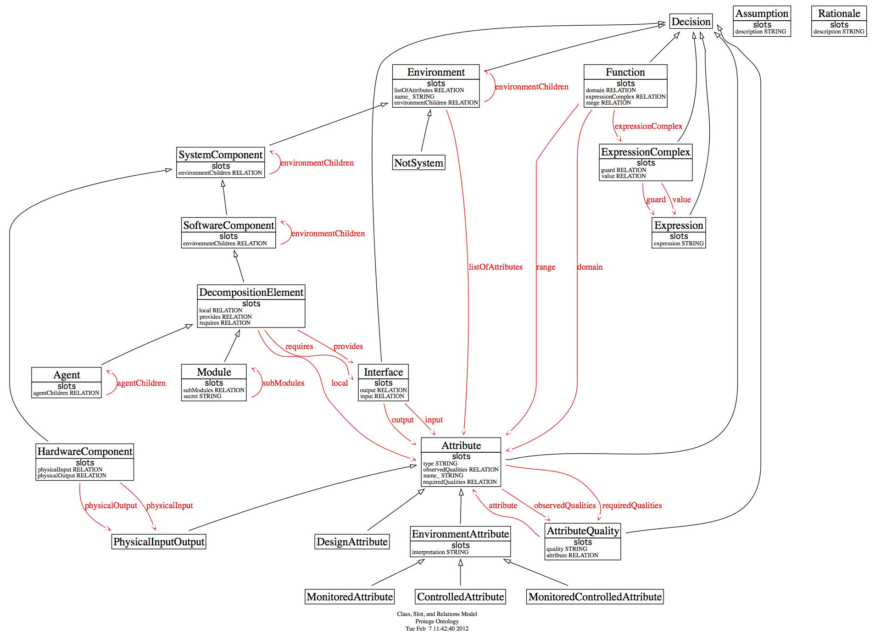
Software Production Ontology
Notes:
Incomplete work-in-progress.

Slide 4
Understanding Software Production
Inadequate, anecdotal understanding
How to create, sustain software infrastructure in response to changing needs and technologies?
Few examples of large-scale data collection
Little standardization of data
Widely-varying industrial settings
Avionics, Automotive, Medical, Energy, Defense, Telecommunications, Entertainment
Evidence is often anecdotal or based on small- scale trials

Slide 5
Software Production Data
Decisions considered, rejected, made, changed
Rationale
Formal software artifacts
Source and executable code; specifications; machine-readable models
Structured informal artifacts
Pseudo-code, requirements, graphical models, test plans, email addressing info, subject
Unstructured artifacts
Email body, notes, code comments, etc.
Notes:
Much data here not described by software production ontology.

Slide 6
Software Production
Information process
Sequence of representations (Denning)
Software production representation
Union of existing artifacts at point in time
Sequence of representations
Demarcated by creation of artifacts and changes to them over time
State space of software production

Slide 7
Software Production Information Process
Open source software (OSS) Mozilla Core as of 20 May 2011
1379 developers over 13 years
10.8M lines of codes and comments
205,799 changes committed to version control system
State space of Mozilla Core software production
205,799 representations X average of ~5M lines
Note:
Artifacts other than code not considered
Not a very large project
One OSS project vs. Commercial vs. contractor-developed government project vs. .....

Slide 8
Questions?

