Slide 1
Big Data that might benefit from ontology technology, but why this usually fails
Barry Smith
National Center for Ontological Research

Slide 2
The strategy of annotation
Databases describe data using multiple heterogeneous labels
If we can annotate (tag) these labels using terms from common controlled vocabularies, then a virtual arms-length integration can be achieved, providing
immediate benefits for search and retrieval
a starting point for the creation of net-centric reference data
potential longer term benefits for reasoning
with no need to modify existing systems, code or data
See Ceusters et al. Proceedings of DILS 2004. http://ontology.buffalo.edu/bio/LinkSuite.pdf

Slide 3
String searches yield partial results, rest on manual effort and on familiarity with existing database contents
Ontologies facilitate grouping of annotations
brain 20
hindbrain 15
rhombomere 10
Query ‘brain’ without ontology 20
Query ‘brain’ with ontology 45

Slide 4
Examples of where this method works
Reference Genome Annotation Project http://www.geneontology.org/GO.refgenome.shtml
Human resources data in large organizations
http://www.youtube.com/watch?v=OzW3Gc_yA9A
Military intelligence data
Salmen et al. in http://ceur-ws.org/Vol-808/
Other potential areas of application:
Crime • Public health
Insurance • Finance

Slide 5
But normally the method does not work
Semantic technology (OWL, …) seeks to break down data silos
Unfortunately it is now so easy to create ontologies that myriad incompatible ontologies are being created in ad hoc ways leading to the creation of new, semantic silos
The Semantic Web framework as currently conceived and governed by the W3C (modeled on html) yields minimal standardization
The more semantic technology is successful, they more we fail to achieve our goals

Slide 6
Reasons for this effect
Just as it’s easier to build a new database, so it’s easier to build a new ontology for each new project
You will not get paid for reusing existing ontologies (Let a million ontologies bloom)
There are no ‘good’ ontologies, anyway (just arbitrary choices of terms and relations …)
Information technology (hardware) changes constantly, not worth the effort of getting things right

Slide 7
How to do it right?
how create an incremental, evolutionary process, where what is good survives, and what is bad fails
create a scenario in which people will find it profitable to reuse ontologies, terminologies and coding systems which have been tried and tested
silo effects will be avoided and results of investment in Semantic Technology will cumulate effectively

Slide 8
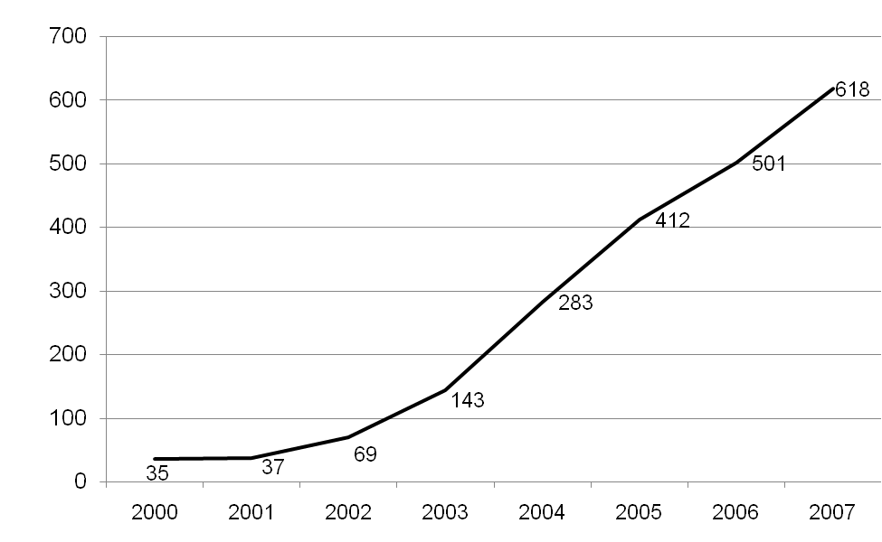
Uses of ‘ontology’ in PubMed abstracts

Slide 9
By far the most successful: GO (Gene Ontology)

Slide 10
GO provides a controlled vocabulary of terms for use in annotating (tagging) biological data
multi-species, multi-disciplinary, open source
built and maintained by domain experts
contributing to the cumulativity of scientific results obtained by distinct research communities
natural language and logical definitions for all terms to support consistent human application and computational exploitation
rigorous governance process
feedback loop connects users to editors

Slide 11
How to do it right
ontologies should mimic the methodology used by the GO (following the principles of the OBO Foundry: http://obofoundry.org)
ontologies in the same field should be developed in coordinated fashion to ensure that there is exactly one ontology for each subdomain
ontologies should be developed incrementally in a way that builds on successful user testing at every stage

