Slide 1
Model-based Systems Engineering
(MBSE) Initiative
Slides by Henson Graves
Presented by Matthew West

Slide 2
INCOSE MBSE Definition
“Model-based systems engineering (MBSE) is the formalized application of modeling to support system requirements, design, analysis, verification and validation activities beginning in the conceptual design phase and continuing throughout development and later life cycle phases.”
  INCOSE SE Vision 2020 (INCOSE-TP-2004-004-02), Sept 2007

Slide 3
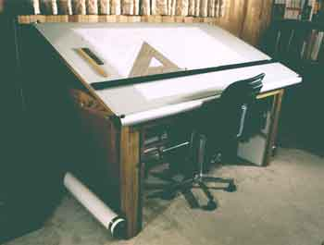
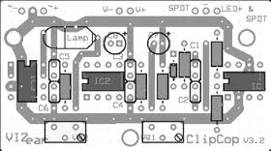
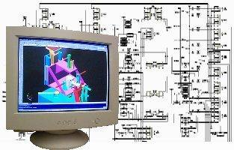
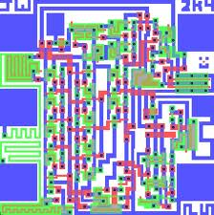
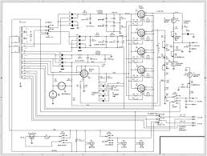
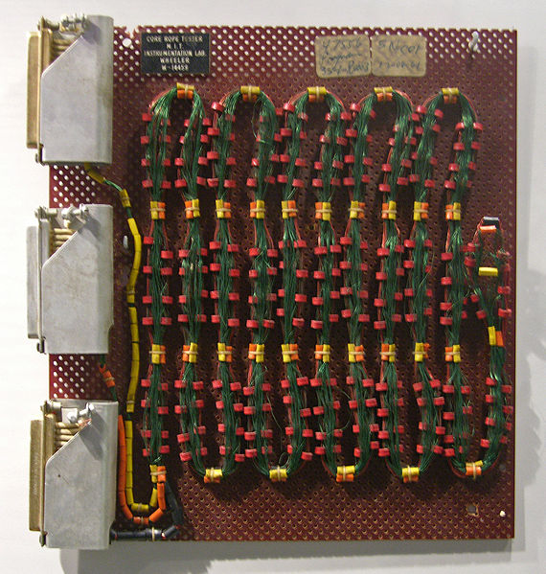
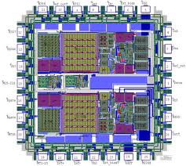
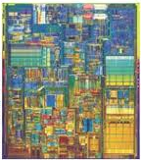
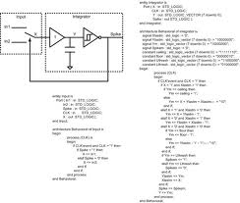
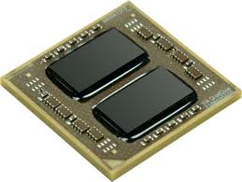
This requires change…
Documents
Document
Generation
Disconnected
System
Models
MBSE
Notes:
This will require some changes in the product development process, just like moving from core/rope memory that was put together by hand to quad-core mass produced billion gate IC’s required changes…
From drafting tables and tape, to CAD layout, to auto layout driven by schematics, to hardware description languages
Remember Dr. Rose’s HDL quote… ‘your not going to lay out a billion gate integrated circuit by hand’
Your not going to build the next generation products with billions of circuits, millions of lines of code, in hostile environments, in highly regulated situations like you did in the past using old methods—they’re not scalable.
Just as electronics design moved to higher levels of design and abstraction, you need to higher, cross-domain design approaches

Slide 4
INCOSE MBSE Roadmap
Reduced cycle times
System of systems
interoperability
Design optimization across broad trade space
Cross domain effects based analysis
MBSE Capability
Extending Maturity and Capability
Institutionalized
MBSE across
Academia/Industry
Distributed & secure model repositories
crossing multiple domains
Defined MBSE theory, ontology, and formalisms
Well Defined MBSE
Refer to activities in
the following areas:
Maturity
Architecture model integrated
with Simulation, Analysis, and Visualization
Planning & Support
Research
Standards Development
Processes, Practices, & Methods
Tools & Technology Enhancements
Outreach, Training & Education
Matured MBSE methods and metrics,
Integrated System/HW/SW models
Ad Hoc MBSE
Document Centric
Emerging MBSE standards
2010
2010
2020
2025

Slide 5
Topics Seeking Ontology Help On
Potential for Upper Ontologies as MetaData model to organize and manage engineering data
Use of ontology for modeling composite structures
Development of specific hierarchies of domain ontologies for inclusion in SysML modeling
Use of ontology results to construct good modeling principles for SysML modeling

Slide 6
Vision For Integration of Reasoning With System Engineering
Ontologies - General terminology reusable across multiple engineering domains
Requirements
Deployment
Design
Test & Verification
Ontologies specialized for domain specific applications
Implementation
Develop requirements specifications
facts about specific applications
Develop design specifications
Perform integration tests
Perform verification
tests
Knowledge Management & Reasoning System
Make/retract assertions about data
Answer queries
Check design consistency
Evaluate evidence for assertions
Check specification consistency
Check design specializes requirements
Verify implementation realizes design
Verify product satisfies requirements
Produced by Engineering Tools
Produced by Reasoning Tools
… with great potential for reducing work and rework

Slide 7
Significant Research Results On Embedding SysML into Logics
OWL
Classes & properties correspond to a fragment of FOL
Decidability
Rich class constructors
Individuals
First Order Logic
Quantifiers
Nary-predicates
Functions
Type theory
Contains a higher order logic
Set theory like abstraction
Type Theory
SysML
Classes & properties
Composite structure
Behavior
OWL
Composite Diagrams
Class Diagrams
FOL
Notes:
The logical systems of primary interest have an inference semantics and a reference semantics. An inference semantics is given by rules which can be used to derive conclusions from axioms, i.e., other true statements. The reference semantics for an axiom set describes a class of valid interpretations. The axioms are by definition true in any valid interpretation. Of course an axiom set may not have any valid interpretations. Meta-logic theorems are used to connect inference and reference semantics. The inference rules are sound if a statement derived from the axioms is true in any valid interpretation. A formal system is said to be sound when the statements derived from an axiom set are true with respect to the reference semantics and is said to be complete when all statements true in the reference semantics can be derived from the axiom set.
In a semantic embedding the informal SysML semantics is in accord with logic semantics. Many candidate logics are relevant as targets for embedding SysML. The informal semantics of SysML as specified by an informal notion of valid interpretation accords well with the formal concept of valid interpretation. Translating or embedding SysML models into logical system has pitfalls. Any useful formal semantics for SysML will have to be correct in so far as this is possible, given that SysML does not have a formal semantics. Otherwise, the semantics is potentially dangerous as it may lead to false conclusions.
When an application is represented by a SysML model the engineering questions translate into questions about the axiom set encoding the model. Is the model satisfiable, i.e., do the axioms have a valid interpretation (model in the logician’s sense). Many engineering problems can be reduced to the question of satisfaction of the axiom set. Logical implication problem: is the statement true in any realization of model. An axiom set is satisfiable if it has a valid interpretation. An axiom set may have many or no valid interpretations. If an axiom set has no valid interpretations, it is said to be unsatisfiable. satisfaction of an axiom set is equivalent to consistency in the logics considered here. In general satisfiability is undecidable. However, for important classes of problems there are decision algorithms.
For integration with reasoning we are looking for logical systems that have inference engines.

Slide 8
Use case 1: Maintaining Design Consistency During Development
Components get added to designs during the course of design development, e.g. a pump
May make the system design become invalid if design constraints are violated
These problems are not apparent from manual model inspection
Working with computer scientists to produce examples and feasibility studies
Notes:
Often design models in MBSE do not capture design constraints such as
How many connections can be made to an electrical circuit
Not always obvious from manual inspection of a design model that constraints violated

Slide 9
Plans Forward
Continue prototyping reasoning use cases
Hopefully the OntologySummit2012 will produce material that can be used in MBSE context
Looking for members for OAT willing to take on responsibilities for tasks

Slide 10
Quick Review of Objectives
We want to use the formalism of ontologies to represent knowledge in fields of interest to us:
  Space flight in particular
  Systems engineering in general
  Fundamental phenomena underlying the above: physics, chemistry, economics, psychology, politics, probability, etc.
We want these knowledge representation conventions to be stable and durable: independent of particular programs, projects, organizations, and software tools
We want to customize or adapt our modeling and analysis tools to support our knowledge representation conventions
  At least to translate to/from internal representations
  At best to teach the tool to operate on our concepts and properties as extensions or specializations of its native counterparts

Slide 11
A Simplified View of JPL Ontologies
Divided into three main categories:
  Foundation
    General concepts and properties
    Examples at right
  Discipline
    Specializations for electrical, mechanical, etc.
    Mostly about describing properties
  Application
    Specializations for cross-discipline use cases (e.g., orbiter, lander, observatory, etc.)
Each ontology may import other ontologies
«ontology»
base
imports
«ontology»
mission
imports
«ontology»
project

Slide 12
The strange life of System Components
C1
C2
Bloggs 100H Pump
Tag
P101
Serial No. 5755/A
Crude Distillation Unit

