Slide 1
Social Life Networks: Ontology-based Recognition
Ramesh Jain
Contact: jain@ics.uci.edu

Slide 2
Relevant Trends
Social Networks and their role in communication
Micro-blogs becoming major source of News.
Internet of Things is emerging.
More than 75% of the world poulation owns a mobile phone.

Slide 3
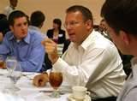
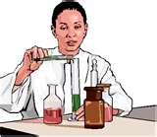
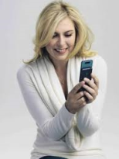
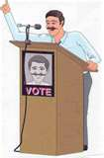
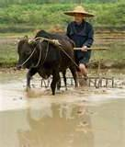
Social Networks
Connecting People

Slide 4
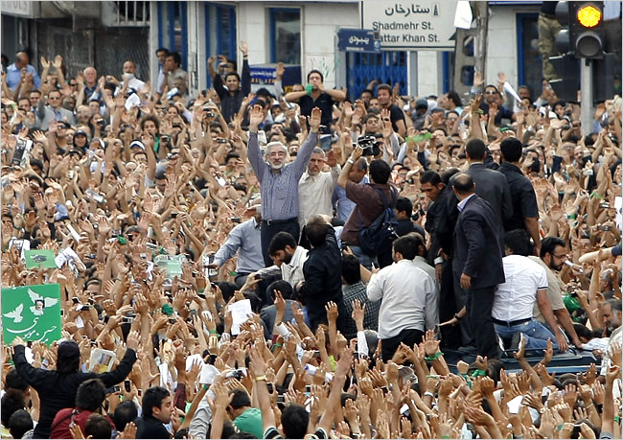
From Micro Events to Situations
From Tweets to Revolutions

Slide 5
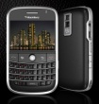
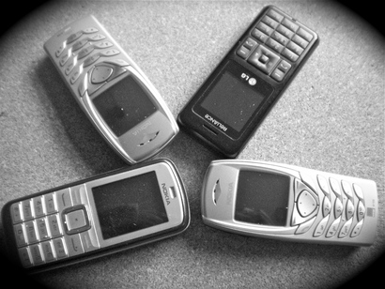
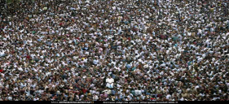
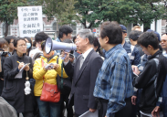
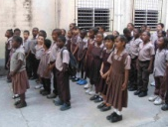
The World as seen through
Mobile Phones
Most attention by Technologists – so far.
Top 1.5 Billion
Middle 3 Billion
Middle of the Pyramid (MOP):
Ready, BUT …
Bottom 2 Billion
Not Ready

Slide 6
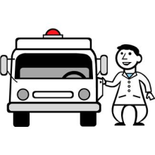
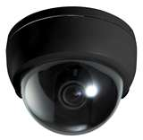
Social Life Networks
Connecting People
And
Resources
Aggregation and Composition
Situation Detection
Information
Alerts
Queries

Slide 7
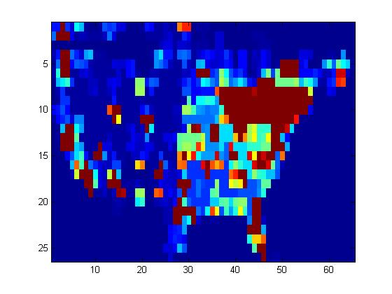
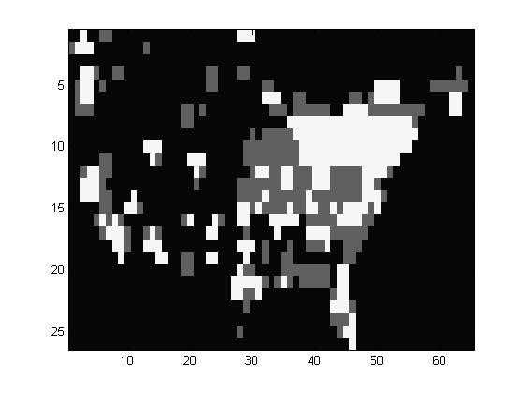
Swine flu social image and its segmentation
into ‘high’ and ‘low ’activity zones.

Slide 8
Situational Recommendation System
Macro situation
Alert Level=High
Date=12/09/10
Micro event
e.g. “Arrgggh, I have a sore throat”
(Loc=New York, Date=12/09/10)
Situational controller
Goal
Macro Situation
Rules
Control Action
“Please visit nearest CDC center at 4th St immediately”
Level 1 personal threat + Level 3 Macro threat -> Immediate action

Slide 9
Real Time Situation Analysis
Situation Recognition
Representations
More abstraction,
Less detail
Level 3: Events
Properties
Characterizations
Level 2: S-t-t aggregate e.g. Emage
Properties
Transformations
Level 1: S-t-t Data
Properties
Less abstraction,
More detail
Level 0: Raw data
e.g. tweets, cameras, traffic, weather, RSS, check-ins, www

Slide 10
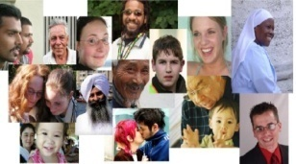
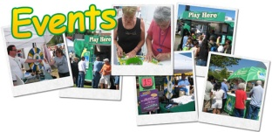
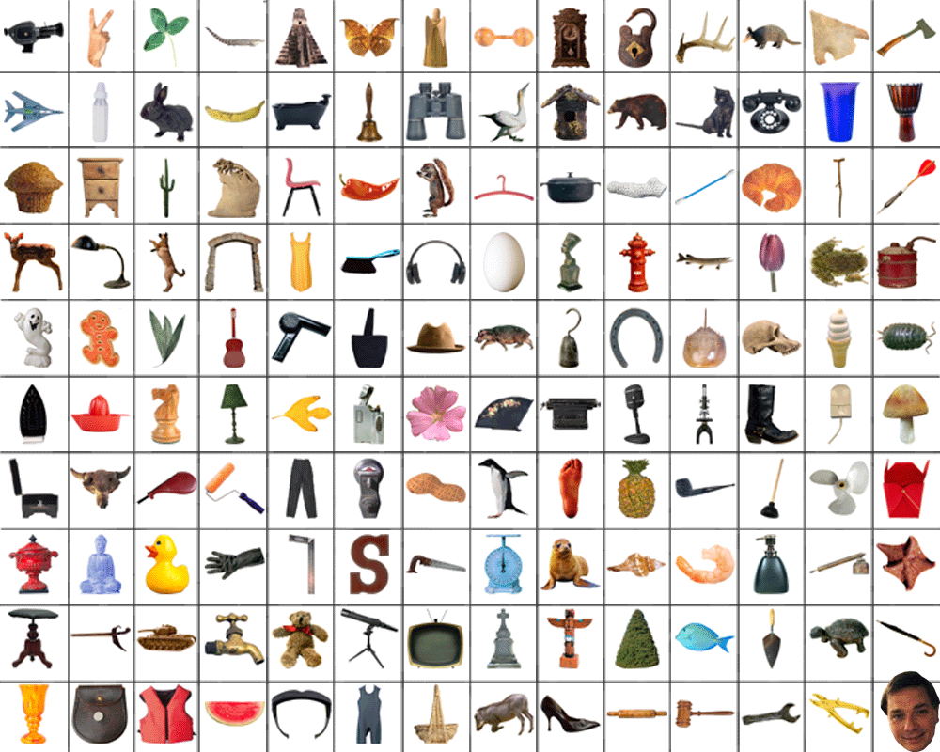
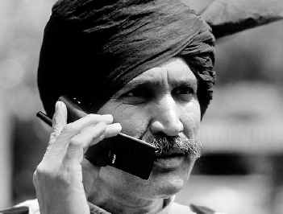
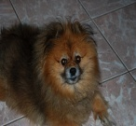
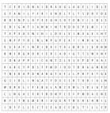
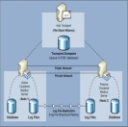
Transformations
Users
Objects
Semantic Gap
Lists, Arrays, Documents, Images …
Alphanumeric Characters
Data
Bits and Bytes

Slide 11
Semantic Gap
The semantic gap is the lack of coincidence between the information that one can extract from the visual data and the interpretation that the same data have for a user in a given situation. A linguistic description is almost always contextual, whereas an image may live by itself.
Content-Based Image Retrieval at the End of the Early Years Found in: IEEE Transactions on Pattern Analysis and Machine Intelligence Arnold Smeulders , et. al., December 2000

Slide 12
Models bridge the Semantic Gap.

Slide 13
Models
A model in science is a physical, mathematical, or logical representation of a system of entities, phenomena, or processes. Basically a model is a simplified abstract view of the complex reality.
Models in software allow scientists to leverage computational power to simulate, visualize, manipulate and gain intuition about the entity, phenomenon or process being represented

Slide 14
Ontology
An ontology is a formal representation of knowledge as a set of concepts within a domain, and the relationships between those concepts. It is used to reason about the entities within that domain, and may be used to describe the domain.
From http://en.wikipedia.org/wiki/Ontology_(information_science)

Slide 15
Descriptions
The purpose of description is to re-create, invent, or visually present a person, place, event, or action so that the reader may picture that which is being described.

Slide 16
Ontologies have been used mostly for description of domain knowledge.

Slide 17
Recognition
Recognition is identification of something already known

Slide 18
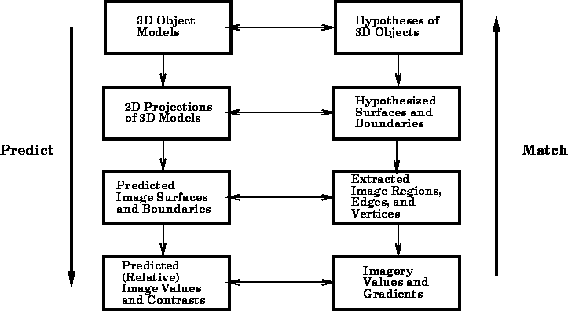
Thomas O. Binford. Image understanding: intelligent systems.
In Image Understanding Workshop Proceedings,
volume 1, pages 18-31, Los Altos, California, February 1987.

Slide 19
Creating R-Ontology
Upper Ontology
Domain Ontology-1
….…
Domain Ontology-n
Context-n
Context-1
Context-n
…
…
Augmented Ontology-1
…
Augmented Ontology-n
Augmented Ontology-1
…
Augmented Ontology-n
Trip to Huangshan
Trip to Beijing
Visiting Summer palace
visiting forbidden city
….…
visiting Yellow Mountain
visiting Huangshan Geopark

Slide 20
Recognition using R-Ontology
Model
Data
Ontology
(time, loc, visual , ….)
(Upper and Domain)
Context
Match/
Classification
Augmented Ontology Model for Recognition
clustering

Slide 21
Conclusion
Ontology for a specific situation augmented with available contextual information.
Augmented Ontology used for recognition of situation from multiple sources of data.
Ontology allow explicit specification of models that could be modified using context information to provide very flexible models to bridge the semantic gap.

Slide 22
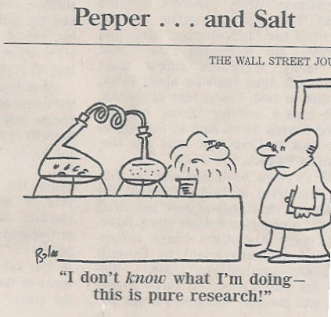
Thanks for your time and attention.
For questions: jain@ics.uci.edu

