Slide 1
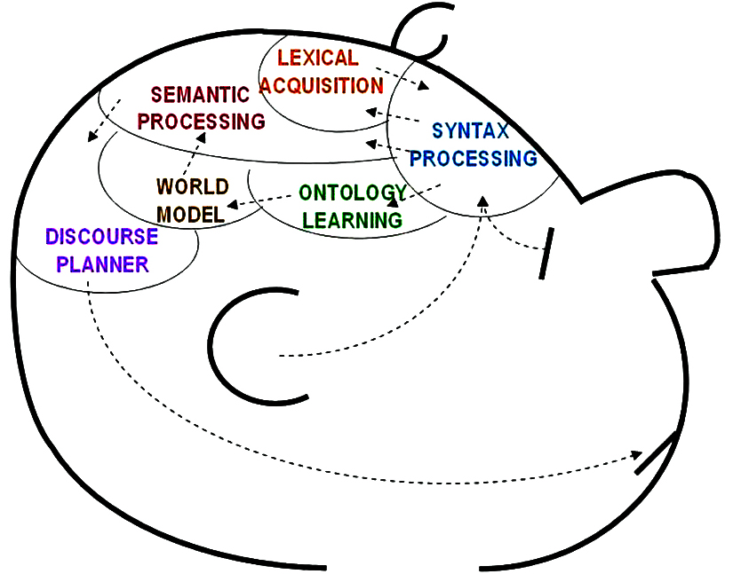
Harvesting the Business Value of Ontologies:
Recent Case Examples (Part-1)
Mills Davis
Project10X
mdavis@project10x.com

Slide 2
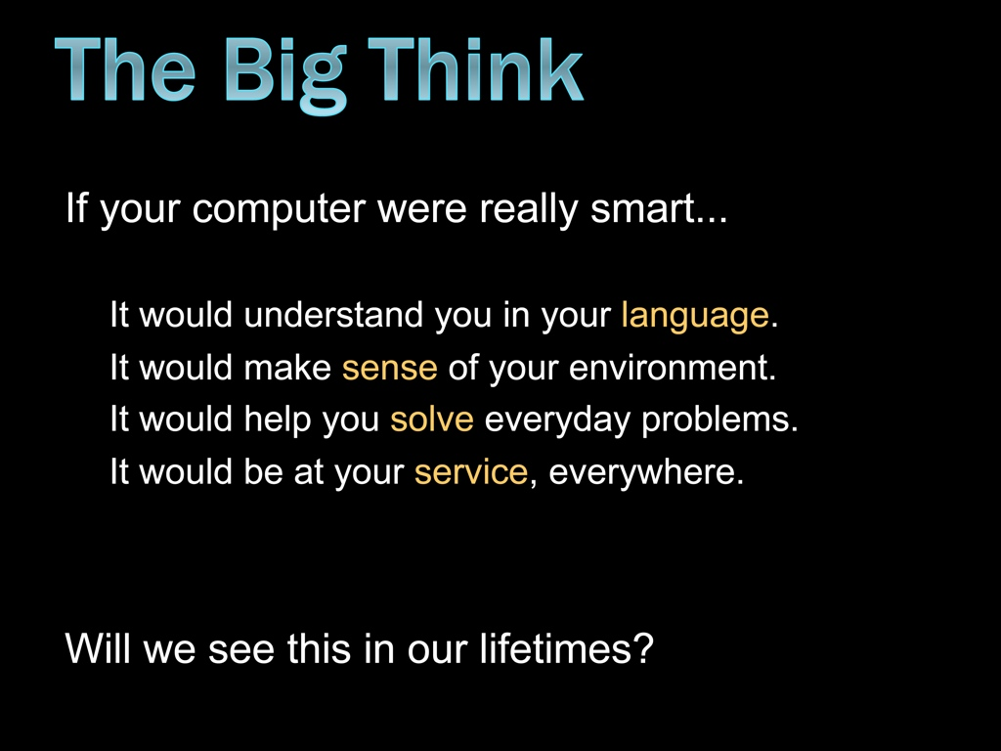
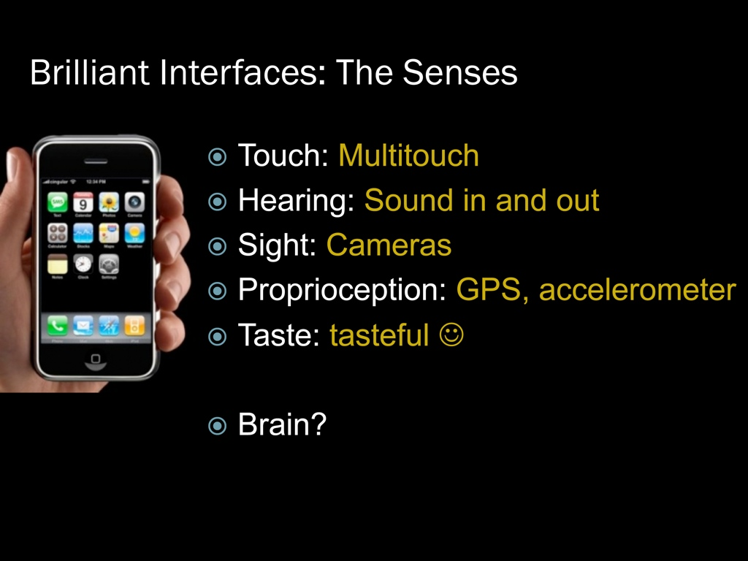

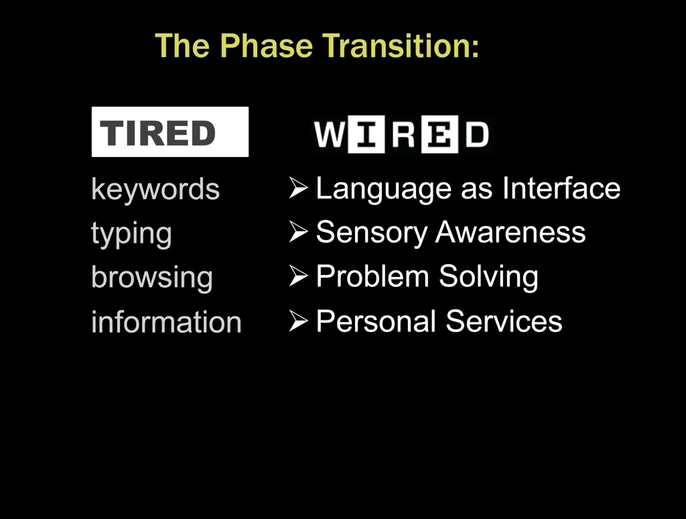
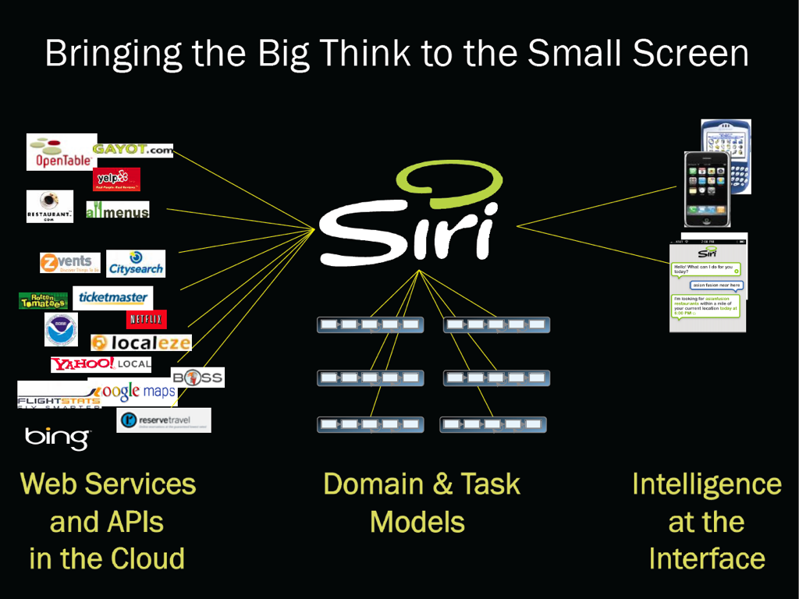
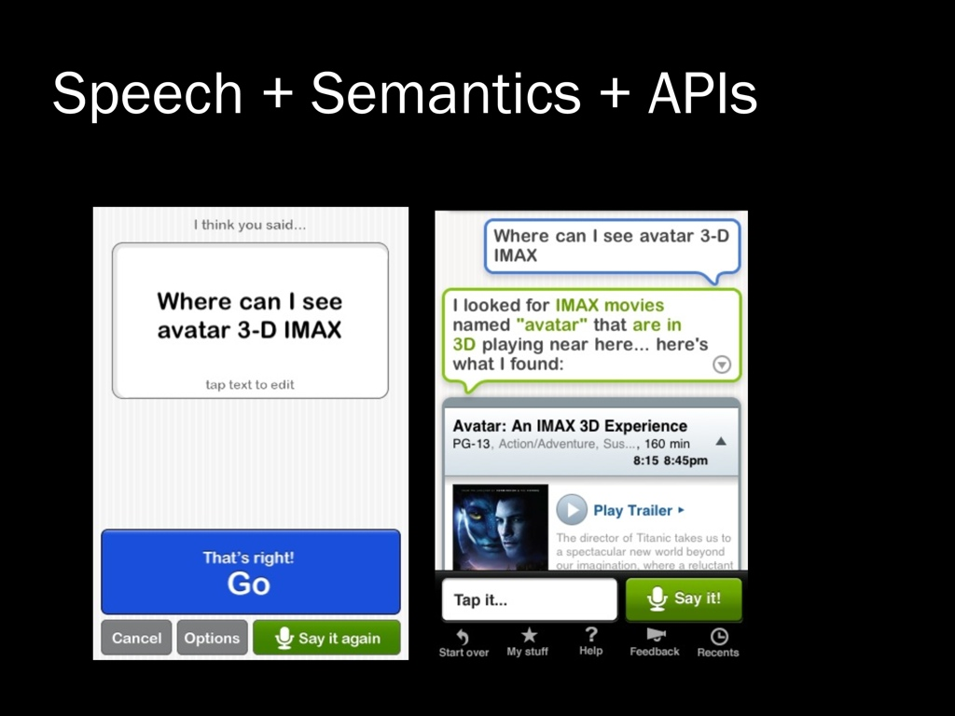
Smart platforms, smart devices
Context-aware services, semantic browsing, expert systems,
and virtual assistants that complete tasks for you.

Slide 3
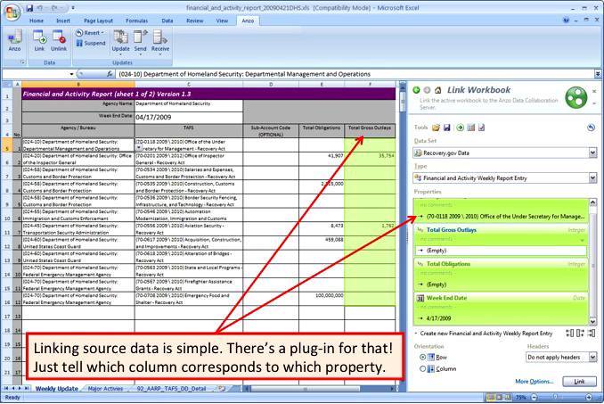
Do-it-yourself data exploration
CHALLENGE
When events trigger action, researchers and analysts examine the data. Combining information from multiple spread sheets and databases is tedious and manual. Desktop tools do not know the categories and properties expressed by column (or row) headings. Moreover, for IT to create a new database or data warehouse is time-consuming, costly, and assumes that all requirements are knowable in advance..
SOLUTION
Knowledge-centric solution for data exploration links source data from spreadsheets, files, or database tables to a standard (semantic) model stored on a server. There’s an app for that. Works on desktop or via browser. Selecting data to add to a spreadsheet is a pull-down menu option. Filters apply easily. Numerous lenses for visualizing data.
BENEFITS
Focuses on ease of use for end-users with tools they know how to use; minimum IT involvement, if at all.
Rapid and low-cost to solution (hours/days), vs. slow and time-consuming for RDBMS, data warehouse, or manual
Flexibility in the face of inevitable change: rapid, low-cost, incremental modification vs. time-consuming costly, and difficult revision of conventional stores.
“Low-hanging fruit” for many agencies and programs..
Source: Cambridge Semantics

Slide 4
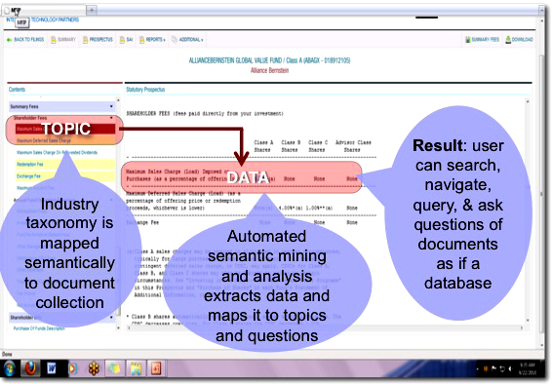
Better access with semantic search, navigation, query & question answering
CHALLENGE
Mutual fund industry rules change requires consumer friendly interactive access to 250,000 mandated plan documents. While the industry’s trade association has developed a standard taxonomy for key topics, (a) buyers do not know industry jargon, (b) often related data is not adjacent to topic, and (c) buyer lacks a way to hone in on answers to questions. Conventional DB and CMS approaches are labor intensive, error prone and costly to update.
SOLUTION
Knowledge-centric solution semantically analyzes and indexes the database corpus using deep linguistics and domain knowledge to extract data, link information to topics, and find answers to questions. Consumers can navigate by topic (faceted search) pose questions in natural language, and query data contained in documents as though it were a database.
BENEFITS
Concept-based faceted navigation uses semantic analysis of content to reduce cognitive burden for users including extract specific data from tables (e.g., the amount of a specific type of fee). Question answering allows users to express questions in their own words and get the right answer.
Automated semantic indexing and analysis is more consistent, accurate, and cost-effective than comparable manual methods. Since, 80% of all data in organizations is unstructured, applications within government and industry are massive.
Source: Recognos Financial
Notes:
This slide illustrates structuring unstructured data (specifically, documents in the Edgar database) and how this enhances citizen access to information
It shows a Mutual Fund Prospectus that was filed with the SEC.
The left panel of the screen displays a taxonomy associated with Mutual Funds. It is widely used and was developed by the Investment Company Institute.
The right panel displays the actual filed document with the selected field value highlighted within the body of the document itself.
The screen shot highlights how the taxonomy maps to the point in the document where the topic occurs.
This mapping is automated. Semantic processing of the text results in clean data (as received directly from the source of the data) with all standard data elements identified and extracted from the document without being touched by human hands (no data entry). Automated semantic extraction maintains the integrity of the data.
More ways to add value to financial documents and improve information accessibility:
If 80% of all data in organizations is unstructured then the applications for this technology within the financial services industry are endless. It can be used to identify and extract specific required information from not only Prospectus Documents but from:
Loan Agreements Dividend Announcements
Letters of Credit Corporate Actions
Loan Applications Asset Servicing Agreements
Client Agreements News Articles
Contracts Any text document germane to a specific function.

Slide 5
Knowledge-centric information webs & process interoperability
CHALLENGE
DoD attempted to build a data warehouse to connect HR systems and information across the Department. After 11 years and $1B dollars expended, had nothing to show for it.
“We’ve tried everything else and failed.”
— DoD CTO for Business Mission
SOLUTION
Built a semantic information web that connected existing systems of record using a common domain ontology connected to relational mapping and source (metadata) ontologies
After 9 months (and very modest dollars expended), DoD had demonstrated a solution
Enterprise Information Web Ontology Architecture
BENEFITS
Semantic information web ontology patterns enable federated search, information sharing, and SQL-like querying across heterogeneous business databases.
Basic to very complex analytics and reporting across all systems become end-user generated queries that reference analytics ontology(s) connected to the domain ontology.
Development, extension, and upgrades to the “system of systems” is rapid, incremental, iterative, non-invasive and low-risk.
Discussion Ontology
Standards Ontology
Community Ontology
Process Ontology
Domain
Ontology
Analytics Ontology
Relational Mapping
Ontology
Relational Mapping
Ontology
Source Ontology
Source Ontology
RDBMS
RDBMS

Slide 6
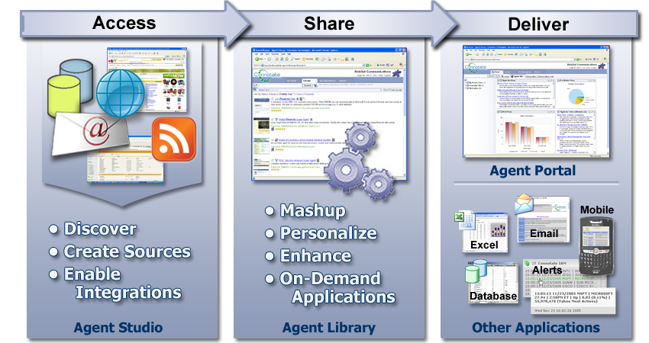
Do-it-yourself semantic agents to discover, aggregate, analyze & report information
CHALLENGE
Agencies need to find, monitor, aggregate and make sense of information from a great many sources across the web as well as internally within government. The manual effort involved can consume 25-45% of an analysts time. Also, it is costly to custom program and update searches and analytics as needs change.
SOLUTION
Intelligent semantic software agents to access, harvest, tag, and standardize information that are easy to create by anyone and can be shared and reused. Train agents to capture site information, content elements, and take action to extract specific data, capture files, define schemas. Agents “speak” HTML, XML, RSS, RDF, PDF, database and Excel. Mash-ups create new data by element and schema, in time periods, across sources and time periods, and put data into context.
BENEFITS
360 degree views on topics, issues, etc. combining information from internal and external sources including web pages, blogs, local news, message boards, social media, databases, email, intranets, enterprise applications, etc.
Productivity improvements from automated gathering, monitoring, and alerting for needed information events that is 24/7/365 or other frequency.
Source: Connotate

Slide 7
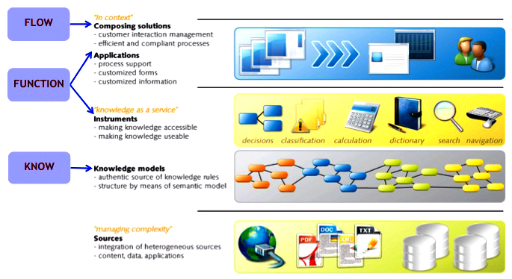
Smart knowledge-driven citizen-centric services
CHALLENGE
Permitting site synthesizes requirements, processes, and information across multiple jurisdictions and 14 independent institutions into a unified user experience.
Immigration site helps new arrivals solve varied problems of relocation. It combines information, and decision logic from 12 agencies into an easy to use single point of service delivery.
SOLUTION
Knowledge-centric solution separates the know from the flow and the function to create declarative applications configured by users with semantic models of legislation, knowledge, processes, data, and UI. The core infrastructure consists of an ontology, which is enriched with business rules. All functions use the same ontology, e.g., semantic search, information access, automated decision making, decision support, and dynamic processes.
BENEFITS
“Open knowledge as a service” bridges the gap between government and citizens and facilitates effective cooperation between independent institutions – both public and private.
Provides automated decisions and decision support; means for agencies to manage their knowledge / rules; ability to quickly adapt to external events / implement new legislation; improved decision making, guaranteed compliancy, less errors; improved service delivery to the public; and substantial cost reductions.
Source: OSD (Readiness)
Source: BeInformed
Notes:
Citizen centric:
no wrong door, all the right answers;
no unnecessary questions;
correct advice based upon the citizen's personal context;
pro-active service;
tailor made.
One government
One application;
One front office;
One process, but also;
One inspection;
Despite the number of
institutions involved
Semantic search
www.overheid.nl, www.minbzk.nl, www.minvrom.nl, www.minocw.nl, www.minfin.nl, www.minaz.nl, www.belastingdienst.nl, www.douane.nl, www.toeslagen.nl, www.e-overheid.nl, http://almanak.overheid.nl
Life events
www.onderwijsenbijverdienen.overheid.nl, www.overlijden.overheid.nl, www.newtoholland.nl, www.vertreknaarhetbuitenland.overheid.nl, www.overlijdeninhetbuitenland.nl
Virtual Integrated Front Office
Department of VROM, Department of V&W, CWIIND, WMO-front office, Rechtwijzer;
Knowledge infrastructure
Immigrations Office, Port of Rotterdam
Government metadatamanagement
ICTU, OWMS, VROM
Combined inspections
Port of Rotterdam, Customs, Immigrations Office
Policy formulation
Department of Justice (Legis Duplis)

Slide 8
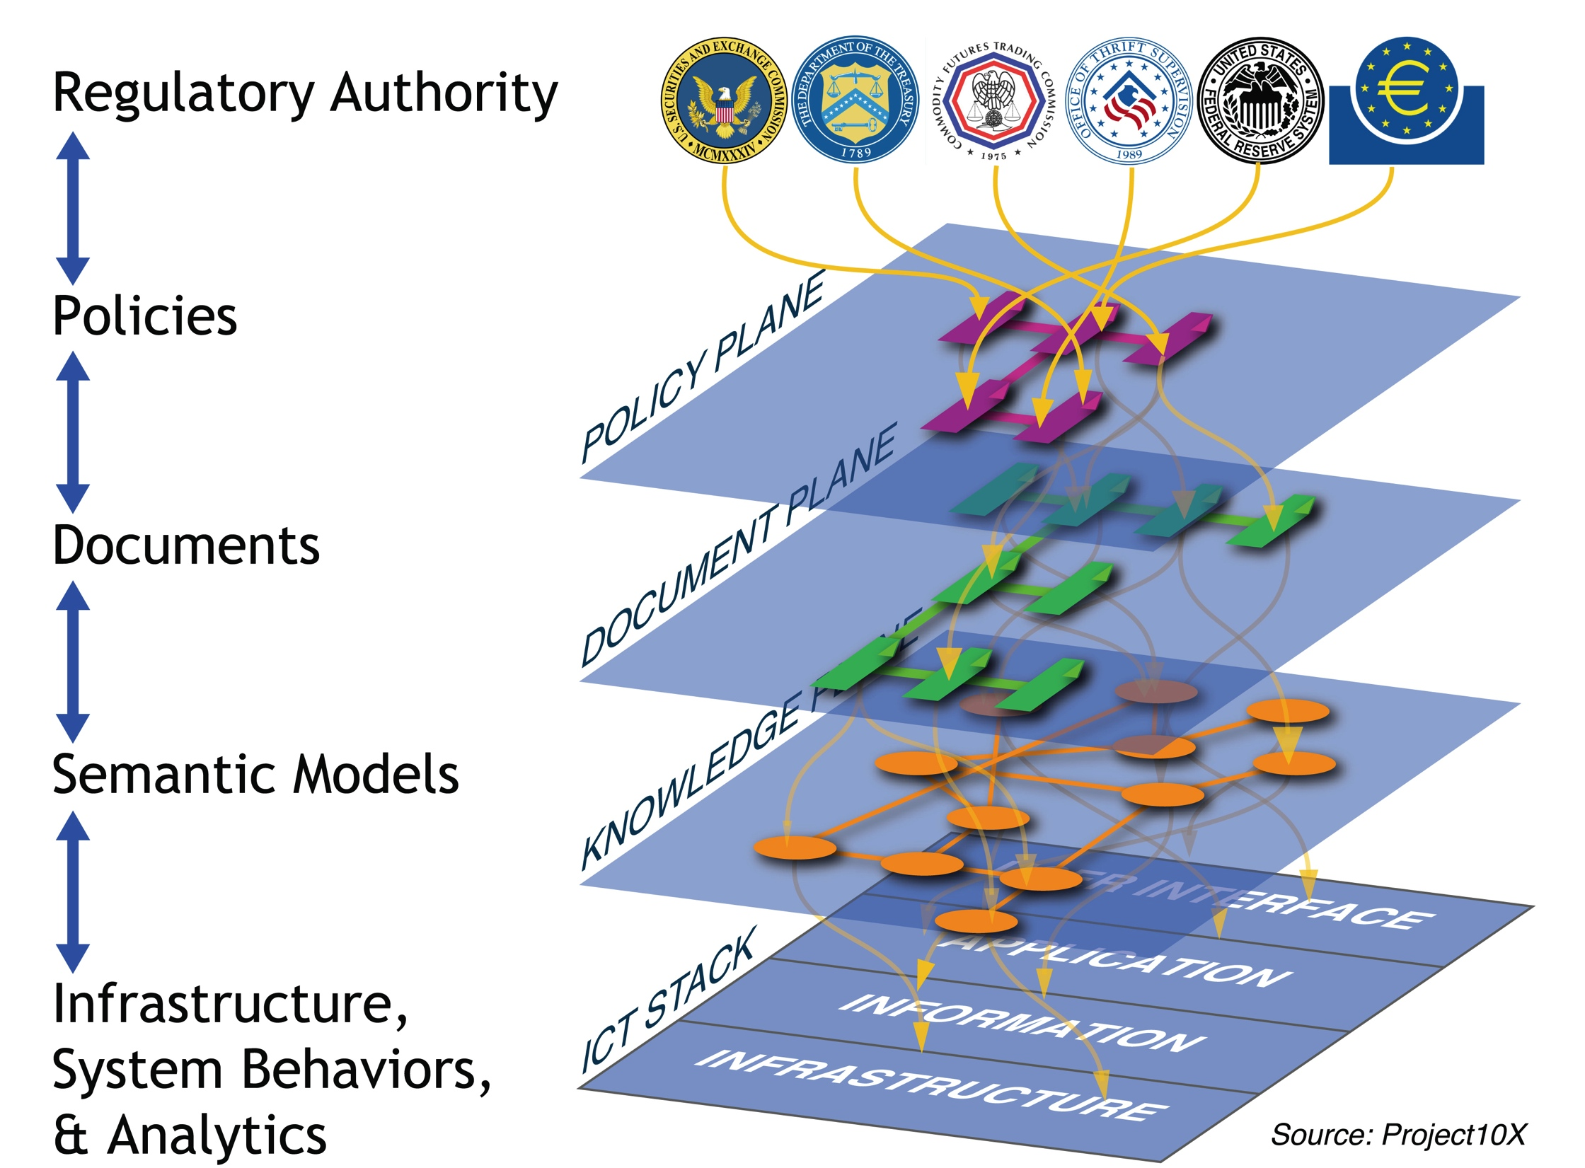
Policy-driven compliance, risk, and change management
OPPORTUNITY
Global financial services firm was $600B behind in M&A because it could not keep up with compliance requirements. Knowledge to track and report regulatory mandates comprehensively across the business was fragmented in separate documents, systems, and data stores, thus slow, prone to error, and difficult to change.
“Our only solution is to add more belly buttons, which means committing thousands of people to compliance.”
SOLUTION
Knowledge centric collaborative solution that captures all of the regulatory mandates, maps them to policy documents, then to semantic models defining schemas, processes, and decision-making rules, to deployed operational systems and procedures, to analytics that track, assess, and report human and system behavior and ensure compliance.
FEATURES
BENEFITS
Development of knowledge-centric compliance solution requires fewer resources, is more rapid, less costly, quicker to show value.
Operation of knowledge-centric solution requires less labor, is more reliable and less error prone.
Maintenance and upgrades are less costly and time consuming. Assessing impact of changes on documentation, systems, and procedures is more automated. Change management and version control is automated.
Compliance
Notes:
Risk, compliance and policy-driven processes include situation awareness, exceptions, fraud, case management, emergency response.
Semantic technologies map the external (legal) requirements to policies (expressed as documents) to semantic models (defining information structures, processes, and user responsibilities) to system infrastructure, behaviors, and analytics (measures of performance). This provides visibility and traceability from mandate to manifestation to compliance reporting.
For example, semantic technologies prevent unauthorized user access to systems, data, or other resources by defining access rules and mapping these to various security systems. Transactional recording and rules to determine if fraudulent or other "bad" behavior is occurring.
Development is collaborative, iterative, incremental, rapid and relatively inexpensive. (Information webs are dramatically cheaper to build than data warehouses, less brittle, and far less expensive to change.
Operations become substantially less labor intensive, and less error prone.
When policies change, evolution of capabilities is more agile.
For example, queries across the knowledgebase help automate assessment of impacts to all dimensions of the system.
How do semantic technologies enable integration and interoperability of different forms of knowledge? Common machine representation interrelates them.
Using semantic technologies, we can specify, interrelate, and manage knowledge at the level of individual concepts and relationships independently of its source artifact, whether this knowledge comes from:
(a) Documents via natural language or visual language understanding, and semantic tagging;
(b) Models including file formats, database schema, object models, content semantics, policies, event and process models, context models, domain ontologies, etc.
(c) Behaviors including software source libraries, directories, frameworks, methods, subroutines, objects, semantic agents, and infrastructure standards.
A common computer interpretable representation of knowledge from these different source formats is possible in much the same way that different forms of logic can always be translated to and expressed in a subset of natural language (e.g. English) that can be readily understood by people who speak this language, without specialized training in the notational formalisms used by logicians.

Slide 9
Ontology-driven application and process themes
Semantics in commercial off the shelf software such as BI, ERP, CRM, SCM, PLM, and HR
Ontology-driven discovery in law, medicine, science, defense, intelligence, research, investigation, and real-time document analysis
Advanced (collaborative) analytics for hindsight, insight, and foresight
Risk, compliance and policy-driven processes such as situation assessment, exceptions, fraud, case management, predictive analytics, and emergency response
Knowledge-intensive processes such as modeling & simulation, acquisition, design, engineering, and virtual manufacturing
Network & process management such as diagnostics, logistics, planning, scheduling, cyber-security, and event-driven processes
Adaptive, autonomic, & autonomous processes such as robotics, intelligent systems, and smart infrastructure
Systems that know, learn & reason as people do such as e-learning, tutors, advisors, cognitive agents, and games.

Slide 10
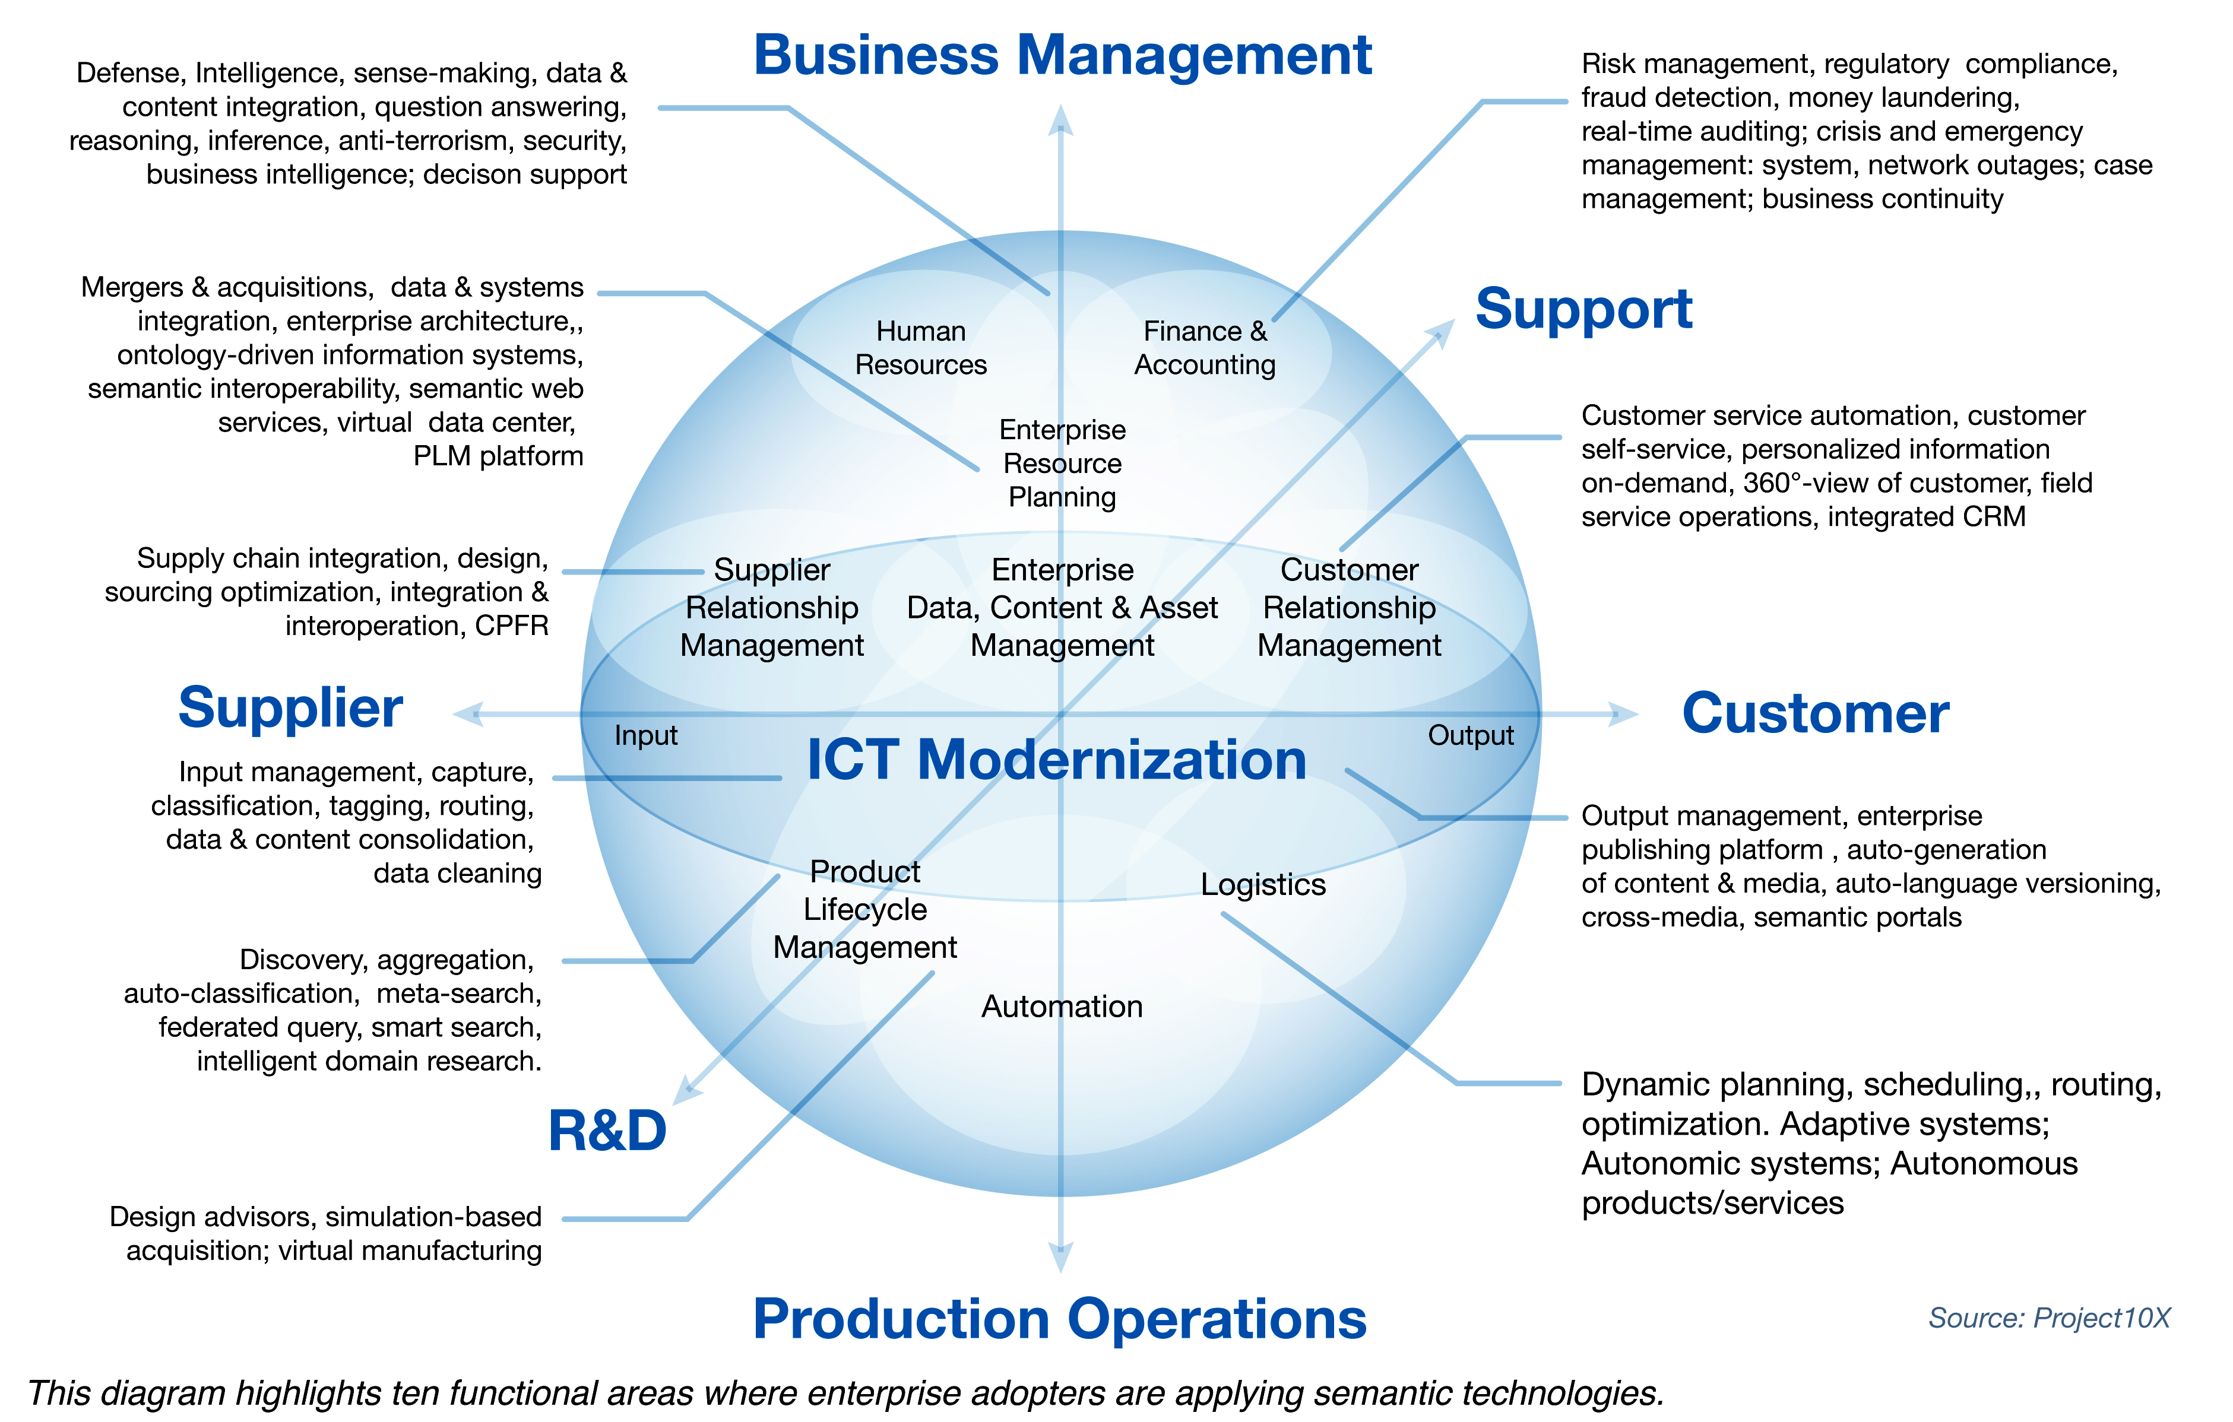
Where else can we apply ontology-driven approaches?
Just about everywhere you look..

Slide 11
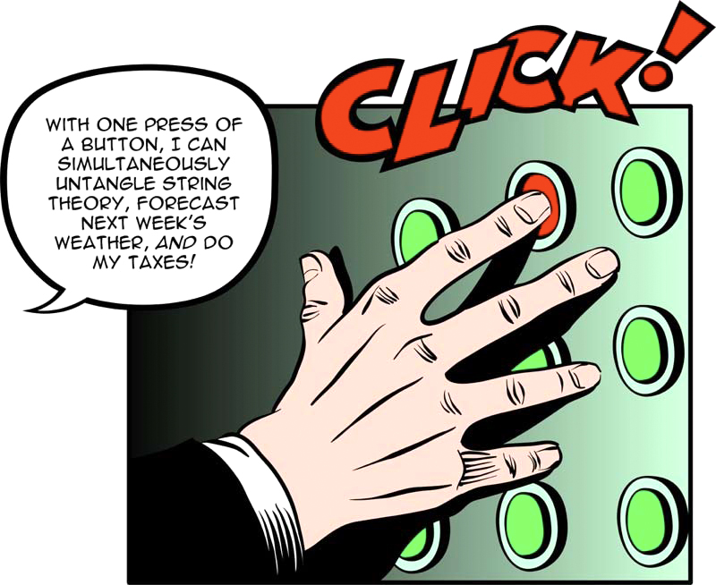
Questions?

