Slide 1
Units and Measures in Engineering
1
System Design
Physical Design
Operation

Slide 2
Systems view - The Radar Equation
2
Antenna Gain
dB
Transmitter wavelength
(cm)
Signal to Noise Ratio
decibel
Transmit Power
Watts
P_{t} G² λ² σ
Target Radar Cross Section
square metres
(actually a ratio to a nominal 1 sq.m sphere)
S/N =
R⁴ (4 π)³ k T B F
Range to target
Nautical Miles
[Imperial = 6080 Feet
Metric - 1852 metres]
Receiver Bandwidth
Hertz
Noise Factor
dB
(A multitude of factors lumped together)
Mathematical Constant
Receiver Noise Temperature
Degrees Kelvin
Physics Constant - Boltzmann's Constant
1.38 x 10⁻²³ Watt Second per degree Kelvin

Slide 3
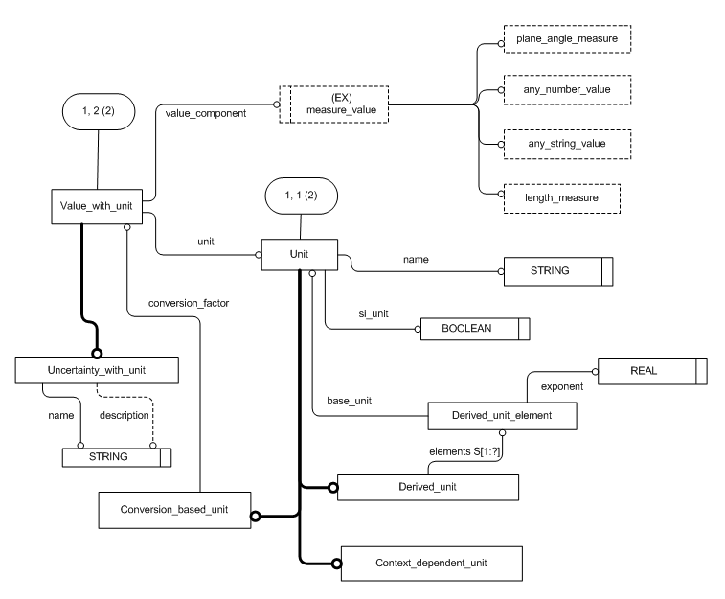
STEP: Value with Unit Module (diagram copyright ISO 2004)
3
Units found on Bills of Material
"Rolls" of tape
"Drums" of filler
"as required" for rivets

Slide 4
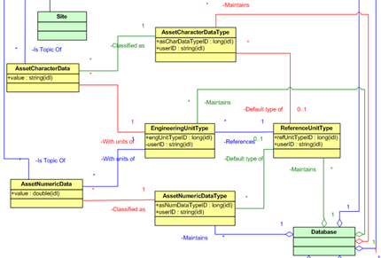
MIMOSA EAI
4
Extract from the RegAsset module (copyright Mimosa 2012)
Source of Reference Data

