Slide 1
Public Health Ontology 101
Die Seuche (The Plague), A. Paul Weber, Courtesy of the NLM
Mark A. Musen, M.D., Ph.D.
Stanford Center for Biomedical Informatics Research
Stanford University School of Medicine

Slide 2
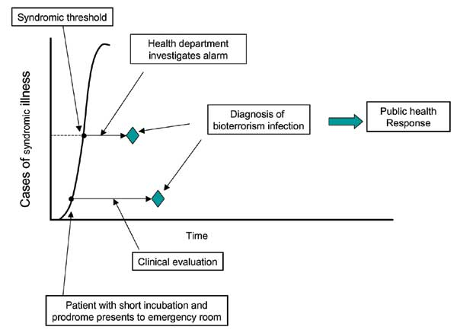
Many Factors can Influence the Effectiveness of Outbreak Detection
Progression of disease within individuals
Population and exposure characteristics
Surveillance system characteristics
From Buehler et al. EID 2003;9:1197-1204

Slide 3
Computational Challenges
Access to data
Interpretation of data
Integration of data
Identification of appropriate analytic methods
Coordination of problem solving to address diverse data sources
Determining what to report

Slide 4
Interpretation of data
Clinical data useful for public health surveillance are often collected for other purposes (e.g., diagnostic codes for patient care, billing)
Such data may be biased by a variety of factors
Desire to protect the patient
Desire to maximize reimbursement
Desire to satisfy administrative requirements with minimal effort
Use of diagnostic codes is problematic because precise definitions generally are unknown—both to humans and computers

Slide 5
A Small Portion of ICD9-CM
724 Unspecified disorders of the back
724.0 Spinal stenosis, other than cervical
724.00 Spinal stenosis, unspecified region
724.01 Spinal stenosis, thoracic region
724.02 Spinal stenosis, lumbar region
724.09 Spinal stenosis, other
724.1 Pain in thoracic spine
724.2 Lumbago
724.3 Sciatica
724.4 Thoracic or lumbosacral neuritis
724.5 Backache, unspecified
724.6 Disorders of sacrum
724.7 Disorders of coccyx
724.70 Unspecified disorder of coccyx
724.71 Hypermobility of coccyx
724.71 Coccygodynia
724.8 Other symptoms referable to back
724.9 Other unspecified back disorders
Notes:
Informal: people don’t understand the term or misuse it

Slide 6
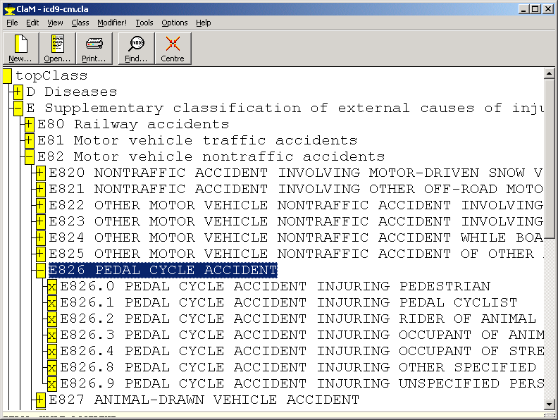
The combinatorial explosion 1970s ICD9: 8 Codes

Slide 7
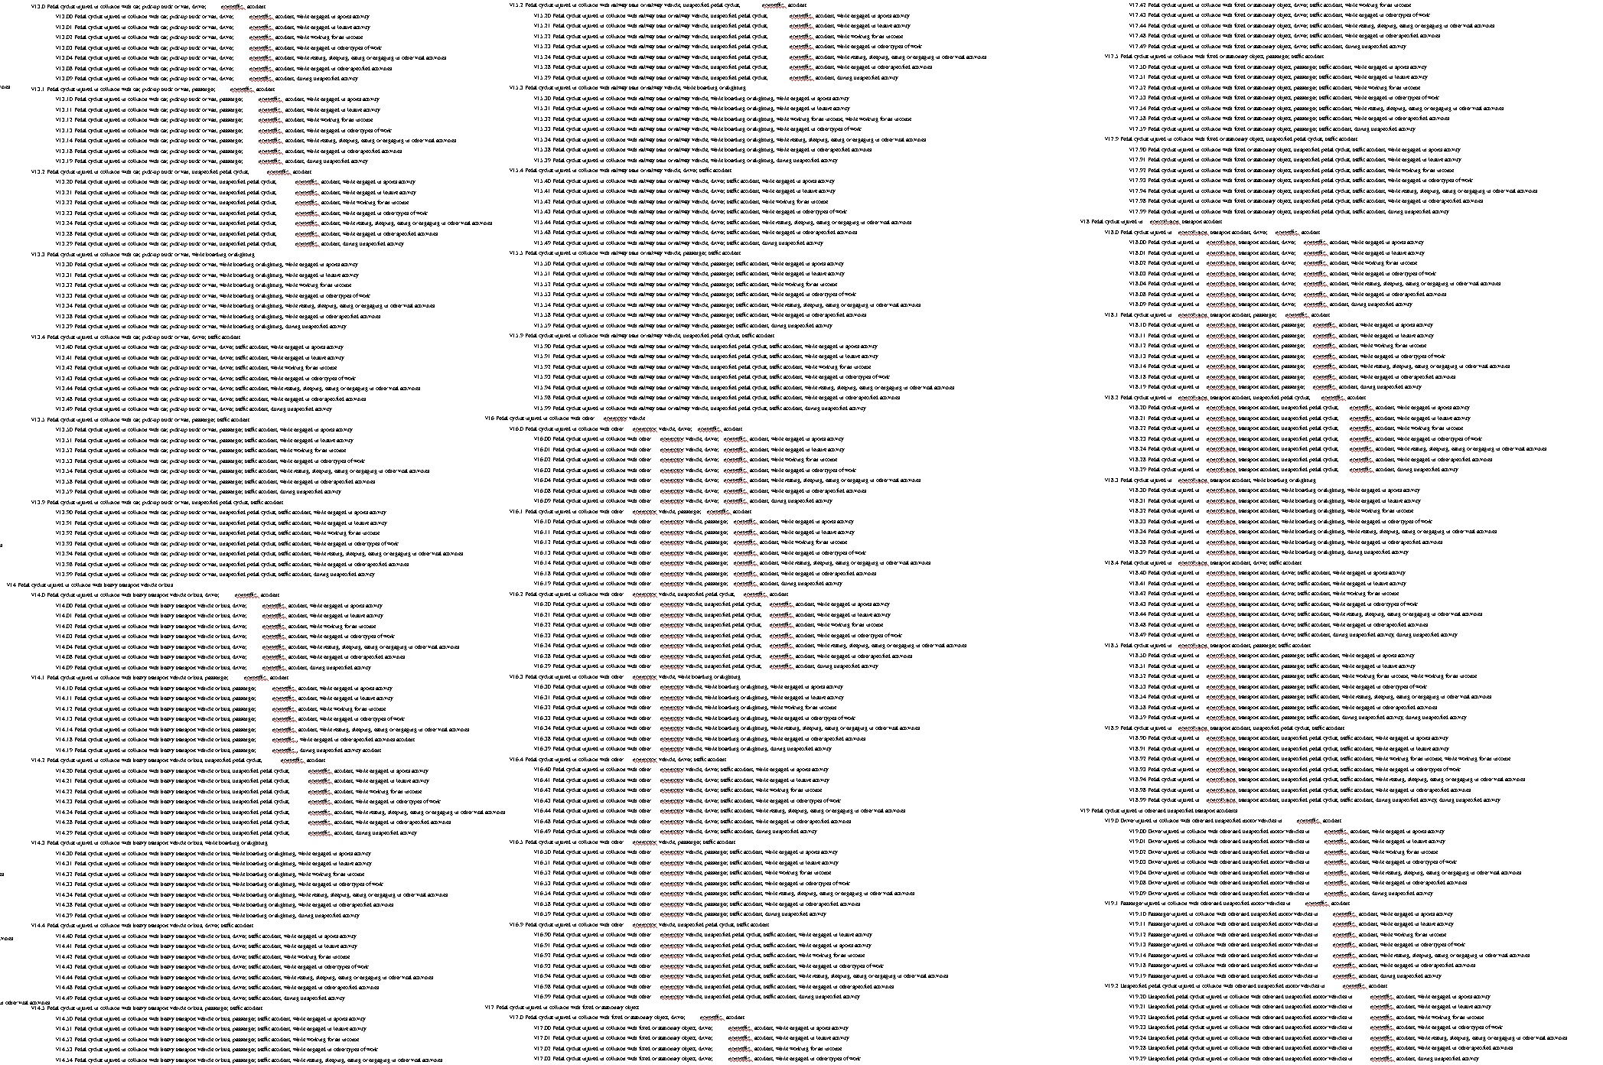
ICD10 (1999): 587 codes for such accidents
V31.22 Occupant of three-wheeled motor vehicle injured in collision with pedal cycle, person on outside of vehicle, nontraffic accident, while working for income
W65.40 Drowning and submersion while in bath-tub, street and highway, while engaged in sports activity
X35.44 Victim of volcanic eruption, street and highway, while resting, sleeping, eating or engaging in other vital activities

Slide 8
Syndromic Surveillance
Requires enumeration of relevant “syndromes”
Requires mapping of codes (usually in ICD9) to corresponding syndromes
Is complicated by the difficulty of enumerating all codes that appropriately support each syndrome
Is complicated by lack of consensus on what the “right” syndromes are in the first place

Slide 9
There is no consistency in how “syndromes” are defined or monitored
System | Syndrome
ENCOMPASS | “Respiratory illness with fever”
CDC MMWR 10/01 | “Unexplained febrile illness associated with pneumonia”
RSVP, New Mexico | “Influenza-like illness”
Santa Clara County | “Flu-like symptoms”
Winter Olympics, Utah 2002 | “Respiratory infection with fever” consensus definition

Slide 10
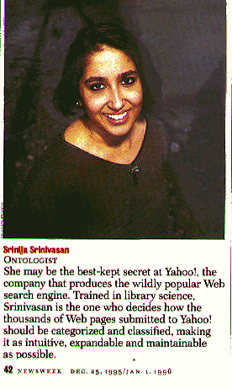
The solution to the terminology mess: Ontologies
Machine-processable descriptions of what exists in some application area
Allows computer to reason about
Concepts in the world
Attributes of concepts
Relationships among concepts
Provides foundation for
Intelligent computer systems
The Semantic Web

Slide 11
What Is An Ontology?
The study of being
A discipline co-opted by computer science
to enable the explicit specification of
Entities
Properties and attributes of entities
Relationships among entities
A theory that provides a common
vocabulary for an application
domain

Slide 12
Porphyry’s depiction of Aristotle’s Categories
Supreme genus: SUBSTANCE
Differentiae: material immaterial
Subordinate genera: BODY SPIRIT
Differentiae: animate inanimate
Subordinate genera: LIVING MINERAL
Differentiae: sensitive insensitive
Proximate genera: ANIMAL PLANT
Differentiae: rational irrational
Species: HUMAN BEAST
Individuals: Socrates Plato Aristotle …

Slide 13
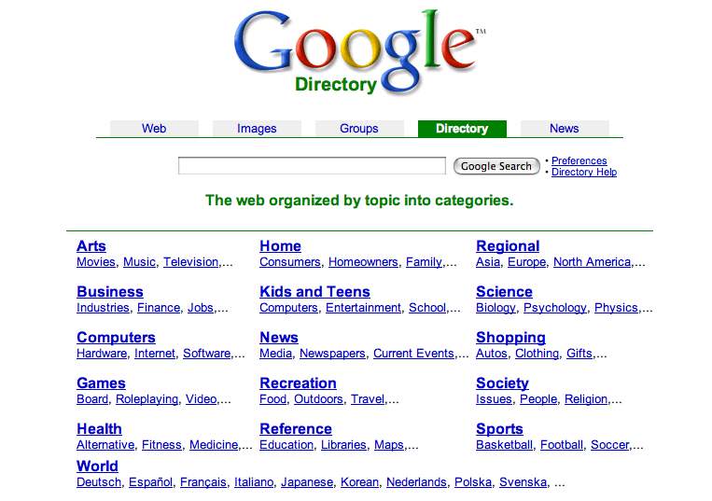

Slide 14
Notes:
Semantic Glue
In partnership with its users. Built specialist tools for annotation and ontology creation and management.
Consensus outweighs complexity
It doesn’t matter how simple/scruffy the ontology is, what counts is if everyone uses it.
It doesn’t matter how smart and complete the ontology is, it doesn’t count if no-one uses it.
Its so boriiinnnnnnggggggggg
Hendler Principle – a little semantics goes a long way.
SAEL - SOFG Anatomy Entry List.
Plenty of complexity if it can managed.

Slide 15
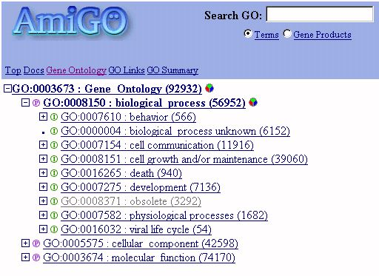

Slide 16
Foundational Model of Anatomy
Anatomical
Spatial Entity
Anatomical
Structure
Organ
Organ
Part
Body
Space
Anatomical
Feature
Viscus
Organ
Subdivision
Organ
Component
Organ
Cavity
Internal
Feature
Hollow
Viscus
Cardiac
Chamber
Heart
Parts of the heart
Organ Cavity
Subdivision
Cavity
of Heart
Right
Atrium
Wall
of Heart
Is-a
Cavity of
Right Atrium
Fossa
Ovalis
Wall of
Right Atrium
Myocardium
Part-of
Sinus
Venarum
Myocardium
of Right Atrium
SA
Node

Slide 17
The FMA demonstrates that distinctions are not universal
Blood is not a tissue, but rather a body substance (like saliva or sweat)
The pericardium is not part of the heart, but rather an organ in and of itself
Each joint, each tendon, each piece of fascia is a separate organ
These views are not shared by many anatomists!

Slide 18
Why develop an ontology?
To share a common understanding of the entities in a given domain
among people
among software agents
between people and software
To enable reuse of data and information
to avoid re-inventing the wheel
to introduce standards to allow interoperability and automatic reasoning
To create communities of researchers

Slide 19
We really want ontologies in electronic form
Ontology contents can be processed and interpreted by computers
Interactive tools can assist developers in ontology authoring

Slide 20
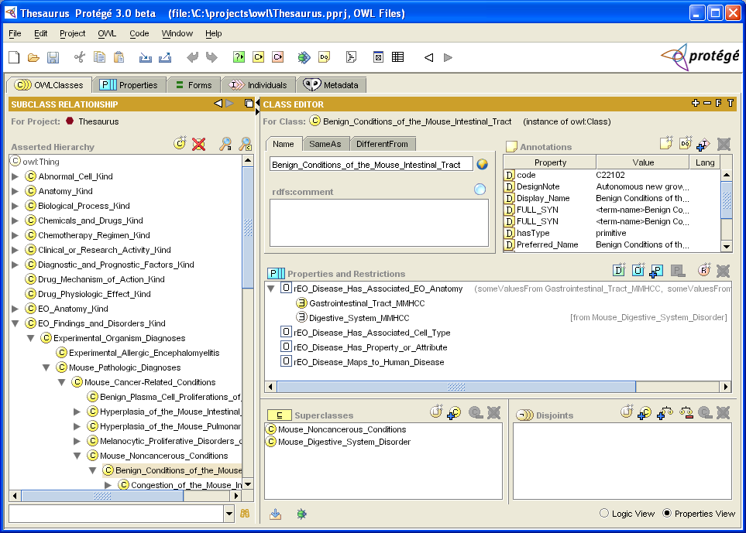
The NCI Thesaurus in Protégé-OWL

Slide 21
Goals of Biomedical Ontologies
To provide a classification of biomedical entities
To annotate data to enable summarization and comparison across databases
To provide for semantic data integration
To drive natural-language processing systems
To simplify the engineering of complex software systems
To provide a formal specification of biomedical knowledge

Slide 22
Biosurveillance Data Sources Ontology
Notes:
Data Source Taxonomy: This is the list of the kinds data sources known. This list provides a taxonomy of data sources and their characteristics, so that when one group talks about a “school,” other groups can know exactly what is meant by that term. The list can be expanded as necessary to accommodate new sources of data.

Slide 23
Ontology defines how data should be accessed from the database

Slide 24
Ontologies: Good news and bad news
The Good news
Ontologies allow computers to “understand” definitions of concepts and to relate concepts to one another
Automated inheritance of attributes makes it very easy to add new concepts to an ontology over time
Ontologies can be developed in standard knowledge-representation languages that have wide usage
The Bad news
Most current biomedical ontologies have been developed using non-standard languages
It’s still very hard to get people to agree about the content of proposed ontologies

Slide 25
Computational Challenges
Access to data
Interpretation of data
Integration of data
Identification of appropriate analytic methods
Coordination of problem solving to address diverse data sources
Determining what to report

Slide 26
The Medical Entities Dictionary (after Cimino)
MED
Patient
Registration
Pharmacy
Clinical
Laboratory
Radiology

Slide 27
Ontologies for data integration
Patient
Database
1
Lab
Result
Bicarbonate
Ontology of
patient data
Hema-
tology
Serum
Chemistry
Patient
Database
2
Bicarb
Electro-
lytes
Amino-
transferases
Patient
Database
3
HCO₃–
Sodium
HCO₃
HCO₃
(Canonical
data value)

Slide 28
Computational Challenges
Access to data
Interpretation of data
Integration of data
Identification of appropriate analytic methods
Coordination of problem solving to address diverse data sources
Determining what to report

Slide 29
Different types of data require different types of problem solvers
Are the data multivariate or univariate?
Do the data involve temporal or spatial dimensions?
Are the data categorical or probabilistic?
Are the data acquired as a continuous stream or as a batch?
Is it possible for temporal data to arrive out of order?
What is the rate of data acquisition and what are the numbers of data that need to be processed?

Slide 30
An ontology of problem solvers for aberrancy detection
Obtain Baseline Data
Database Query
Constant
(theory-based)
Outlier Removal
Compute Expectation
Transform Data
Smoothing
Empirical Forecasting
. . . .
Estimate Model Parameters
Mean, StDev
Trend Estimation
Aberrancy Detection (Temporal)
GLM Model Fitting
Obtain Current Observation
ARIMA Model Fitting
Database Query
. . . .
EWMA
Cumulative Sum
Forecast
Generalized Exponential Smoothing
Compute Test Value
Moving Average
GLM Forecasting
Signal Processing Filter
ARIMA Forecasting
EWMA
. . . .
P-Value
. . . .
Raw Residual
Compute Residual
Z-Score
Residual-Based
. . . .
Evaluate Test Value
Evaluate Residual
Aberrancy Detection (Control Chart)
Binary Alarm
Layered Alarm
Binary Alarm
Layered Alarm

Slide 31
BioSTORM: A Prototype Next-Generation Surveillance Sytem
Developed at Stanford, initially with funding from DARPA, now from CDC
Provides a test bed for evaluating alternative data sources and alternative problem solvers
Demonstrates
Use of ontologies for data acquisition and data integration
Use of a high-performance computing system for scalable data analysis

Slide 32
BioSTORM Data Flow
Data Source Ontology
Mapping Ontology
Control Structure
Data Broker
Data Mapper
Heterogeneous Input Data
Semantically Uniform Data
Customized Output Data
Data Sources
Data Regularization Middleware
Epidemic Detection Problem Solvers

Slide 33
Data Broker and Data Source Ontology
Data Source Ontology
Semantically Uniform Data Objects
Heterogeneous Data Input
Distributed Data Sources
Data
Broker

Slide 34
Biosurveillance Data Sources Ontology
Notes:
Data Source Taxonomy: This is the list of the kinds data sources known. This list provides a taxonomy of data sources and their characteristics, so that when one group talks about a “school,” other groups can know exactly what is meant by that term. The list can be expanded as necessary to accommodate new sources of data.

Slide 35
Ontology defines how data should be accessed from the database

Slide 36
Data Broker and Data Source Ontology
Data Source Ontology
Semantically Uniform Data Objects
Heterogeneous Data Input
Distributed Data Sources
Data
Broker

Slide 37
Data Mapper and Mapping Ontology
Data Source Ontology
Mapping Ontology
Input–Output Ontology
Customized Data Objects
Semantically Uniform Data Objects
Problem Solver
Data Mapper

Slide 38
Varying Problem Solvers
Mapping Ontologies
Input–Output Ontologies
Semantically Uniform Data Objects
Customized Data Objects
Problem Solvers
Data Mapper

Slide 39
An ontology of problem solvers for aberrancy detection
Obtain Baseline Data
Database Query
Constant
(theory-based)
Outlier Removal
Compute Expectation
Transform Data
Smoothing
Empirical Forecasting
. . . .
Estimate Model Parameters
Mean, StDev
Trend Estimation
Aberrancy Detection (Temporal)
GLM Model Fitting
Obtain Current Observation
ARIMA Model Fitting
Database Query
. . . .
EWMA
Cumulative Sum
Forecast
Generalized Exponential Smoothing
Compute Test Value
Moving Average
GLM Forecasting
Signal Processing Filter
ARIMA Forecasting
EWMA
. . . .
P-Value
. . . .
Raw Residual
Compute Residual
Z-Score
Residual-Based
. . . .
Evaluate Test Value
Evaluate Residual
Aberrancy Detection (Control Chart)
Binary Alarm
Layered Alarm
Binary Alarm
Layered Alarm

Slide 40
BioSTORM Data Flow
Data Source Ontology
Mapping Ontology
Control Structure
Data Broker
Data Mapper
Heterogeneous Input Data
Semantically Uniform Data
Customized Output Data
Data Sources
Data Regularization Middleware
Epidemic Detection Problem Solvers

Slide 41
Computational Challenges
Access to data
Interpretation of data
Integration of data
Identification of appropriate analytic methods
Coordination of problem solving to address diverse data sources
Determining what to report

Slide 42
We need to address the challenges of automating surveillance
Current surveillance systems
Require major reprogramming to add new data sources or new analytic methods
Lack the ability to select data sources and analytic methods dynamically based on problem-solving requirements
Ignore qualitative data and qualitative relationships
Will not scale up to the requirements of handling huge data feeds
The existing health information infrastructure
Is all-too-often paper-based
Uses 19th century techniques for encoding knowledge about clinical conditions and situations
Remains fragmented, hindering data access and communication

Slide 43
The National Center for Biomedical Ontology
One of three National Centers for Biomedical Computing launched by NIH in 2005
Collaboration of Stanford, Berkeley, Mayo, Buffalo, Victoria, UCSF, Oregon, and Cambridge
Primary goal is to make ontologies accessible and usable
Research will develop technologies for ontology dissemination, indexing, alignment, and peer review

Slide 44
Our Center offers
Technology for uploading, browsing, and using biomedical ontologies
Methods to make the online “publication” of ontologies more like that of journal articles
Tools to enable the biomedical community to put ontologies to work on a daily basis

Slide 45
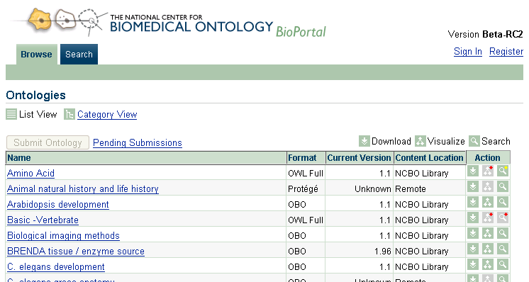
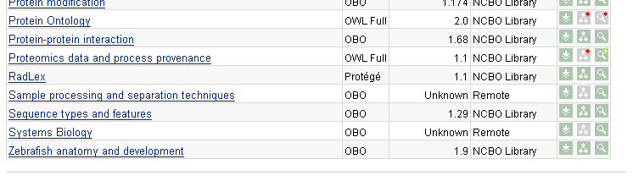
http://bioportal.bioontology.org

Slide 46
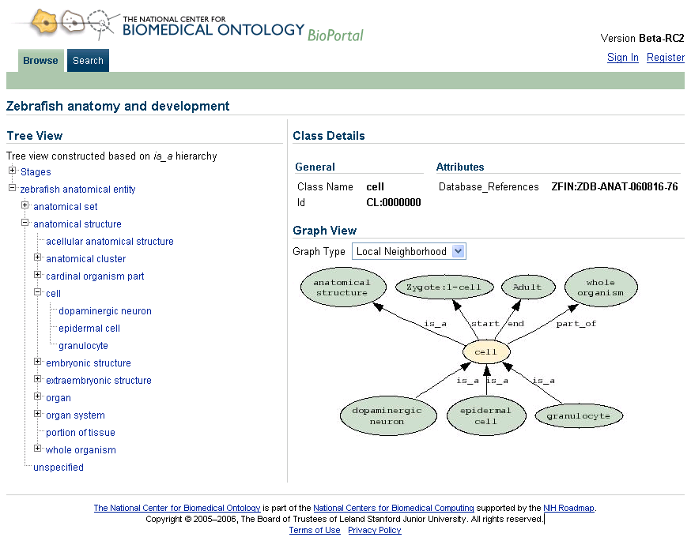
Browsing/Visualizing Ontologies
Local Neighborhood view

Slide 47
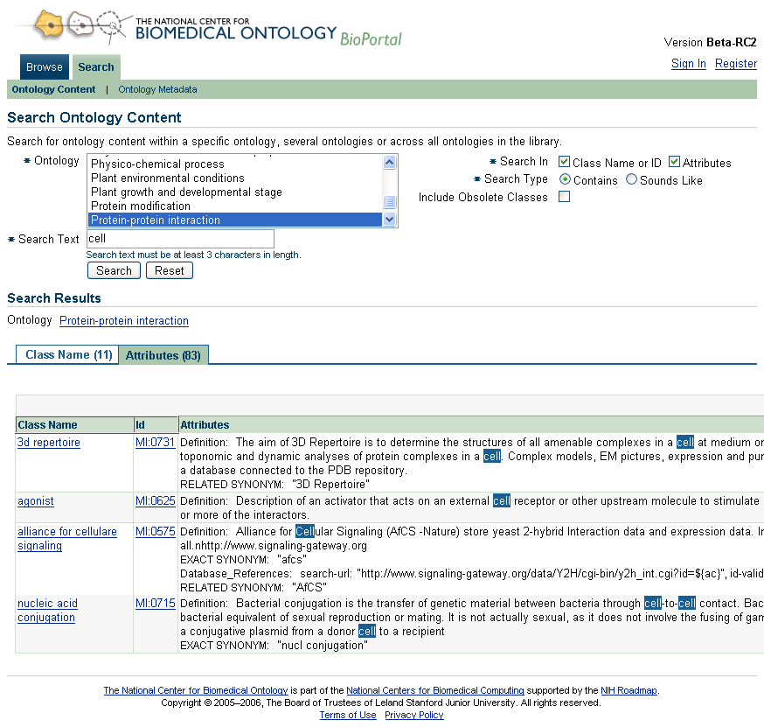

Slide 48
BioPortal will experiment with new models for
Dissemination of knowledge on the Web
Integration and alignment of online content
Knowledge visualization and cognitive support
Peer review of online content

Slide 49
BioPortal is building an online community of users who
Develop, upload, and apply ontologies
Map ontologies to one another
Comment on ontologies via “marginal notes” to give feedback
To the ontology developers
To one another
Make proposals for specific changes to ontologies
Stay informed about ontology changes and proposed changes via active feeds

Slide 50
Public Health Ontology 101
Die Seuche (The Plague), A. Paul Weber, Courtesy of the NLM
Mark A. Musen, M.D., Ph.D.
Stanford Center for Biomedical Informatics Research
Stanford University School of Medicine

