Slide 1
The Semantics of Things that Happen an exploration
Mike Bennett
Ontolog Forum, 5 November 2015

Slide 2
Outline
Brief introduction to FIBO
The requirements for occurrent
Issues with current placeholders
A philosophical investigation
Occurrent pairwise disjoint facets
Conclusions and discussion starters

Slide 3
Introducing FIBO

Slide 4
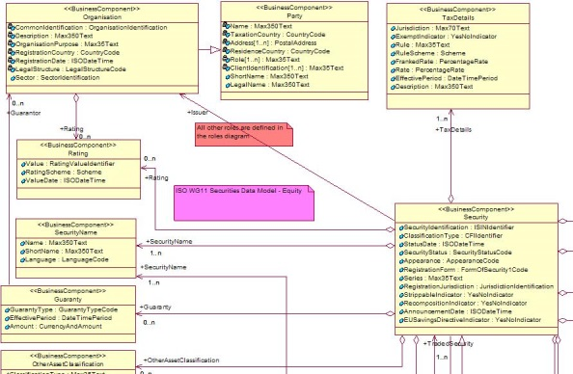
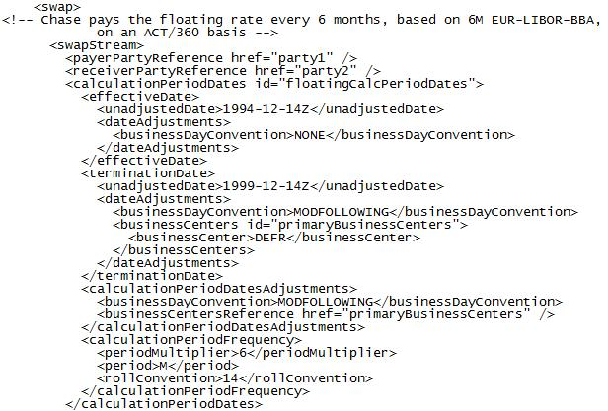
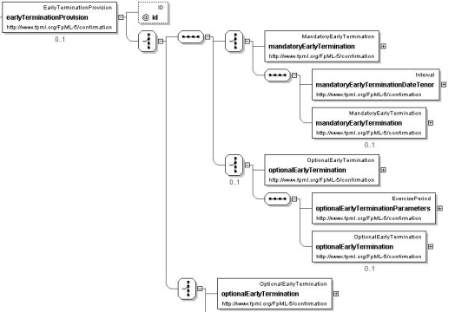
Financial Industry Data Standards

Slide 5
Disparate Data
?
?
?
?
?

Slide 6
Unified Semantics
Conceptual ontology
Shared business meanings

Slide 7

Business Validation
Conceptual ontology
Shared business meanings
Validated by business

Slide 8
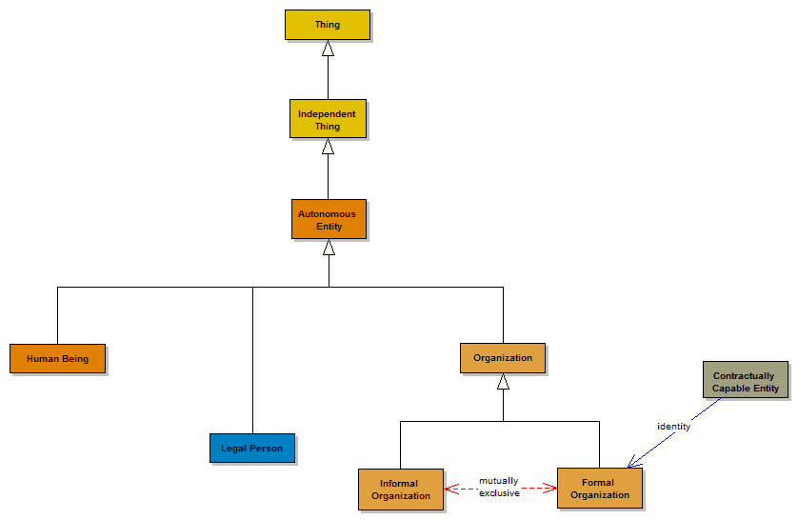
Formal Logic Representation
Conceptual ontology
Shared business meanings
Expressed logically
Validated by business

Slide 9
Finance Industry Language
Terminology / Vocabulary
  Focus is on words
  Different people use the same words for different concepts and different words for the same concepts
Data Dictionary
  Documents the meaning or meanings of individual data elements
  Good design means one data element has many applications
Ontology
  Each element in the model represents on concept

Slide 10
The FIBO Moment
Previous standardization efforts at message and data levels
Arguments over terms
Atkin: “What if we considered the concepts without worrying about the words people use?”
  Sudden outbreak of peace!

Slide 11
The FIBO Principles
Concepts not Words
Meanings are grounded in the terms of law, contract etc.
Use of upper level abstractions

Slide 12
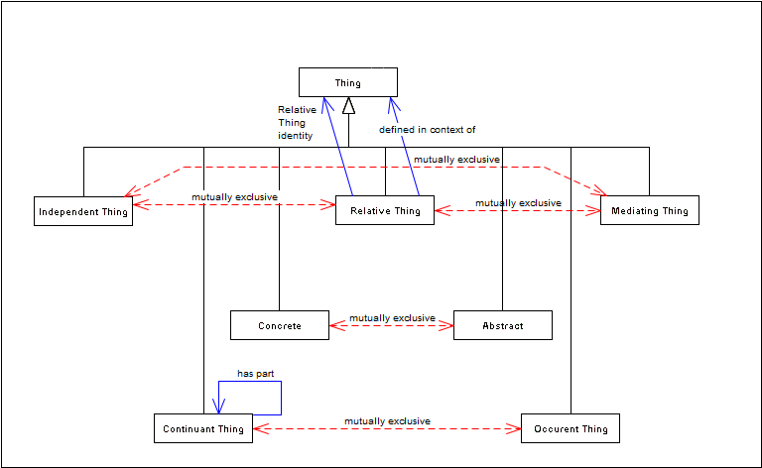

Upper Ontology Partitions

Slide 13
Continuants and Occurrents
Thing
Continuant
Occurrent

Slide 14
Continuants and Occurrents
Thing
Continuant
Occurrent
Continuant: where it exists, it exists in all its parts
  Even if these change over time
Occurrent: the concept is only meaningful with reference to time

Slide 15
Continuants and Occurrents
Thing
Continuant
Occurrent
Person
Contract
Pilot
Event
State
Etc.
Continuant: where it exists, it exists in all its parts
  Even if these change over time
Occurrent: the concept is only meaningful with reference to time

Slide 16
Ontology Partitioning
Thing
Continuant
Occurrent
Person
Contract
Pilot
Event
State
Etc.
Things which are independent or relative are also either continuant or occurrent

Slide 17
Continuants and Occurrents Example
Thing
Continuant
Occurrent
Me
My life
Me: where I exist I exist in all my parts
  Even if these change over time
My life: happens over a period of time and cannot be defined without time

Slide 18
Why does this Matter?
Frame concepts which have a temporal component which are of interest to the business
  Events, activities
  States
  Statuses, prices, other time-variant concepts
Provide a basis for ontological modelling of business process
This brings the two sides of development (structural and behavioural) into the same conceptual model

Slide 19
FIBO Occurrent Things Placeholders
Event
Activity
Process (e.g. securities issuance)
Corporate events
Lifecycles
Interest Accrual
Conditions and triggers
Transacton workflow / payments process

Slide 20
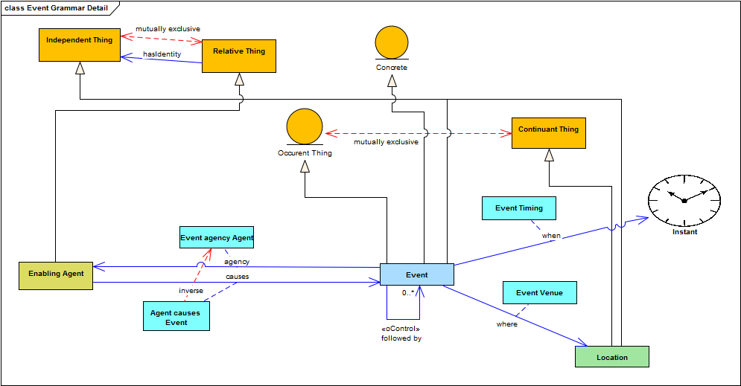
Event

Slide 21
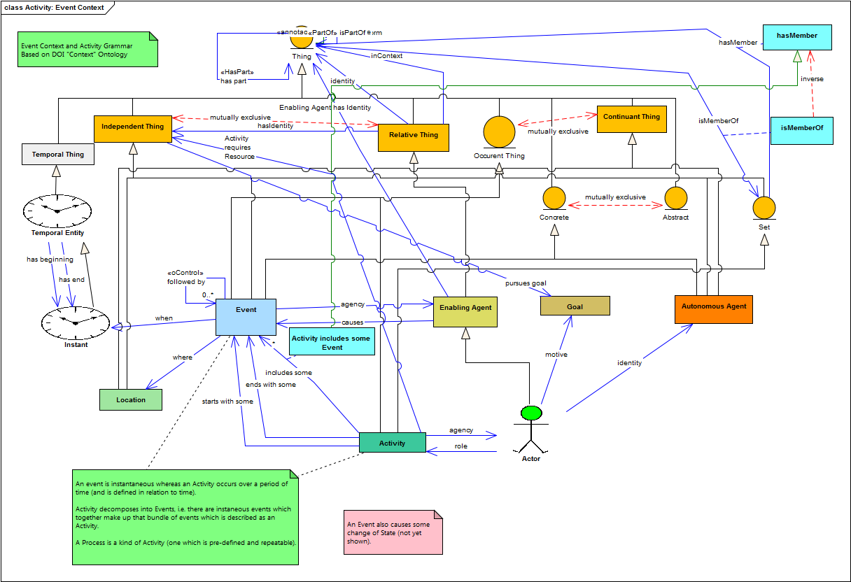
Activity

Slide 22
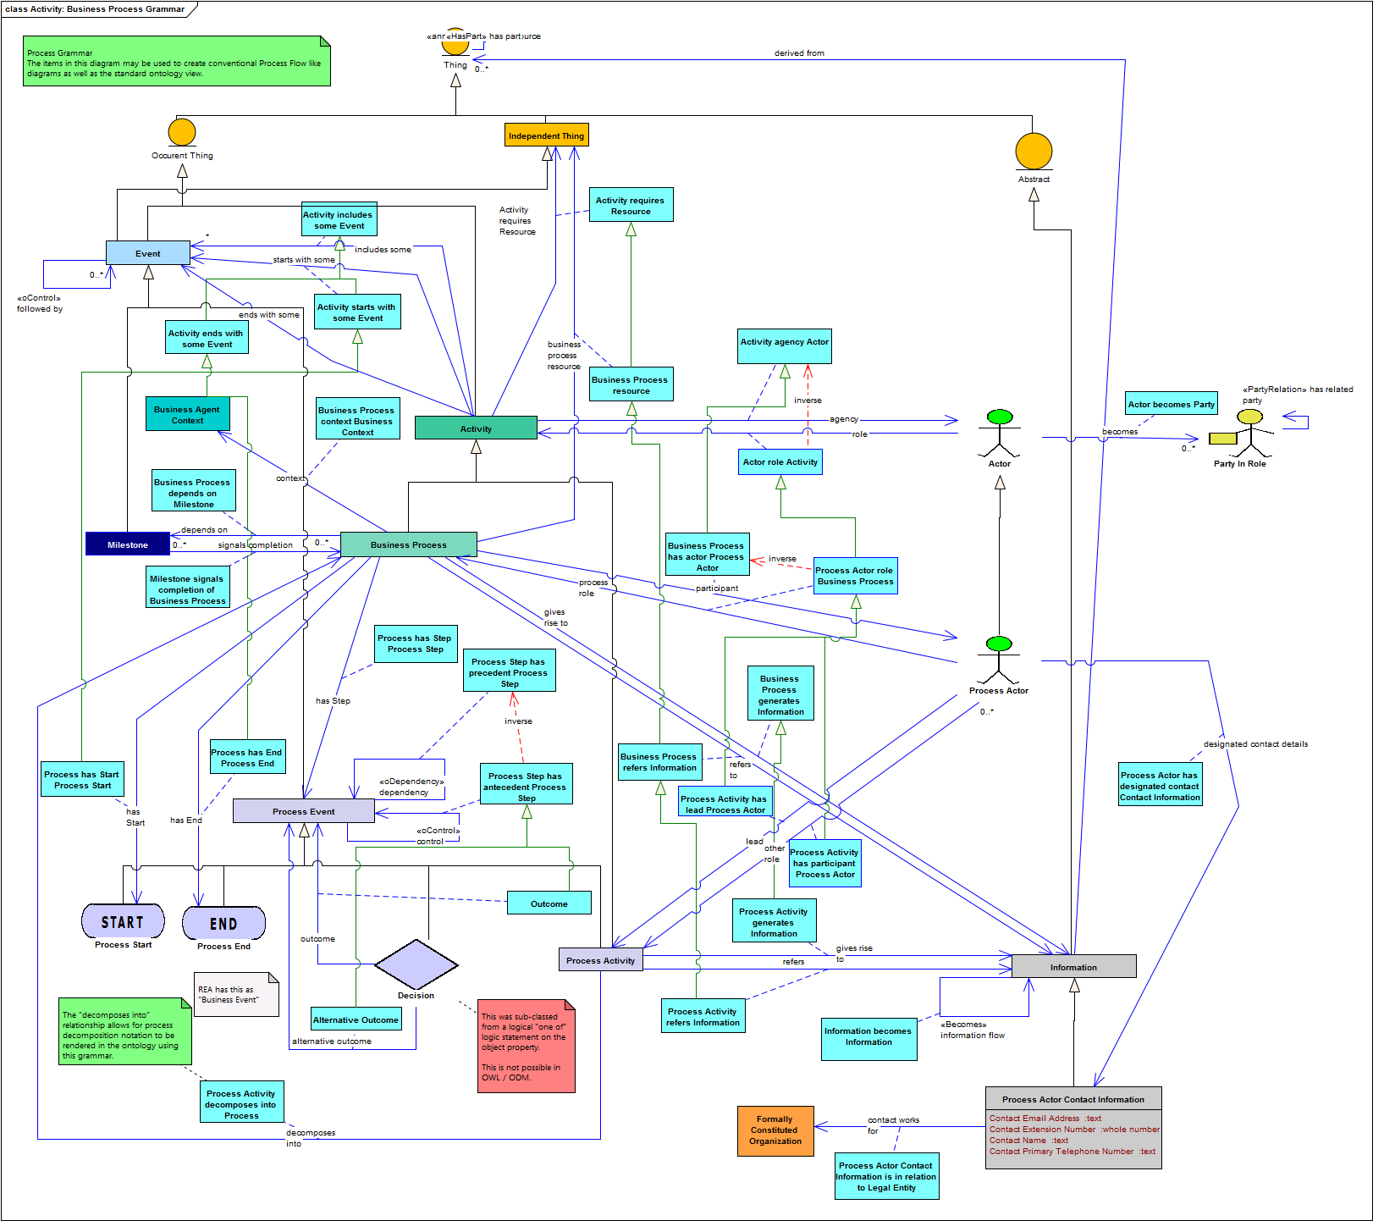
Process

Slide 23
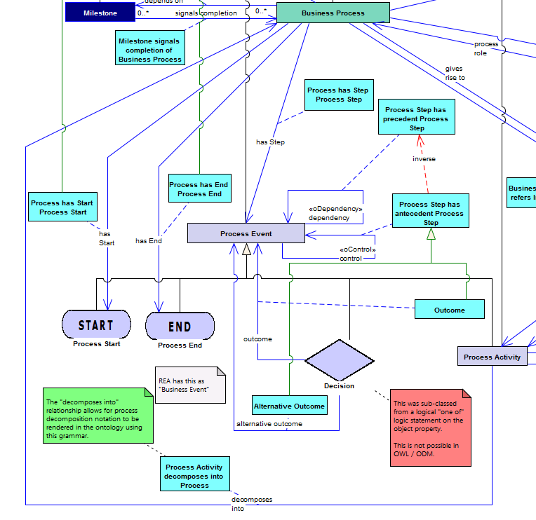
Process

Slide 24
Terms Derived from REA Ontology

Slide 25
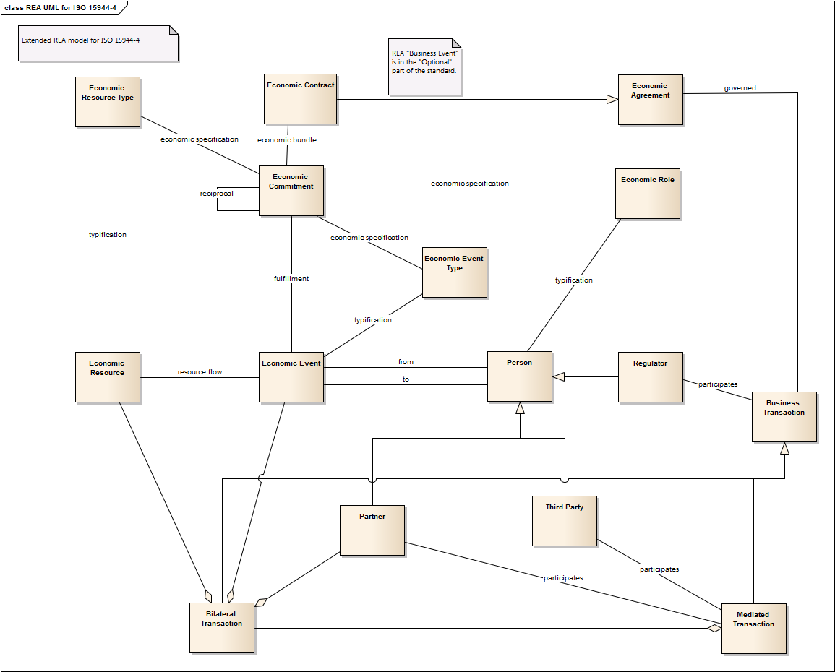
ISO 15944-4

Slide 26
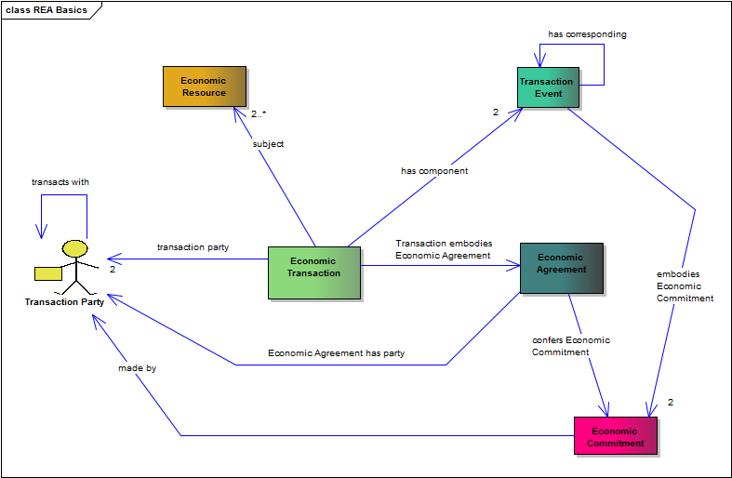
REA Basic Terms

Slide 27
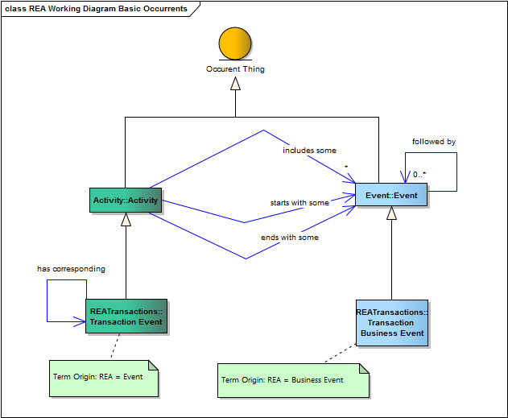
Occurrents

Slide 28
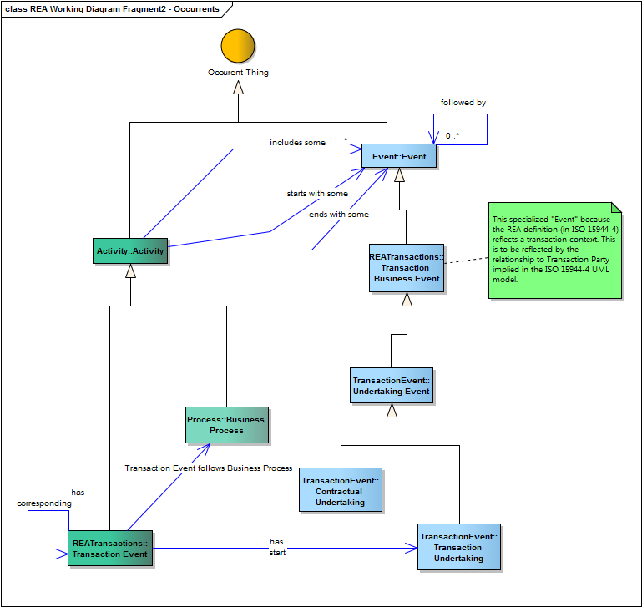
Txn Event

Slide 29
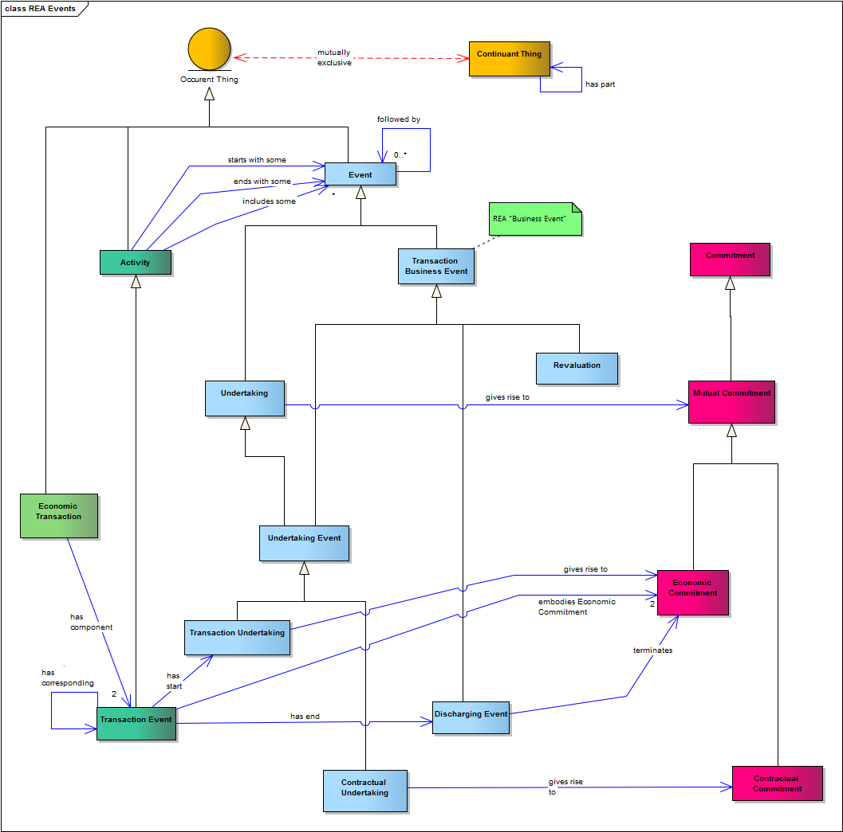
Txn Event Detail – Undertakings

Slide 30
Ontology Summit 2014 Risk Hackathon

Slide 31
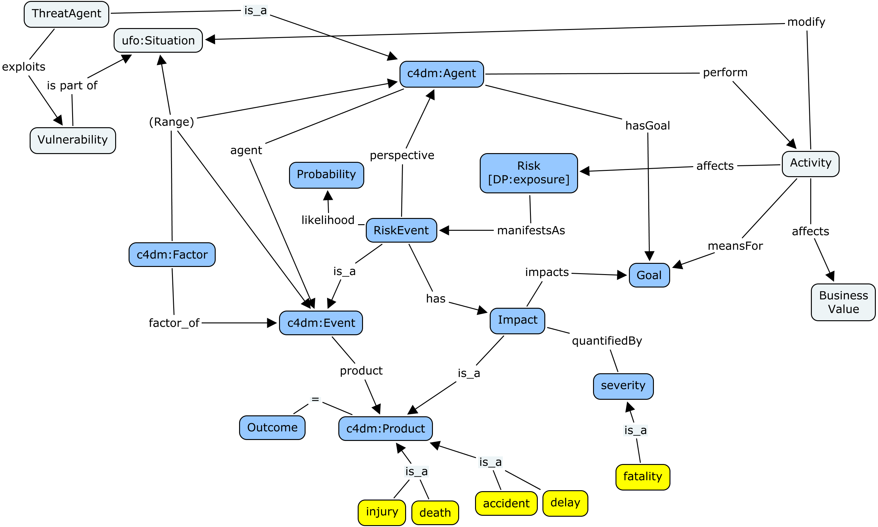
Initial Diagram for Risk Concepts

Slide 32
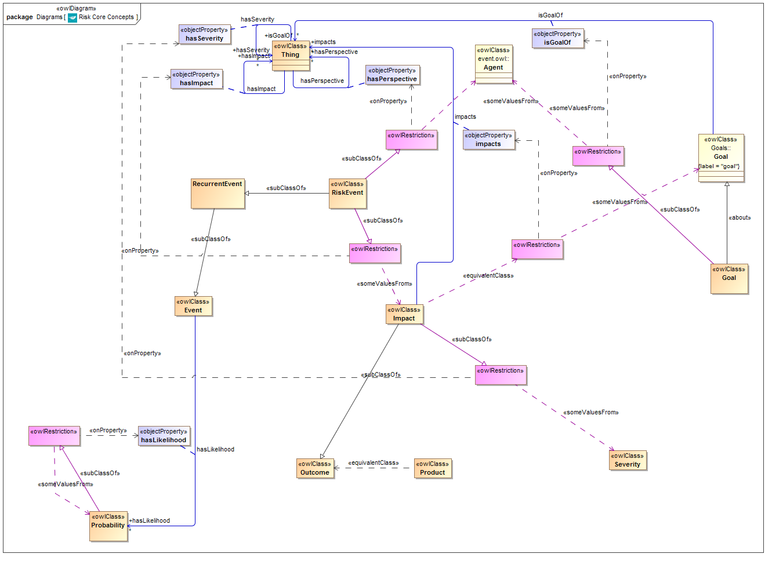
Risk Concepts Ontology

Slide 33
Risk Concepts Ontology

Slide 34
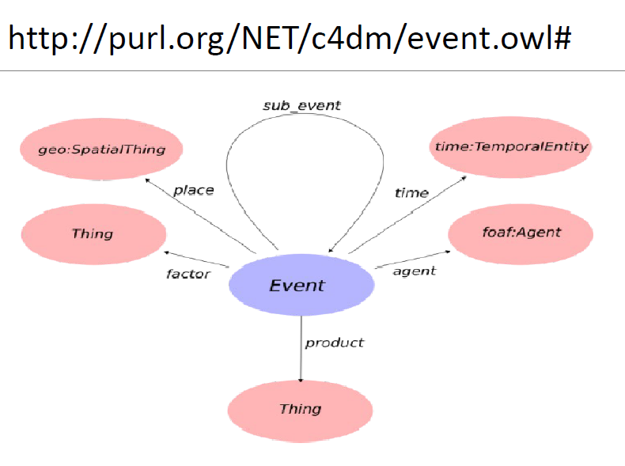
Event Ontology Design Pattern

Slide 35
What is Event?
Event as something with a time and a place?
Event as a relationship between 2 states?
Event as every kind of “Occurrent Thing”?

Slide 36
Other Occurrent Requirements
Occurrent thing
Something which really happens
(at some time)
Definitive Occurrent
Definition of what should happen
(repeatable)
Descriptive Occurrent
Prescriptive Occurrent
Historic Occurrent
Predictive Occurrent
Process Definition
Plan
Method

Slide 37
Philosophical Investigation

Slide 38
Achievements and Attainments
Stanford Encyclopedia
DOLCE
Some reactions and followups

Slide 39
Definitions
From
  http://www.researchgate.net/post/Perdurant_occurrents_and_perdurant_continuants_definitions_and_implications

Slide 40
Continuants and occurrents.
Continuants correspond largely to physical bodies, objects, and particular masses of matter, while occurrents correspond to events, processes, and - perhaps - momentary states. Here, I employ the following distinction:
  a continuant is constructed as a spatial entity that has all its parts at an instant t, and no spatial parts at any other instant
  an occurrent is constructed as a temporal entity that has only one part, or that has sequential temporal parts.

Slide 41
Endurants and perdurants
In contemporary theories of persistence, a persisting entity either endures by having all its parts at any instant; or perdures by having parts at sequential instants. More generally,
  an endurant has no temporal parts (or, at least, no conceptually distinguishable temporal parts) and thus exists in its entirety at each instant of its existence
  a perdurant has temporal parts, and is at least temporally extended.

Slide 42
Discussion
Continuant:
  Leibniz’s Law
    Identity is based on having the same properties
    However, parts and other properties change over time
  They key is identity
  “A thing which continues in its identity”
  Reject the explicitly “spatial” element of the definition
    A commitment is a continuant

Slide 43
Discussion
Occurrent
  Some commentators suggest that time scale plays a part in the definition
    We reject this
  Use the perdurant definition
  The concept is temporal in its definition
    Bit it need not be instantaneous
    A thing consisting entirely of temporal parts is itself an occurrent/perdurant

Slide 44
FIBO Working Definitions
Continuant:
  Definition: “something which exists and retains its identity across points in time”
  Explanatory Note: These persist over time even when their constituents alter over time
Occurrent:
  Definition: “something which is defined wholly with reference to time or which consists of one or more things which are defined wholly with reference to time”
  Explanatory Note: These are extended in time and so are only partly present at any time in which they exist

Slide 45
Extensions
DOLCE has 4 extensions of perdurant
  Achievement
  Accomplishment
  State
  Process
We need some clarity on achievement versus accomplishment, since the English words are synonymous – need to determine what are the assertions that distinguish these

Slide 46
DOLCE Light
DOLCE Light left out a lot of the endurant v perdurant stuff, and simply said
  there is an object, which is something that is rather than something that happens;
  and then there is Event, which is something that happens.
These are the same concepts with different labels

Slide 47
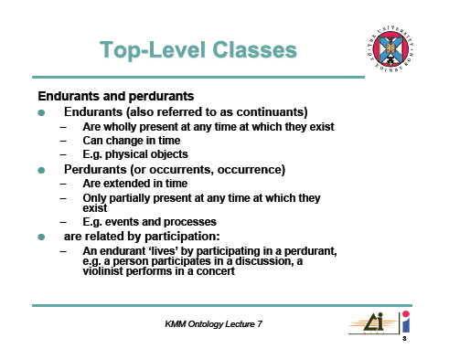
DOLCE Explanation
Source: http://www.inf.ed.ac.uk/teaching/courses/kmm/PDF/L7-DOLCE.pdf

Slide 48
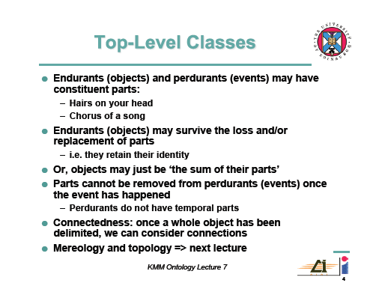
DOLCE Explanation
Source: http://www.inf.ed.ac.uk/teaching/courses/kmm/PDF/L7-DOLCE.pdf

Slide 49
Wikipedia Definitions
Endurant
  Also known as continuants, or in some cases as "substance", endurants are those entities that can be observed-perceived as a complete concept, at no matter which given snapshot of time. Were we to freeze time we would still be able to perceive/conceive the entire endurant.
  Examples include material objects (such as an apple or a human), and abstract "fiat" objects (such as an organization, or the border of a country).
Perdurant
  Also known as occurrents, accidents or happenings, perdurants are those entities for which only a part exists if we look at them at any given snapshot in time. When we freeze time we can only see a part of the perdurant.
  Perdurants are often what we know as processes, for example: "running". If we freeze time then we only see a part of the running, without any previous knowledge one might not even be able to determine the actual process as being a process of running. Other examples include an activation, a kiss, or a procedure.

Slide 50
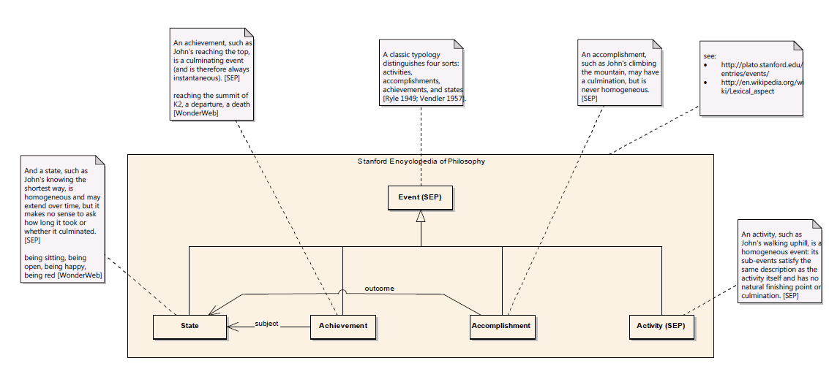
Events (SEP)

Slide 51
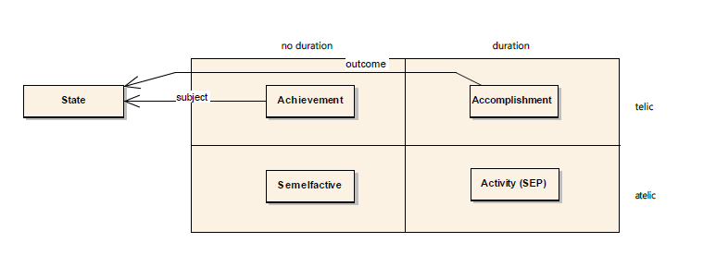
Events (sorted)
These are not the labels we will use
Ontology is about the concepts

Slide 52
Comments
Achievement and Accomplishment
  As labels these were not helpful to business SMEs
  Also not clear if we would use them in FIBO
  Meanwhile, each represents a combination of concepts per the 2x2 table
Conclusion
  Separate out the distinct meanings
  Pairwise disjoint facets
  Also support earlier use cases for e.g. process as prescriptive occurrent

Slide 53
Proposals
Faceted classification
Some proposed facets
Extending and using these

Slide 54
Faceted Classification
Thing

Slide 55
Faceted Classification
Thing
Red Thing
Blue Thing
Differentiae: what distinguishes the sub types of the Thing

Slide 56
Faceted Classification
Thing
Round Thing
Square Thing
Differentiae: what distinguishes the sub types of the Thing

Slide 57
Faceted Classification
Thing
Red Thing
Blue Thing
Round Thing
Square Thing
Round Red Thing
Round Blue Thing
etc.

Slide 58
In initial prototyping environment
(Sparx EA, with visual representation of OWL constructs but not RDF export)
Facets:
  Culminating
  Prescriptive
  Functional
    Purposeful
  Instantaneous
Linking provisionally to FIBO placeholders

Slide 59
*geneous

Slide 60
Occurrent Facets

Slide 61
Culminating Facet

Slide 62
Telic: Function v Purpose
Telic can be read as being something with a function
Some interpretations attribute intent to the notion of function
  We reject this – see e.g. Finke
    http://www.patheos.com/blogs/camelswithhammers/2011/10/natural-functions/
  A hand has a function but no designer intended that function
Functional occurrent is superclass of purposeful occurrent
  We would not use a word like telic anyway
  Functional = Telic

Slide 63
Functional and Purposeful

Slide 64
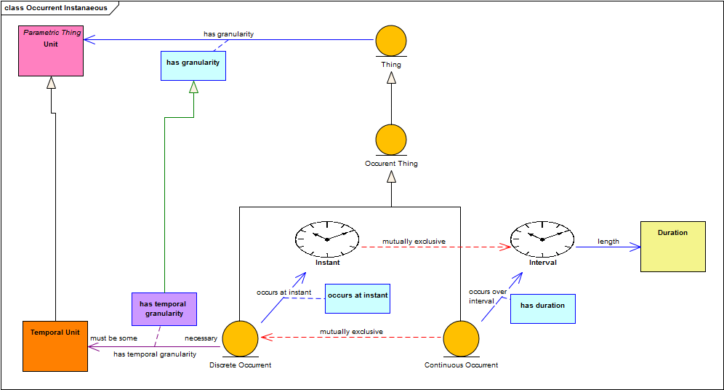
Instantaneous Facet

Slide 65
Prescriptive

Slide 66
Prescriptive detail

Slide 67
Goal

Slide 68
Ongoing and Purposeful

Slide 69
Implementation
Move these into Cameo Conceptual Modeler for onward RDF/OWL generation
Still needed to address the question of State

Slide 70
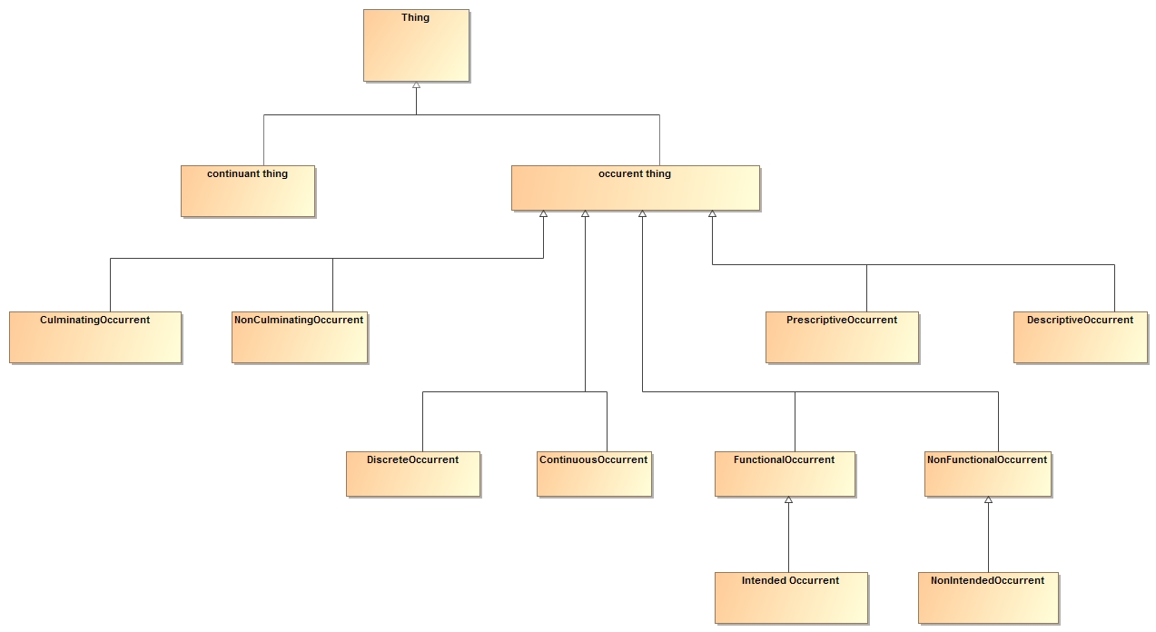
Occurrent Facets

Slide 71
What is State
There are two concepts often referenced by the word “State”
  The state something is in
    E.g. being red, being in default
    Per State Transition Diagrams
    This is occurrent
  The state itself
    The state of redness, the state of default
    This is a continuant thing
    It is also abstract (does not have concrete members in the world)

Slide 72
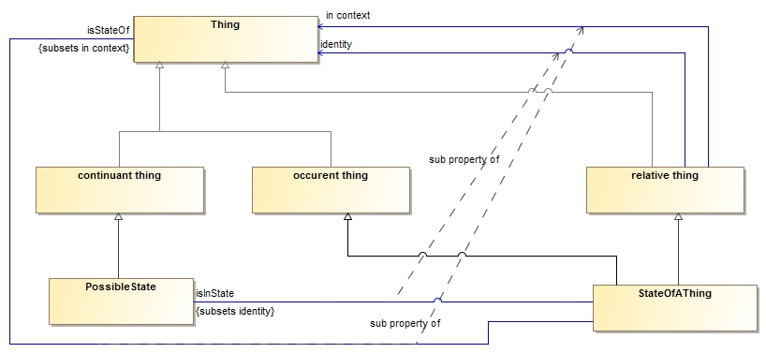
State Concepts

Slide 73
Achievement and Accomplishment
Homogeneous
Heterogeneous
Occurrent Thing
Culminating Occurrent
Non Culminating Occurrent
PurposefulOccurrent
Non Purposeful Occurrent
Stanford “Achievement”
Stanford “Accomplishment”

Slide 74
Achievement and Accomplishment
Homogeneous
Heterogeneous
Occurrent Thing
Instantaneous Occurrent
Durative Occurrent
PurposefulOccurrent
Non Purposeful Occurrent
Stanford “Achievement”
Stanford “Accomplishment”

Slide 75
Occurrent Facets Uses
Homogeneous
Heterogeneous
Occurrent Thing
Instantaneous Occurrent
Durative Occurrent
PurposefulOccurrent
Non Purposeful Occurrent
Definitive Occurrent
Interest Accrual
Achievement of a Milestone
Process
Culmination of a goal-directed activity
Think of this as (one meaning of) Process*
Has a start and an end but has a duration
Then split this into prescriptive
and descriptive
Interest Payment
= Milestone?
Not quite
Series: Sequences of the same thing
Ordered sequences of (different) things
*Reserved word

Slide 76
Summary and Discussion Points
We needed high level primitive concepts within which to frame various things which happen in finance
These need not be highly axiomatized
  rather, we want to ground out the meanings of a minimum set of primitive concepts so other concepts are derivable from these by use of axioms
Analysis of existing concepts revealed multiple concepts
  So we segregated these into pairwise disjoint facets
  Have identified a possibly complete (?) set of facets
  State was a challenge as it is two things only one of which is occurrent
Have we defined a high level language from which to articulate things which happen?

Slide 77
Thank You!
Mike Bennett
  mbennett@edmcouncil.org
  mbennett@hypercube.co.uk
  www.edmcouncil.org
  http://www.edmcouncil.org/semanticsrepository/index.html

